Slide 1
Session 02
FMOM Training Module on Procurement Processes

Slide 2
Session Overview
General Overview of RA 9184 and its IRR
Principles of Public Procurement
Scope and Application
Procurement Organizations
Procurement Methods and Procedures
Procurement Planning and Monitoring
  Project Procurement Management Plan (PPMP)
  Annual Procurement Plan (APP)
  Procurement Monitoring Report (PMR)
7. School-Based Procurement

Slide 3
Learning Objective
To improve school efficiency by strengthening the knowledge and skills of the Head of Procuring Entity (HoPE), Bids and Awards Committee (BAC) and BAC Secretariat on the basic principles of public procurement, its functions and processes in accordance with R.A. 9184.

Slide 4
General Provision of
R.A. 9184 otherwise known as the Government Procurement Reform Act (GPRA)

Slide 5


Enactment of GPRA
Implementing Rules and Regulations
Government Procurement Reform Act
10 January 2003
Implementing Rules and Regulations (IRR) Part A
8 October2003
Revised IRR
2 September 2009
2016 Revised IRR
28 October 2016
Executive Orders
Administrative Issuances
Memorandum Circulars
Over 100 Procurement Rules and Regulations

Slide 6
Procurement Reforms
PROBLEMS |  | REFORMS
Confusion caused by fragmented legal system |  | Enactment of the Government Procurement Reform Act (GPRA)
Inconsistent policies, rules, and regulations due to lack of standards |  | Creation of the Government Procurement Policy Board (GPPB)
Lack of transparency |  | Use of PhilGEPS (Philippine Government Electronic Procurement System)
Lack of check and balance |  | Participation of civil society

Slide 7
General Provision : Section 2: Declaration of Policy
“ ...to promote the ideals of good governance ...”
Government Procurement Reform Act
RA 9184

Slide 8
General Provision : Section 2: IRR
“...to adhere to the principle of transparency, accountability, equity, efficiency, and economy...”
“... procurement...shall be competitive and transparent, and shall therefore go through public bidding...”
Government Procurement Reform Act
RA 9184

Slide 9
Governing Principles
Public Monitoring
  Awareness and vigilance
Accountability
  Responsibility over actions/decisions (“Answerable”)
Competitiveness
  Equal opportunity to all eligible bidders
Transparency
  Wider dissemination of bid opportunities
Streamlined Process
  Uniformly applicable to all government agencies
  Effective and efficient method

Slide 10
Essence of PUBLIC MONITORING
Section 3 of R.A. 9184 mandates all procuring entities of the government to comply with the governing principles of government procurement;
Section 13 of R.A. 9184 mandates the Bids and Awards Committee (BAC) to invite observers from recognized private group and non-government organization (NGO) other than the Commission on Audit (COA) in all stages of the procurement process to enhance transparency.

Slide 11
ACCOUNTABILITY
OF PUBLIC OFFICIALS
Pertinent laws and the prescribed procedures must be faithfully complied with in the discharge of functions in all stages of the procurement process as well as the implementation of contracts.
Private parties that deal with government should also be held accountable for their actions.

Slide 12
Ensuring COMPETITIVENESS
As a rule, procurement must be conducted through competitive bidding process, unless otherwise provided under GPRA, its IRR and this Manual, then the Alternative Methods of Procurement can be resorted to.
This is to guarantee:
  Equitable and fair grounds for competition among bidders.
  That no single bidder significantly influences the outcome of the bidding.

Slide 13
Ensuring TRANSPARENCY
Posting of bid opportunities (Sec. 21) and award notices (Sec. 37.1.6) in the PE’s website, PhilGEPS and conspicuous place within the premises of PE.
Posting of Annual Procurement Plan (APP) and Project Monitoring Report (PMR)
  Submission to GPPB (AO 222) and posting in the procuring entity's website of its APP (EO 662), following the form and format downloadable from the GPPB website
  Submission to GPPB (Section 12.2) and posting in the procuring entity's website of its approved PMR every semester, following the form and format downloadable from the GPPB website (EO 662)

Slide 14
Essence of STREAMLINED
PROCUREMENT SYSTEM
Uniform application to all government procurements.
Simple and adaptable to advances in modern technology in order to ensure an effective and efficient method of procurement.
GPPB conducts a periodic review of government procurement procedures, and whenever necessary, formulates and implements changes thereto.

Slide 15
General Provision : Section 4: Scope & Application
What’s covered?
Who procures?
Procurement
☑
Government
What’s procured?
Where do funds
come from?
Goods
Infrastructure Projects
Local (GOP)
or Foreign (IFIs)
Consulting Services
Government Procurement Reform Act
RA 9184

Slide 16
General Provision : Section 4: Scope & Application
Acquisition
Goods
Consulting Services
&
Infrastructure Projects
Lease
Goods
&
Real Estate
Procurement
Government Procurement Reform Act
RA 9184

Slide 17
General Provision : Section 4: Scope & Application
Branches
Instrumentalities
Departments
Agencies
Offices
Bureaus
GOCCs
LGUs
GFIs
SUCs
Constitutional Commissions/Offices
Government
Government Procurement Reform Act
RA 9184

Slide 18
General Provision : Section 4: Scope & Application
Items
Supplies
Materials
Gen. Support Services
needed in
transaction of public business
or
pursuit of government undertaking,
activity and project
Goods
Government Procurement Reform Act
RA 9184

Slide 19
General Provision : Section 4: Scope & Application
construction
improvement
rehabilitation
demolition
repair
restoration
maintenance
Works of government
Infrastructure
Projects
Government Procurement Reform Act
RA 9184

Slide 20
General Provision : Section 4: Scope & Application
adequate
external
technical
Professional
Expertise
beyond capability
and/or
capacity
of government
Consulting
Services
Government Procurement Reform Act
RA 9184

Slide 21
Scope and Coverage
Branches
Instrumentalities
Departments
Agencies
Offices
Bureaus
GOCCs
LGUs
GFIs
SUCs
Constitutional Commissions/Offices
Government

Slide 22
Scope and Coverage
Section 4.3, 2016 Revised IRR (May 10, 2016)
  Free Trade Negotiations
  The GoP negotiating panels shall, as its default position, adhere to R.A. 9184 and this IRR, or at the very least, selection through competitive bidding, in all Foreign-funded Procurement.
  If the Treaty or International or Executive Agreement states otherwise, then the negotiating panel shall ensure that the reasons for the adoption of a different rule or method of procurement are clearly reflected in the records of discussion.

Slide 23
Scope and Coverage
Section 4.5 (new provision, 2016 Revised IRR)
The following are not procurement activities under R.A. 9184 and this IRR:
  Direct financial or material assistance given to beneficiaries in accordance with the existing laws, rules and regulations, and subject to the guidelines of the concerned agency;
  Participation in local or foreign scholarships, trainings, conferences, seminars or similar activities that shall be governed by applicable COA, CSC, and DBM rules;
  Lease of government-owned property as lessor for private use;
  Hiring of Job Order Workers;
  Joint Venture under the revised NEDA Guidelines (GOCC and Private Entities), and Joint Venture Agreements by LGU with Private entities; and
  Disposal of Property and Other Assets of the Government.

Slide 24
Scope and Coverage
EXCEPT:
1. Procurement for goods, infrastructure projects, and consulting services funded from Foreign Grants covered by R.A. 8182, as amended by R.A. 8555, entitled “An Act Excluding Official Development Assistance (ODA) from the Foreign Debt Limit in order to Facilitate the Absorption and Optimize the Utilization of ODA Resources, Amending for the Purpose Paragraph 1, Section 2 of Republic Act No. 4860, as amended”, unless the GOP and the foreign grantor/foreign or international financing institution agree otherwise;
2. Acquisition of real property which shall be governed by R.A. 8974, entitled “An Act to Facilitate the Acquisition of Right-of-Way Site or Location for National Government Infrastructure Projects and for Other Purposes,” and other applicable laws;

Slide 25
Scope and Coverage
3. Public-Private sector infrastructure or development projects and other procurement covered by R.A. 6957, as amended by R.A. 7718 (BOT Law), entitled “An Act Authorizing the Financing, Construction, Operation and Maintenance of Infrastructure Projects by the Private Sector, and for Other Purposes,” as amended;
4. Disposal of government properties;
  Commission on Audit Circular No. 86-264
  National Budget Circular No. 425

Slide 26
Mixed Procurement
  In case of projects involving mixed procurements, the nature of the procurement, shall be determined based on the primary purpose of the contract.
  Determination shall be made by the procuring entity.

Slide 27
Procurement ORGANIZATIONS
Sections 11-16, 63-64

Slide 28
Bids and Awards Committee (BAC)
BAC Secretariat,
Technical Working Group (TWG),
Head of Procuring Entity (HOPE)
& Observers
Government Procurement Reform Act
RA 9184

Slide 29
Procurement Organization
One (1) BAC
In PE’s head office
BUT
HOPE may create Separate BACs
number and complexity of items to be procured so warrant;
Single BAC cannot reasonably manage the procurement process resulting to delay
BAC
How many
per PE?
Government Procurement Reform Act
RA 9184

Slide 30
Procurement Organization
5-7 members
HOPE designates
*alternate BAC members
may be designated
BAC
Who
comprises?
Government Procurement Reform Act
RA 9184

Slide 31
Procurement Organization
NGAs, GOCCs, GFIs, SUCs
Regular Members
Chairman
at least 3rd ranking,
permanent official
2 Officers
5th ranking permanent, or if not available, an officer of the next lower rank
w/knowledge, experience, expertise
one (1) each from legal or admin, and finance
In the case of bureaus, reg.offices and sub-regional/district offices, BAC members shall be at least 3rd ranking, or if not available, an officer of the next lower rank
BAC
Who
comprises?
Government Procurement Reform Act
RA 9184

Slide 32
Procurement Organization
NGAs, GOCCs, GFIs, SUCs
Provisional Members
*w/ technical experience
w/knowledge, experience, expertise
Rep from end-user unit
* w/knowledge, experience, expertise
BAC
Who
comprises?
Government Procurement Reform Act
RA 9184

Slide 33
Procurement Organization
One (1) year
*from date of appointment
*renewable
Once term expired, BAC shall continue to exercise functions until designation of new members
In cases of resignation, retirement, separation, transfer, re-assignment, removal, or death, the replacement shall serve only the unfinished term
For suspension,only for duration of leave
BAC
Term
of
office?

Slide 34
Procurement Organization
Official who approves
procurement contracts
Chief Accountant or Head of the Provincial/City/Municipal Accounting Office and his/her staff, unless the Accounting Department is the end-user unit, in which case the Chief Accountant, Head of the Accounting Department or his/her staff may be designated as an end-user member. (COA Circular Letter No. 2004 – 3)
Who are disqualified from membership
in the BAC?

Slide 35
Procurement Organization
advertises and/or posts IB/REI
conducts pre-proc & pre-bid conferences
receives bids
determines eligibility of prospective bidders
conducts evaluation of bids
undertakes post-qualification proceedings
recommends awards of contracts to HoPE
BAC
What are
its functions?
Government Procurement Reform Act
RA 9184

Slide 36
Procurement Organization
resolves MRs
recommends imposition of sanctions
recommends use of alternative methods of procurement
performs such other functions, including creation of TWG
ensures that PE abides by standards, prepares PMR for submission to GPPB-TSO within 14 days after the end of each semester
BAC
What are
its functions?
Government Procurement Reform Act
RA 9184

Slide 37
Procurement Organization
Quorum
Simple Majority of total BAC composition
Chair/Vice -Chair must be present
Valid and binding act
At least a majority of those present
Chair/Vice Chair votes in
case of tie
BAC
How many
required
for quorum?
Government Procurement Reform Act
RA 9184

Slide 38
Procurement Organization
HOPE may
designate existing organic office
within PE
create procurement units
to serve as BAC Sec
Integrity
Procurement proficiency
Appropriate CS qualification standards
BAC Secretariat
How formed?
Factors in selecting
BAC Secretariat
Government Procurement Reform Act
RA 9184

Slide 39
Procurement Organization
In Central Offices
*At least 5th ranking
permanent employee
*if not available, permanent official of next lower rank
In bureaus, reg. Offices, subregional/district offices
*at least 3rd ranking permanent employee
*if not available, permanent official of next lower rank
BAC Secretariat
Who heads
the BAC Sec?
Section 14.2, 2016 Revised IRR
In case of an existing ad hoc secretariat,
the HoPE shall assign full-time support staff to their BAC Secretariat.
Government Procurement Reform Act
RA 9184

Slide 40
Procurement Organization
provides admin support to BAC
organizes and makes all necessary arrangements for BAC meetings, conferences
advertises and/or post bidding opportunities
manages sale & distribution
of Bidding Documents
prepares minutes of BAC meetings and draft BAC Resolutions
BAC Secretariat
What are
its functions?
Government Procurement Reform Act
RA 9184

Slide 41
Procurement Organization
takes custody of procurement docs and other record
assists in managing the procurement process
monitors procurement activities & milestones for proper reporting to relevant agencies, when required
consolidates PPMPs from various units of PE, to make them available for review
BAC Secretariat
What are
its functions?
Government Procurement Reform Act
RA 9184

Slide 42
Procurement Organization
acts as central channel of communications
*for BAC with
*end users, PMOs, other units of line agency, other government agencies, providers of goods, infrastructure projects, and consulting services, observers, general public
BAC Secretariat
What are
its functions?
Government Procurement Reform Act
RA 9184

Slide 43
Procurement Organization
Technical Working
Group (TWG)
Who
comprises?
Created by BAC
Pool who are experts in various disciplines who can handle different aspects of procurement (goods, infrastructure, consulting services)
Government Procurement Reform Act
RA 9184

Slide 44
Procurement Organization
Section 12.1, May 10, 2016
Revised IRR
Duties of TWG:
1.) Review of the Technical Specifications, Scope of Work, and Terms of Reference;
2.) Review of Bidding Documents;
3.) Shortlisting of Consultants;
4.) Eligibility Screening;
5.) Evaluation of Bids;
6.) Post-Qualification; and
7.) Resolution of Request for Reconsideration
TWG
What are its responsibilities?

Slide 45
GRANT OF HONORARIA
Ceiling for Honoraria
 | Maximum Honorarium rate per procurement project
BAC Chair | Php 3,000.00
BAC Members | Php 2,500.00
BAC Secretariat TWG Chair and Members | Php 2,000.00
Members of the BAC Secretariat whose positions are in the Procurement Unit of the agency shall not be entitled to honoraria although the payment of overtime services may be allowed, subject to existing policy on the matter.

Slide 46
GUIDELINES ON THE GRANT OF HONORARIA
Budget Circular No. 2004-5A, dated 7 October 2005 As amended by Budget Circular No. 2007-3, dated 29 November 2007.
Only for successfully completed procurement projects that involves competitive bidding – Competitive Bidding, LSB and Nego Proc-Two Failed Bidding.
Granted to Chair or Members of the BAC, BAC Secretariat and the TWG (if any) by the PE concerned.

Slide 47
GUIDELINES ON THE GRANT OF HONORARIA
PE is authorized to grant honoraria to the members of the BAC, the TWG, and the BAC Secretariat provided the amount so granted does not exceed twenty-five percent (25%) of their respective basic monthly salary, subject to the following conditions:
    funds are available for the purpose; and
    the grant of honoraria conforms to the guidelines promulgated by the DBM. (Section 15, IRR of R.A. 9184)

Slide 48
GUIDELINES ON THE GRANT OF HONORARIA
Collections from successfully completed procurement projects, limited to activities prior to the awarding of contracts to winning bidders:
proceeds from sale of bid documents;
fees from contractor/supplier registry;
fees charged for copies of minutes of bid openings, BAC resolutions and other BAC documents;
protest fees; and
proceeds from bid security forfeiture

Slide 49
Procurement Organization
Designate the BAC and create BAC Secretariat
Approves the APP
Approves/disapproves RTA and Contracts and ensure that all procurement abides by the IRR
Promptly act on BAC recommendation (approve/disapprove)
Head of Procuring Entity (HoPE)
What are the responsibilities ?

Slide 50
Procurement Organization
HoPE
What are the responsibilities ?
Approve the extension of post-qual period
Impose the necessary sanctions
Resolve protest strictly on the basis of records of the BAC
Ensure the BAC, BAC Secretariat and TWG receive their incentives

Slide 51
Procurement Organization
HoPE
What are the responsibilities ?
Ensure attendance of procurement staff in trainings
Section 16, May 10, 2016 new IRR
  Within six (6) months upon designation, the BAC, its Secretariat and TWG members should have satisfactorily completed such training or program conducted, authorized or accredited by the GPPB through its Technical Support Office.
  The HoPE is encouraged to attend similar procurement training and capacity development activities

Slide 52
COA and
Two (2) organization duly registered with SEC or CDA,
Knowledge, experience, expertise in subject matter of contract
Absence of actual or potential conflicts of interest
Any other relevant criteria
*BAC determines this
The Observers
What are
the
requirements?
The Procuring Entities should ensure that the invitation is received at least five(5) calendar days before each procurement activity. In the event that a procurement activity has to be postponed, the observers shall be notified immediately of the change in schedule. (a)
Government Procurement Reform Act
RA 9184

Slide 53
Prepares report
(jointly/separately)
  *assess extent of BAC’s compliance
  *submit to LCE; cc BAC Chair
Submit report to PE, cc GPPB & Ombudsman
  *no report = correct procedure followed
Inhibit & notify in writing the PE of actual/potential conflict of interest
The Observers
What are
the
responsibilities?
Government Procurement Reform Act
RA 9184

Slide 54
Observers shall be allowed access to the following documents FREE of charge upon their request, subject to signing of a confidentiality agreement:
Minutes of BAC meetings;
Abstract of Bids;
Post-qualification summary report;
APP and related PPMP; and
Opened proposals
Section 13, May 10, 2016 New IRR
In all instances, observers shall be required to enter into a confidentiality agreement with the concerned Procuring Entity in accordance with the form prescribed by the GPPB.

Slide 55
Transportation Expenses for Observers
FY2016 GAA
Gen. Provision, Sec. 64
Reimbursement allowed for not more than P800/meeting attended, not to exceed P3,200/month/observer,
charge against MOOE of agencies.

Slide 56
Procurement methods and procedures
Sections 48-54

Slide 57
PROCUREMENT STANDARD
Procuring Entities shall adopt competitive bidding as the general mode of procurement (Section 10 of IRR)
EXCEPTION (Rule XVI)
Alternative methods may be resorted only:
  In highly exceptional case
  To promote economy and efficiency
  Justified by conditions specified in IRR
  GPPB approval as required under EO 423, S. 2005
  (as amended)
No government procurement shall be undertaken unless it is in accordance with the approved APP of the PE (Section 7.2).

Slide 58
Bidding Process (Goods & Infra)
Pre-Procurement Conference
Advertisement and/or
Posting
Pre-Bid
Conference
Bid Submission
Opening of
Technical Proposal
(incl. eligibility docs)
Opening of
Financial Proposal
Contract Award
Bid Evaluation
Post-qualification

Slide 59
Bidding Process (Consulting)
Pre-Procurement Conference
Advertisement and/or
Posting
Eligibility and
Shortlisting
Bid Submission
Opening of
Bids
(QBE or QCBE)
Pre-Bid
Conference
Contract Award
Post-qualification
Bid Evaluation
(QBE or QCBE)
Negotiation

Slide 60
Sale of Bidding Documents
GPPB Resolution 04-2012 dated 24 February 2012
Approved Budget for the Contract | Maximum Cost of Bidding Documents in PhP
500,000 and below | 500.00
More than 500,000 up to 1 Million | 1,000.00
More than 1 Million up to 5 Million | 5,000.00
More than 5 Million up to 10 Million | 10,000.00
More than 10 Million up to 50 Million | 25,000.00
More than 50 Million up to 500 Million | 50,000.00
More than 500 Million | 75,000.00

Slide 61
Alternative Methods of Procurement
Method | Goods | Infrastructure | Consulting
1. Limited Source Bidding | ✓ |  | ✓
2. Direct Contracting | ✓ |  | 
3. Repeat Order | ✓ |  | 
4. Shopping | ✓ |  | 
5. Negotiated Procurement | ✓ | ✓ | ✓

Slide 62
Negotiated Procurement
Negotiated Procurement (Section 53) | Goods | Infra | Consulting
1. Two Failed Biddings | ✓ | ✓ | ✓
2. Emergency Cases | ✓ | ✓ | ✓
3. Take Over Contracts | ✓ | ✓ | ✓
4. Adjacent or Contiguous |  | ✓ | ✓
5. Agency to Agency | ✓ | ✓ | ✓
6. Procurement Agent Scientific, Scholarly, or Artistic Work, Exclusive Technology and Media Services | ✓ | ✓ | ✓

Slide 63
Negotiated Procurement
Negotiated Procurement | Goods | Infra | Consulting
7. Highly Technical Consultants |  |  | ✓
8. Defense Cooperation Agreement | ✓ |  | 
9. Small Value Procurement | ✓ | ✓ | ✓
10. Lease of Real Property | ✓ |  | 
11. NGO Participation | ✓ | ✓ | ✓
12. Community Participation | ✓ | ✓ | 
13. UN Agencies, International Organizations or International Financing Institutions. | ✓ | ✓ | ✓

Slide 64
4. SHOPPING
  Method where the procuring entity simply requests for the submission of price quotations for readily available off-the-shelf goods or ordinary/regular equipment to be procured directly from suppliers of known qualifications
Notes:
Sec. 52
“ordinary or regular office supplies” shall be understood to include those supplies, commodities, or materials which, depending on the procuring entity’s mandate and nature of operations, are necessary in the transaction of its official businesses, and consumed in the day-to-day operations of said procuring entity

Slide 65
4. SHOPPING
  APPLICABILITY [52.1(A) AND (B)]:
  Goods
  CONDITIONS [SHOPPING UNDER §52.1(a)]:
  There is an unforeseen contingency requiring immediate purchase; and
  Amount does not exceed the threshold
  CONDITIONS [SHOPPING UNDER §52.1(B)]:
  Procurement of ordinary or regular office supplies and equipment not available in PS-DBM; and
  Amount does not exceed the threshold

Slide 66
4. SHOPPING
THRESHOLD FOR UNFORESEEN CONTINGENCIES [S. 52.1(a)] (Annex “H”)
  NGAs, GOCCs, GFIs, SUCs – PhP100,000*
  LGUs –
* Double the threshold under new IRR except for Barangays
Classification | Maximum Amount (in Philippine Pesos)
 | Province | City | Municipality
1st Class | 100,000 | 100,000 | 50,000
2nd Class | 100,000 | 100,000 | 50,000
3rd Class | 100,000 | 80,000 | 50,000
4th Class | 80,000 | 60,000 | 50,000
5th Class | 60,000 | 50,000 | 50,000
6th Class | 50,000 | 50,000 | 50,000
In the case of Barangays, the maximum amount is PhP50,000

Slide 67
SHOPPING [S 52.1(b)]
THRESHOLD (Annex “H”)
  NGAs, GOCCs, GFIs, SUCs – PhP500,000*
  LGUs:
* Double the threshold under new IRR except for Barangays
Classification | Maximum Amount (in Philippine Pesos)
 | Province | City | Municipality
1st Class | 500,000 | 500,000 | 100,000
2nd Class | 500,000 | 500,000 | 100,000
3rd Class | 500,000 | 400,000 | 100,000
4th Class | 400,000 | 300,000 | 50,000
5th Class | 300,000 | 200,000 | 50,000
6th Class | 200,000 | 100,000 | 50,000
In the case of Barangays, the maximum amount is PhP50,000

Slide 68
53.9 NEGOTIATED PROCUREMENT -
SMALL VALUE PROCUREMENT
  APPLICABILITY
  All types of Procurement
  CONDITIONS:
  Procurement does NOT fall under Shopping [§52]; and
  Amount does not exceed the threshold
Notes:
Sec. 53.9

Slide 69
SMALL VALUE PROCUREMENT
THRESHOLD (Annex “H”)
  NGAs, GOCCs, GFIs, SUCs – PhP500,000*
  LGUs:
* Double the threshold under new IRR except for Barangays
Classification | Maximum Amount (in Philippine Pesos)
 | Province | City | Municipality
1st Class | 500,000 | 500,000 | 100,000
2nd Class | 500,000 | 500,000 | 100,000
3rd Class | 500,000 | 400,000 | 100,000
4th Class | 400,000 | 300,000 | 50,000
5th Class | 300,000 | 200,000 | 50,000
6th Class | 200,000 | 100,000 | 50,000
In the case of Barangays, the maximum amount is PhP50,000

Slide 70
SHOPPING and SMALL VALUE PROCUREMENT
  Decision to resort to shopping/SVP shall be reflected in the Annual Procurement Plan (APP)
  After approval, BAC may delegate execution
  Posting is required if amount is > PhP50,000.00, except for Shopping Sec. 52.1(a)
  PE to validate legal, technical, and financial capability through relevant documents or other means

Slide 71
SHOPPING and SMALL VALUE PROCUREMENT
  PROCEDURAL GUIDELINES:
Prepare RFQ
Send RFQ to at least 3 suppliers
*May be 1 in case of 52.1(a)
*Receipt of 3 RFQs for 52.1(b) is mandatory, while
Receipt of 1 RFQ in SVP will suffice
Post in PhilGEPS, PE’s website and conspicuous place
*Except 52.1(a) and ABC 50k and below
*Extend deadline if no quotation is received
Prepare Abstract of Quotations
Award to LCB (for SHP & SVP)/HRB (for SVP) that complies with specs and ABC

Slide 72
Posting Requirements
  Advertisement in the newspaper and posting requirements may be dispensed with provided that the BAC through its Secretariat shall post the procurement opportunity (RFQ or RFP) in PhilGEPS, website of PE if available, and conspicuous place in the premise of PE for a period of at least three (3) calendar days, for the following methods:
  Limited Source Bidding [Sec. 54.2]
  Shopping [Sec. 52.1(b)] above P50K
  Negotiated Procurement under Two Failed Biddings [Sec. 53.1]
  NGO Participation [Sec. 53.11]
  Small Value Procurement [Sec. 53.9] above P50K

Slide 73
PHILGEPS REGISTRATION
  Bidders are mandated to register with PhilGEPS, and provide PhilGEPS Registration Number as a condition for award on the following modalities:
Sec. 49 – Limited Source Bidding
Sec. 50 – Direct Contracting;
Sec. 51 – Repeat Order
Sec. 52.1(b) – Shopping for ordinary office supplies and equipment not available in DBM-PS;
Sec. 53.3 – Take Over of Contracts (Only for New Bidders, if any.);
Section 53.6 – Scientific, Scholarly or Artistic Work, Exclusive Technology and Media Services;

Slide 74
PHILGEPS REGISTRATION
  Continuation:
Section 53.7 – Highly Technical Consultants;
Section 53.9 – Small Value Procurement; and
Section 53.10 – Lease of Real Property and Venue.
Sec. 53.11 – NGO Participation
For Sec. 53.1 - Two Failed Biddings, the BAC shall require the submission of a Certificate of PhilGEPS Registration in accordance with Sec. 8.5.2 of the IRR of RA 9184

Slide 75
DOCUMENTARY REQUIREMENTS
Alternative Modality | Mayor’s/ Business Permit | Professional License /CV (Consulting Services) | PhilGEPS Reg. Number | PCAB License (Infra.) | NFCC (Infra.) | Income/ Business Tax Return | Omnibus Sworn Statement
Direct Contracting [Section 50] | ✓ |  | ✓ |  |  | ✓ For ABCs above P500K
Shopping [Sec 52.1(b)] | ✓ |  | ✓
Emergency Cases (Section 53.2)] | ✓ |  |  | ✓ | ✓ For ABCs above P500K | ✓ For ABCs above P500K | ✓

Slide 76
DOCUMENTARY REQUIREMENTS
Alternative Modality | Mayor’s/ Business Permit | Professional License /CV (Consulting Services) | PhilGEPS Reg. Number | PCAB License (Infra.) | NFCC (Infra.) | Income/ Business Tax Return | Omnibus Sworn Statement
Take-Over of Contracts (Section 53.3.2; for new bidders) | ✓ | ✓ | ✓ | ✓ | ✓
Adjacent/ Contiguous (Section 53.4) |  |  |  | ✓ | ✓
Scientific, Scholarly or Artistic Work, Exclusive Technology and Media Services (Section 53.6) | ✓ | ✓ | ✓ |  |  | ✓ For ABCs above P500K

Slide 77
DOCUMENTARY REQUIREMENTS
Alternative Modality | Mayor’s/ Business Permit | Professional License /CV (Consulting Services) | PhilGEPS Reg. Number | PCAB License (Infra.) | NFCC (Infra.) | Income/ Business Tax Return | Omnibus Sworn Statement
Highly Technical Consultant (Section 53.7) |  | ✓
Small Value Procurement (Section 53.9) | ✓ | ✓ | ✓ | ✓ |  | ✓ | ✓
Lease of Real Property Or Venue (Section 53.10) | ✓ |  | ✓ |  |  | ✓ Except for gov’t agencies as lessors

Slide 78
Invitation of Observers
Generally, invitation of Observers are not required when resorting to alternative methods of procurement except in those where competitive bidding or semblance a semblance thereof is still present, such as in Limited Source Bidding and Negotiated Procurement (Two Failed Biddings) under Section 49 and Section 53.1, respectively, of the revised IRR.
Under Section 13.3 of the revised IRR of RA 9184, Observers shall be invited at least three (3) five (5) cd before the date of the negotiation and the absence of Observers will not nullify the BAC proceedings, provided that they have been duly invited in writing.

Slide 79
Reference to Brand Names
Reference to brand names shall not be allowed except for items or parts that are compatible with the existing fleet or equipment of the same make and brand and will maintain the performance, functionality and useful life of the equipment.
This rule shall also apply to the goods component of infrastructure projects and consulting services.

Slide 80
Delegation of Authority
  The conduct of the following may be delegated to End-user unit or any other appropriate bureau, committee, or support unit duly authorized by the BAC through a Resolution approved by the HOPE:
  Shopping
  Negotiated Procurement under Emergency Cases
  Small Value Procurement
  Lease of Real Property and Venue

Slide 81
Performance and Warranty Securities
Alternative Method of Procurement | Performance Security (PS) | Warranty Security (WS)
Limited Source Bidding | ✓ | ✓
Direct Contracting | x | ✓
Repeat Order | x | ✓
Two-Failed Biddings | ✓ | ✓ In no case shall WS be required in the procurement of Consulting Services.

Slide 82
Performance and Warranty Securities
Alternative Method of Procurement | Performance Security (PS) | Warranty Security (WS)
Emergency Cases | Procuring Entity may require PS depending on the nature of the procurement project. However, for Infrastructure Projects, PS is required. | Procuring Entity may require WS depending on the nature of the procurement project. In no case shall WS be required in the procurement of Consulting Services.
Take-over of Contracts | ✓ | ✓
Adjacent/Contiguous | ✓ | For Infrastructure Projects, WS is required.
Emergency Cases | Procuring Entity may require PS depending on the nature of the procurement project. However, for Infrastructure Projects, PS is required. | Procuring Entity may require WS depending on the nature of the procurement project. In no case shall WS be required in the procurement of Consulting Services.

Slide 83
Performance and Warranty Securities
Alternative Method of Procurement | Performance Security (PS) | Warranty Security (WS)
Small Value Procurement | Procuring Entity may require PS depending on the nature of the procurement project. However, for Infrastructure Projects, PS is required. | Procuring Entity may require WS depending on the nature of the procurement project. In no case shall WS be required in the procurement of Consulting Services.

Slide 84

OTHER TERMS AND CONDITIONS
  No procurement shall be undertaken unless in accordance with APP.
  Most advantageous price for government should be obtained (Sec. 48.1)
  Splitting of contracts strictly prohibited (Sec. 54.1)
  Bid security NOT necessary, except in Limited Source Bidding.
  The Uniform Guidelines for Blacklisting of Manufacturers, Suppliers, Distributors, Contractors, and Consultants also apply to Alternative Methods of Procurement.

Slide 85
5 “Rights” in Public Procurement
Procurement
Source
Quantity
Quality
Price
Value for Money
Time/ Delivery

Slide 86
Procurement Planning &
BUDGET LINKAGE
Preparing the Project Procurement
Management Plan (PPMP) and
Annual Procurement Plan (APP)
Rule II of RA9184 IRR

Slide 87
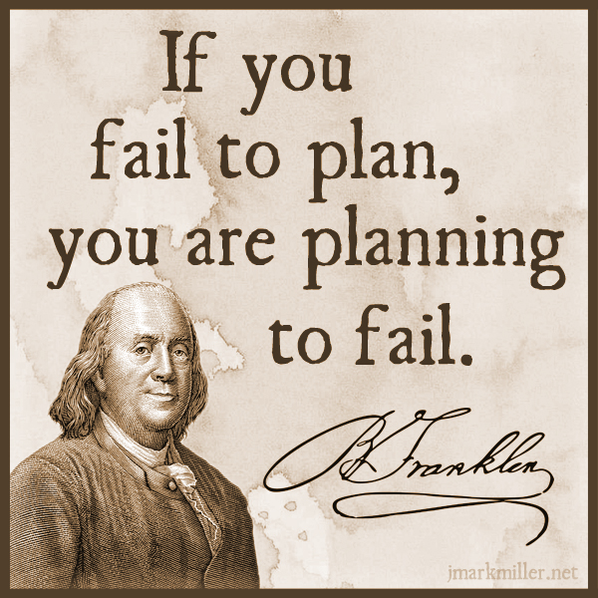

Slide 88
General Provisions
All procurement should be meticulously and judiciously planned by the procuring entity (PE) (Section 7.1 IRR of R.A. 9184)
Only procurement projects considered crucial to the efficient discharge of governmental functions shall be included in the Annual Procurement Plan (APP).
  Included in the approved GAA/Corporate Budget/ Ordinance
  In line with the priority programs of the Department (Key Reform Thrust)
Notes:
Rule II of the IRR of R.A. 9184 provides the guidelines and procedures for procurement planning

Slide 89

General Provisions
NO procurement shall be undertaken unless it is in accordance with the approved annual procurement plan (APP) of the procuring entity.
(Section 7.2)
Notes:
Rule II of the IRR of R.A. 9184 provides the guidelines and procedures for procurement planning

Slide 90
General Provisions
The end-user units or the Project Management Office (PMO) shall prepare their respective Project Procurement Management Plan (PPMP) for their programs, activities, and projects (PAPs) (Section 7.3.2)
The PPMP shall then be submitted to the PEs Budget Office for evaluation and inclusion in the budget proposal for approval of the HOPE (Section 7.3.3)
The BAC Secretariat review and consolidate the PPMPs from the Budget Office into a proposed APP (Section 7.3.4)
Notes:
Rule II of the IRR of R.A. 9184 provides the guidelines and procedures for procurement planning. End-users prepare PAPs at the start of every budget period.

Slide 91

Procurement Planning Process
End User | Budget Office | BAC Sec / BAC | Approving Authority
Formulate PPMP in line with PAPs upon issuance of budget call | Evaluate PPMP and include in budget proposal | BAC Sec review and consolidate into an indicative APP BAC recommends modality | Approve GAA/ Corporate Budget/ Ordinance HOPE approves APP
Revise PPMP |  | Review, consolidate and finalize the APP | HOPE or 2nd in rank approves revised APP
1
2

Slide 92
Procurement Planning
Advantages
Effective and efficient achievement of project goal.
Precludes occasions for unnecessary government purchases and circumventions of the prescribed procurement procedures, such as
  advance deliveries,
  “suki” system, or
  unwarranted resort to alternative methods procurement

Slide 93

Procurement Planning
Done within budgetary context reflecting the Procuring Entity (PE’s) priorities and objectives for the budget period.
It is the government’s fiduciary responsibility to protect the taxpayers’ interests and to safeguard the resources allotted to each department.

Slide 94

Philippine Procurement Paradigm
Post/Advertise opportunity
Open and evaluate bids
Post-qualify
Award and enter into contract
HOPE
Assess
Review studies
Consolidate into APP
Decide procurement method
Approve APP
Determine readiness
Selection
HOPE
BAC
BAC
PS-BAC Sec
TWG
Budget
PS-BAC Sec
End User
End User
Identify
Oversee implementation
Inspect and accept deliveries
Release payment
Implement
Cost-benefit analysis
Feasibility study
Market study
PPMP
Needs
Satisfaction

Slide 95

Developing Project Requirements
Identify the need of the PMO/End-user unit
Identify alternative solutions/ products/ services
Compare the alternatives (consider qualitative and quantitative factors)
Choose the Best Alternative which is most beneficial to the Procuring Entity

Slide 96
Procurement Project Preparation
Key challenges in preparing the PPMP:
identifying the procurement project requirements,
writing the technical specifications,
determining the Approved Budget for the
Contract (ABC),
identifying the schedule of milestone activities, and
determining the method of procurement.

Slide 97
Identifying Project Needs
Suggested basis for identifying needs:
  Core functions of the end-user unit in the organization, i.e. Accounting, Personnel Div., Legal etc.
  Historical data/Foreseen contingencies;
  Identified purpose/goals/MFOs;
  P.E’s Strategic Plans;
  Current supply inventory;
  Other maintenance and operating needs.

Slide 98
DEVELOPING THE PROJECT REQUIREMENT
Consult Stakeholders in developing the project requirements and TS/SOW/TOR,
Procuring Entity may engage the services of technical experts, whether in-house or consultants, to ensure that the requirements and the TS/SOW/TOR are adequate to achieve the objectives of the particular procurement.

Slide 99
PREPARING THE TECHNICAL SPECIFICATIONS, SCOPE OF WORK, AND TERMS OF REFERENCE
Specification for GOODs should
  identify MINIMUM requirements
  allow for competition
  provide a means to benchmark products against other products, and stated requirements
  enable effective and objective evaluation,
  support “best value” purchasing, and
  Consider “life cycle” costing

Slide 100
PREPARING THE TECHNICAL SPECIFICATIONS
Set clear Specifications:
  Generic and flexible
  Clear and unambiguous
  Updated, where technology is taken into account
  Fits the actual requirements of the PMO/End-user
  Reminder on Reference to Brand Names (Section 18)

Slide 101
PREPARING THE TECHNICAL SPECIFICATIONS
  Section 18 of IRR. Reference to Brand Names
  Specifications for the procurement of goods shall be based on relevant characteristics and/or performance requirements. Reference to brand names shall not be allowed.

Slide 102
PREPARING THE TECHNICAL SPECIFICATIONS
“Technical specifications” refers to the physical description of the goods or services, as well as the Procuring Entity’s requirements in terms of function, performance, environmental interface and design standard requirements to be met by manufactured or supplied goods or services to be rendered.
It must include the testing parameters for goods, when such testing is required in the contract.

Slide 103
PREPARING THE TECHNICAL SPECIFICATIONS
“Functional Description” is the description of the functions for which the Goods are to be utilized. For example,
  a pen is expected to write 1.5 km of straight, continuous lines;
  a welding machine should bond two metal parts rigidly;
  a sewing needle is expected to create a passage in the material
  for the thread to pass through smoothly;
  a two-seater table for elementary grade

Slide 104
PREPARING THE TECHNICAL SPECIFICATIONS
“Performance description” refers to the manner Goods are required to perform the functions expected of them. For example,
  a ballpen that writes at 1.5km should do so continuously and smoothly, without skipping, and with the color of the ink being consistent.
  a welding machine producing a high-strength weld with great appearance/neat and little need for cleaning.
  a sewing needle that can be used for dense woven fabrics that causes less damage,
  a table that is durable, stable or does not shake, with smooth surface and can accommodate two students.

Slide 105
PREPARING THE TECHNICAL SPECIFICATIONS
“Environmental interface” refers to the environment in which the required functions are performed at the desired level. For example,
  a ballpen should write continuously for 1.5km on pad paper or bond paper, but not necessarily on wood or on a white board;
  a welding machine suited for windy, outdoor conditions;
  a needle to suit depending on the machine and its stitch type, the needle is designed with variations in length of blade, shank thickness, type of eye etc. It is advisable to check with the machine manufacturer for suitability of needle system to machine.
  a table suitable for the classroom, not necessarily all wood, but movable and/or stackable, if necessary.

Slide 106
PREPARING THE TECHNICAL SPECIFICATIONS
“Design” refers to the technical design or drawing or physical appearance of goods being procured. A design standard is particularly useful in cases where the goods procured are specially manufactured for the Procuring Entity. Example
  Ballpoint, gel-tip, sign pen, technical pen, etc.
  Armchair, grade school desk, laboratory stools

Slide 107
















“Design”
refers to the technical design of the goods being procured
Antique Nostalgic | Heat Lamp | Yellow Bug | Twist & Lock Coil
Appliance Ceiling Fan | Decorative Globe | Amusement Light Bulb | 3-way Screw- in
Standard Colored Party | Decorative Chandelier | Medium Base Stringers | Air Purifying
Reflector | S 14 Design | Picture- Exit | Non- dimmable

Slide 108
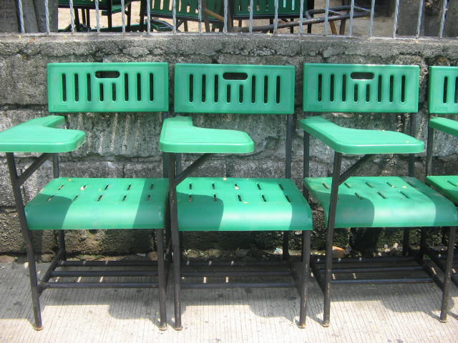
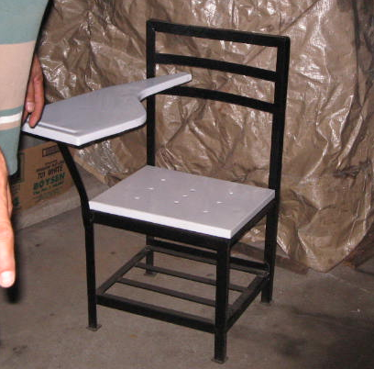
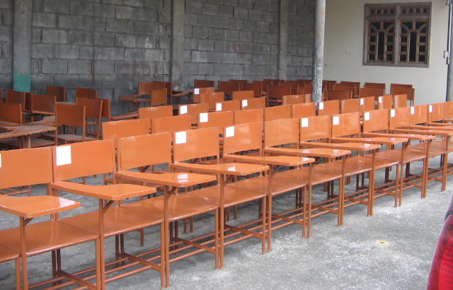
TYPICAL DESIGN OF TABLET ARMCHAIR (NON-WOOD BASED MATERIAL)

Slide 109

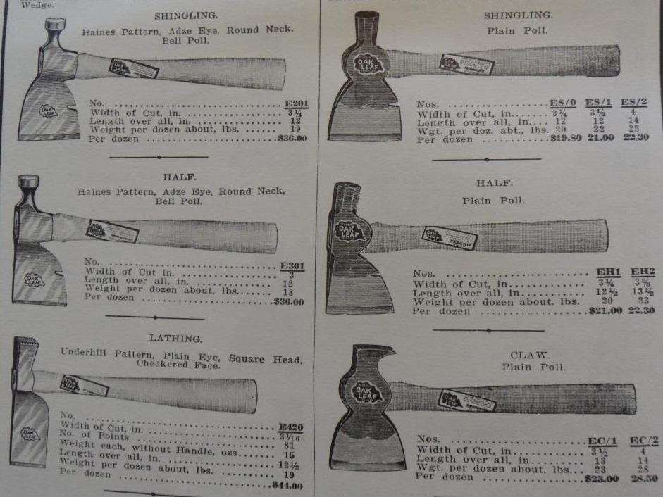
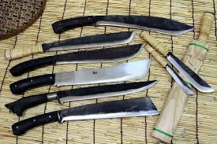

Slide 110
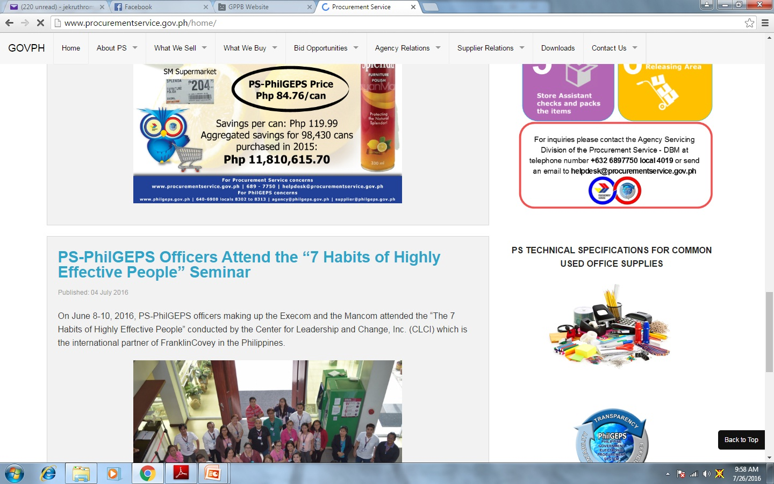

Slide 111
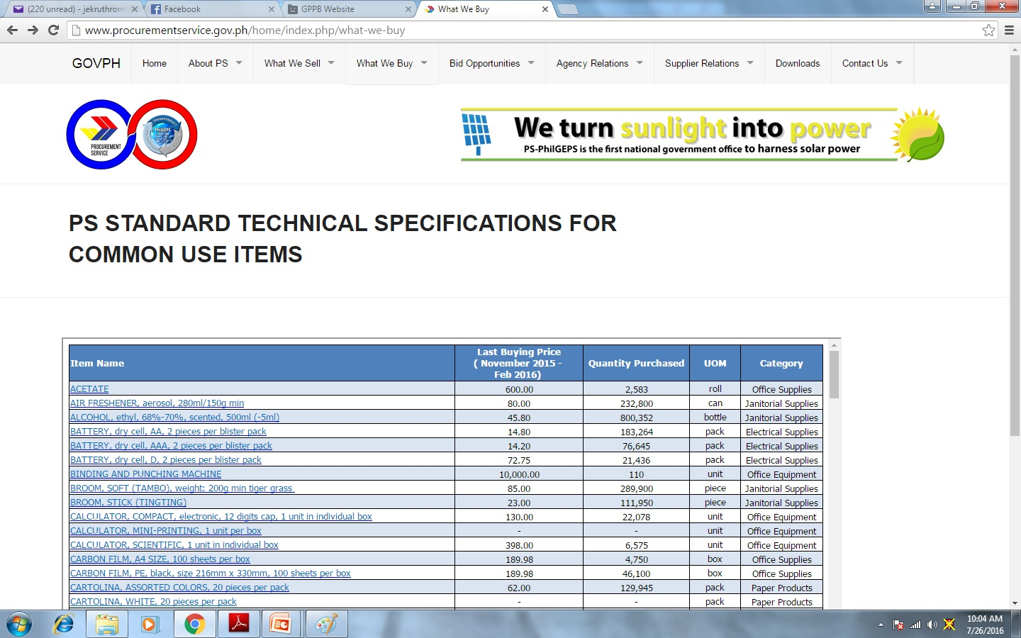

Slide 112
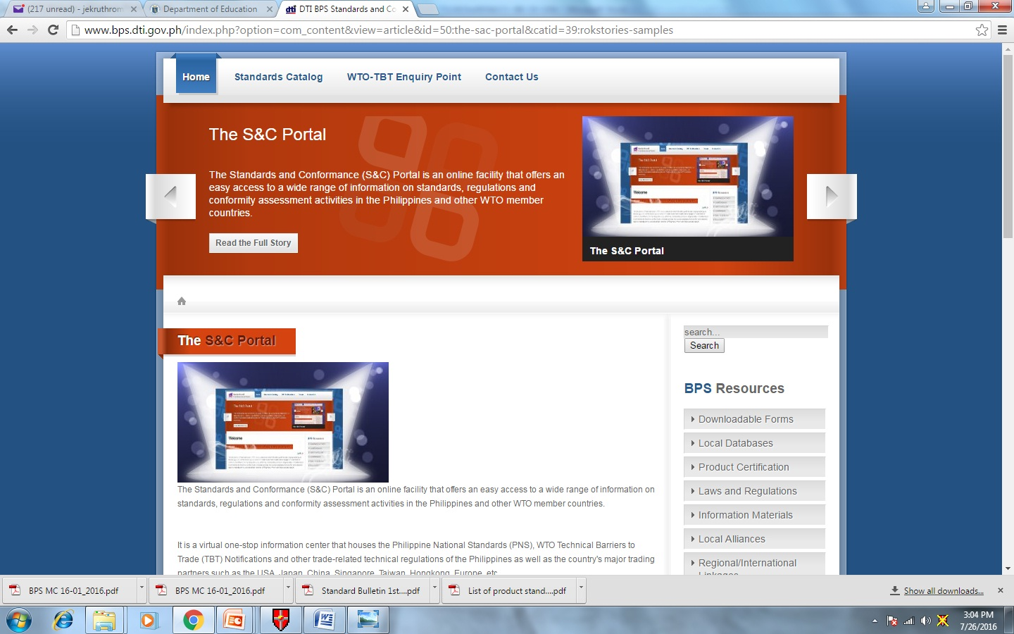

Slide 113


Slide 114
APPROVED BUDGET FOR THE CONTRACT (ABC)
The ABC reflected in the APP or PPMP shall be consistent with the appropriations for the project authorized in the GAA.
  For procurement short of award, based on budget levels under the proposed national budget (National Expenditure Program or NEP) submitted by the President to Congress.
Section 5(b) Approved Budget for the Contract (ABC)
For multi-year contracts, for which a Multi-Year Obligational Authority (MYOA) or an equivalent document is required, the ABC shall be that incorporated in the project cost reflected in the MYOA

Slide 115

PREPARING THE ESTIMATED BUDGET OR ABC
Consider the following:
Nature of the goods or services to be procured
Nature of industry and practices
Volume and quantity, or scope of work/services
Schedule of requirement
Availability of the item or services in the market
Differences in supplier’s terms of offerings/solutions and pricing methods
Obsolescence, operation, and maintenance of equipment/non-consumable goods
Direct or indirect cost

Slide 116
LIFE CYCLE COSTING
LCC – Life Cycle Costing
“Cost” should consider all costs throughout the life-cycle – acquisition cost, utility costs (energy/water consumption, maintenance), and disposal costs.
“Cradle to Grave” vis-à-vis “Cradle to Cradle”

Slide 117
LIFE CYCLE COSTING
  What is the intended operational life?
  What is the cost of annual consumables?
  What is the operating cost?
  What is the cost of maintenance?
  What is covered by warranty?
  Is there any salvage value? Buy-back offer?
  What are the cost associated with environment, health and safety? Are there hazardous materials in the process?

Slide 118
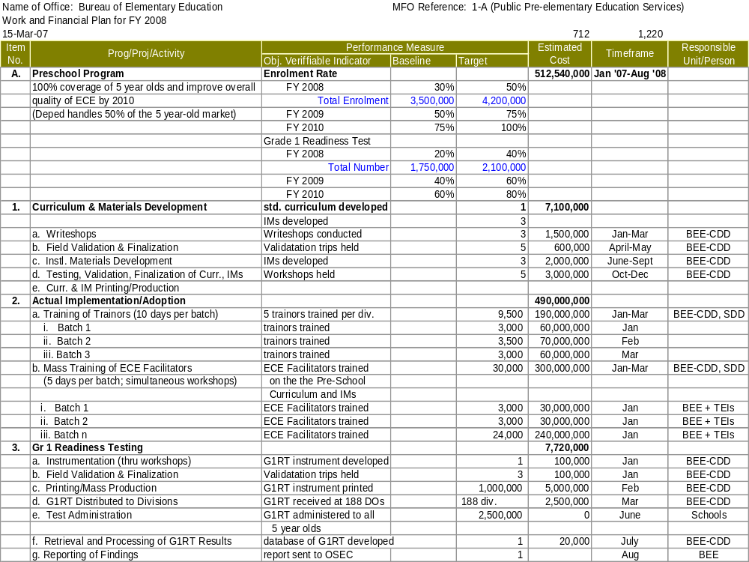
Work & Financial Plan
WHAT TO PROCURE
which involves writing the technical specifications
HOW MUCH TO PROCURE
-determining the quantity and ABC
HOW TO PROCURE
determining the mode of procurement
WHEN TO PROCURE
Identifying the schedule of milestone activities of target implementation schedule

Slide 119

PROJECT PROCUREMENT MANAGEMENT PLAN (PPMP)
A guide document in procurement and contract implementation;
a vital reference in procurement monitoring;
a tool allowing the PE the flexibility to optimize the utilization of scarce resources;
prepared by the end-user unit during the budget preparation to support the cost estimates in the budget proposal.

Slide 120
PROJECT PROCUREMENT MANAGEMENT PLAN (PPMP)
Project Procurement Management Plan
Name of the Project or Procurement
General Description of the Project
Contents
Extent/Size of Contract Scopes/Packages
Time Schedule / Procurement Milestones
Estimated Budget for the Contract

Slide 121
PROJECT PROCUREMENT MANAGEMENT PLAN (PPMP)
END-USER/UNIT: Office DATE: _____
CODE | GENERAL DESCRIPTION | QTY./ SIZE | ESTIMATED BUDGET | MODE OF PROCUREMENT | SCHEDULE/ MILESTONE OF ACTIVITIES (Jan-Dec) (Procurement Stages) | REMARKS
NOTE: Technical Specifications for each Item/Project being proposed shall be submitted as part of the PPMP
Prepared By: Submitted By:
____________________________ ____________________________
Head of OFFICE

Slide 122
PROJECT PROCUREMENT MANAGEMENT PLAN (PPMP) SAMPLE
PROCURING ENTITY: San Roque Elementary School DATE: January 11, 2016
CODE | GENERAL DESCRIPTION | QTY./ SIZE | ESTIMATED BUDGET | MODE OF PROCUREMENT | SCHEDULE/ MILESTONE OF ACTIVITIES (Jan-Dec) (Procurement Stages) | REMARKS
16-01
Construction of 20m. Covered Walk
1 Lot
P150,000
Negotiated Procurement (Small Value)
Bidding- March 2016
Award - March 2016
PTA Donated Funds
16-02
Procurement of Food Commodities for School Feeding Program
Negotiated Procurement (Small Value)
Bidding- May 2016
Award - June 2016
3 Lots
P250,000
GOP-SFP
16-03
Supply of LPG for 10 months
10 Tanks/
Refil
P3,000
Negotiated Procurement (Small Value)
Bidding- June 2016
Award - June 2016
School MOOE
NOTE: Technical Specifications for each Item/Project being proposed shall be submitted as part of the PPMP
Prepared By: Approved By:
____________________________ ____________________________
Head of SCHOOL

Slide 123
PPMP vs PR
Purchase Request (P.R.) – Request for purchase or requisition of supplies, materials and equipment or its equivalent shall be duly approved by proper authorities. (Source: Training Handbook on Government Expenditures)
In no way that the End-user Unit submit their P.R. ahead of the approved PPMP item.

Slide 124
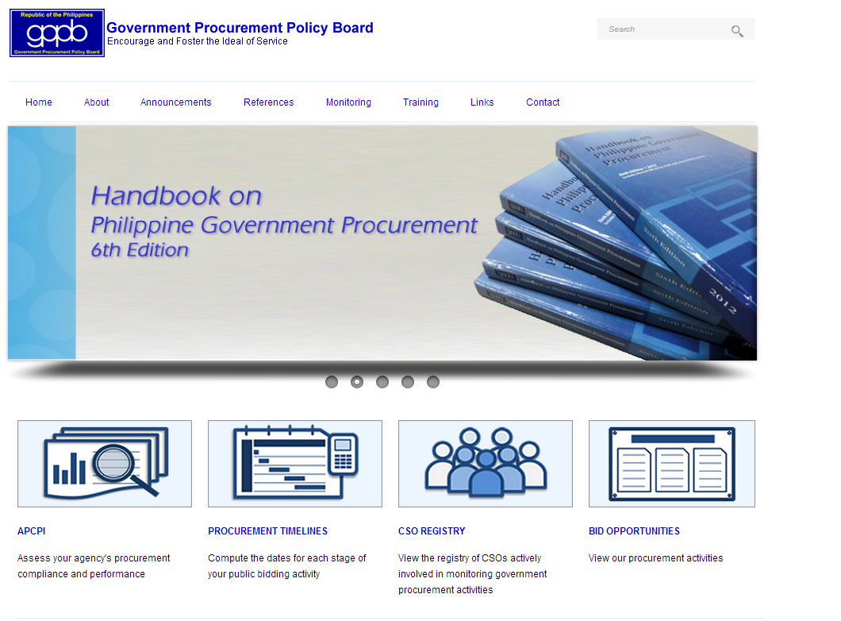
PROCUREMENT MILESTONES

Slide 125
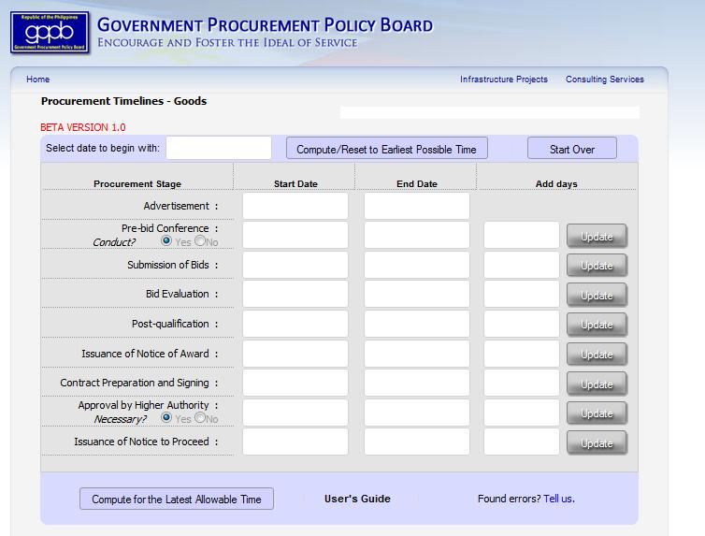
PROCUREMENT MILESTONES
Notes:
Annex “C”

Slide 126
PERIOD OF ACTION ON PROCUREMENT ACTIVITIES (Goods & Infra)
ACTIVITIES | GOODS | INFRA (ABC 50M & below) | INFRA (ABC above 50M)
ADVERTISEMENT | 7 CD | 7 CD | 7 CD
ELIGIBILITY CHECK |  | Refer to Stage 5 | Refer to Stage 5
ISSUANCE & AVAILABILITY OF BID DOCS | From 1st day of advertisement until Bid Opening
PRE-BID CONFERENCE | 1 CD (12 c.d. before Bid Opening)
REQUEST FOR CLARIFICATION | 10 CD before Bid Opening
SUBMISSION & RECEIPT OF BIDS | 1 CD ( 45 c.d. from last day of adv.) | 1 CD ( 50 c.d. from last day of adv.) | 1 CD ( 65 from last day of adv.)
BID EVALUATION | 7 CD | 5 (7) CD | 7 CD
POST-QUALIFICATION | 30 (45)CD
APPROVAL OF RTA/NOA | 7 CD | 4 CD | 7 CD
CONTRACT PREP.& SIGNING | 10 CD | 10 CD | 10 CD
APPROVAL OF CONTRACT BY HIGHER AUTHORITY | 15 CD | 5 CD | 15 CD
ISSUANCE OF NTP | 3 CD | 2 CD | 3 CD
 | 124 CD | 113 CD | 144 CD

Slide 127
PROCUREMENT MILESTONES
Factors to consider in identifying procurement timelines:
  Budget rules, i.e. CSE – every quarter;
  Nature of Procurement Projects, whether simple or complex
  For shopping/small value procurement, give at least two weeks
  Foreseen/Unforeseen Contingencies, i.e. frequent change in specifications, etc.
  Availability in the market.

Slide 128
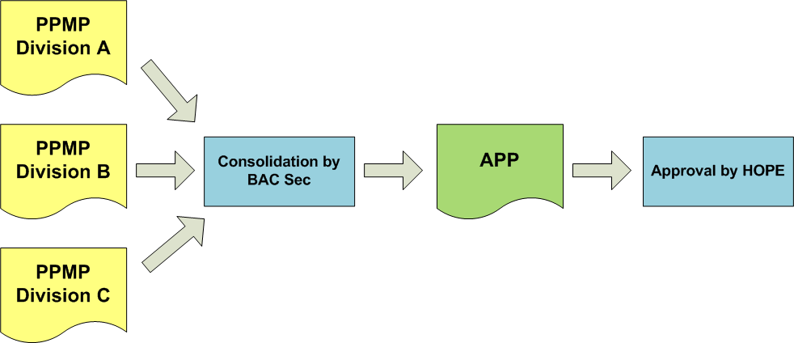
PPMP CONSOLIDATION
Checking of procurement methods
Recommendation of procurement methods (BAC)
Propose procurement methods (End-user)

Slide 129
ANNUAL PROCUREMENT PLAN (APP)
Annual Procurement Plan
Name of the Project
PMO or End-user Unit
Contents
Mode of Procurement
Milestone for Procurement Activity
Source of Fund
Approved Budget for the Contract (ABC)

Slide 130
ANNUAL PROCUREMENT PLAN (APP)
Legal Basis: Section 7 of the IRR of RA 9184
No procurement shall be undertaken unless in accordance with APP
Covers the entire procurement activities that will be undertaken by the procuring Entity within the calendar year
Prepared using the prescribed format of the GPPB
APP should be maintained and updated regularly
Review and updating of the individual PPMPs and the APP shall be done regularly, at least once every 6 months or as often as necessary.
Notes:
-

Slide 131
ANNUAL PROCUREMENT PLAN (APP)
Revised per GPPB Res. 20, s.2015
 | (Name of Agency) Annual Procurement Plan for FY ______
Code (PAP) | Procurement Program/Project | PMO/ End-User | Mode of Procurement | Schedule for Each Procurement Activity |  |  |  |  |  |  |  |  |  |  |  |  | Source of Funds | Estimated Budget (PhP) |  |  | Remarks (brief description of Program/Project)
 |  |  |  | Ads/Post of IB/REI |  |  |  | Sub/Open of Bids |  |  |  | Notice of Award |  |  | Contract Signing |  |  | Total | MOOE | CO
Prepared By: BAC Secretariat Recommended By: BAC Approved By: HOPE
_________________________________ _______________________________ ________________________________

Slide 132
ANNUAL PROCUREMENT PLAN (APP)
Sample
 | (Name of Agency) Annual Procurement Plan for FY ______
Code (PAP) | Procurement Program/Project | PMO/ End-User | Mode of Procurement | Schedule for Each Procurement Activity |  |  |  |  |  |  |  |  |  |  |  |  | Source of Funds | Estimated Budget (PhP) |  |  |  | Remarks (brief description of Program/Project)
 |  |  |  | Ads/Post of IB/REI |  |  |  | Sub/Open of Bids |  |  |  | Notice of Award |  |  | Contract Signing |  |  | Total | MOOE |  | CO
Division of San Francisco
2016
01
Procurement of Window Type 1 unit
Airconditioner
SGOD
Shopping
Feb. 1Wk
Feb. 2Wk
Feb. 3Wk
Feb. 3Wk
GOP
10,000
02
Procurement of Security Services
GSD
Competitive Bidding
April
1Wk
April
1Wk
April
1Wk
April
4Wk
GOP
700,000
w/ MYOA
03
Printing of Teacher’s Guide for Gr1
Negotiated Proc- Sml Value
May
2Wk
May
3Wk
May
4Wk
May
4Wk
GOP
175,000
CID
TOTAL APP
885,000
Prepared By: BAC Secretariat Recommended By: BAC Approved By: HOPE
_________________________________ _______________________________ ________________________________

Slide 133

METHOD OF PROCUREMENT
As a general rule, all procurement should be through public bidding
The selection of the method of procurement is dependent on the presence or absence of specific conditions of other methods of procurement in Sections 48 to 54 of the revised IRR

Slide 134
ANNUAL PROCUREMENT PLAN (APP)
In the consolidation of PPMPs, the BAC may adopt a strategy through where similar items of procurement are packaged into one procurement undertaking.
  Include provisions for lump sum that may cover foreseeable emergencies or contingencies based on historical records.
  The schedule of procurement activities should be conducted by BAC and the end-users involved efficiently prior to contract implementation.

Slide 135
PROCUREMENT STANDARD
In case of change in original mode of procurement in approved APP from public bidding to AMPs:
Update PPMP/s (End-user)
Consolidate updated PPMP/s to APP
(BAC Sec)
Recommend through a Resolution (BAC)
Approve Supplemental APP (HOPE)
Update procurement method/s
Checking of procurement method/s
Justify and recommend the change in procurement method/s

Slide 136
APP vis-a-vis APP-CSE
APP being referred to in the IRR of RA 9184 is different from the Annual Procurement Plan for Common-use Supply and Equipment (APP-CSE)
APP-CSE serves as basis of DBM – PS in projecting its inventory requirements, scheduling of activities, and over-all management of the central procurement of common-use goods (DBM Circular Letter 2011-6 & 2011-6a)
Common-use supplies – refers to those supplies and materials and equipment included in the price list of the PS which are necessary in the transaction of the official business of the procuring entity and consumed in its day-to-day operations

Slide 137
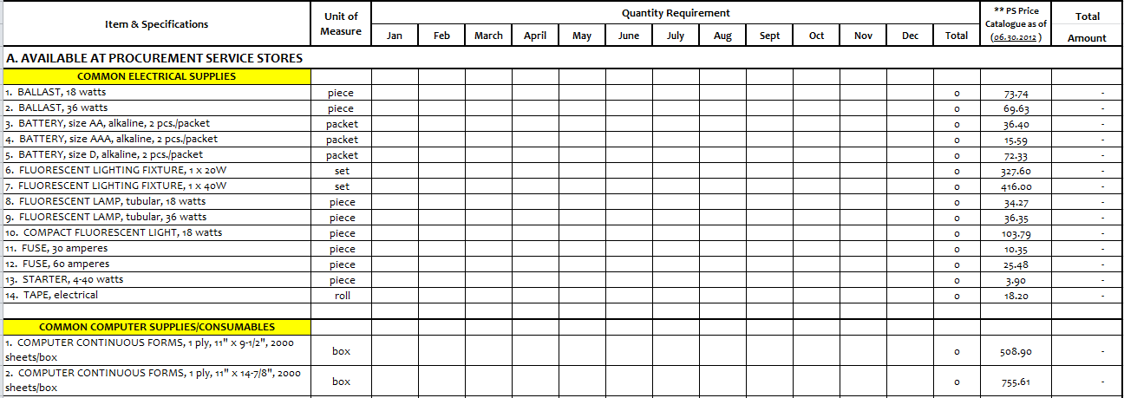
APP-CSE
In the case of foreign consultants, the foregoing eligibility requirements under Class “A” Documents may be substituted by the appropriate equivalent documents.
NPM 42-2013

Slide 138
REVISIONS ON APP
End-user Unit
Update PPMP/Supplemental PPMP
BAC Secretariat
Consolidate PPMP to APP/Supplemental APP
Approve Updated APP/Supplemental APP
HOPE

Slide 139
SECTION 7 of May 10, 2016 new IRR
Poor planning; Delay in budget approval; Delay in procurement Under-spending | MYOA for Multi-year projects (Sec. 5(b), 7.6); Preparation of Indicative APP upon issuance of budget call or similar document (7.3) Require submission of APP and changes thereto to GPPB on or of the budget year, and shall be posted in accordance with E.O. 662, series of 2007, as amended. (7.4) Undertaking Procurement Short of Award (7.6)

Slide 140
Procurement MONITORING REPORT (pmr)
Section 12.2

Slide 141
PROCUREMENT MONITORING REPORT (PMR)
The BAC shall be responsible for ensuring that the procuring entity abides by the standards set forth under R.A. 9184 and its IRR.
BAC is required to prepare a PROCUREMENT MONITORING REPORT (PMR) in the form prescribed by the GPPB .
Notes:
Section 12

Slide 142
PROCUREMENT MONITORING REPORT (PMR)
The PMR shall cover all procurement activities specified in the APP, whether on-going and completed from holding of the pre-procurement conference to the issuance of the notice of award and approval of the contract, including the actual time for each major procurement activity.
The PMR shall be approved and submitted by the Head of the Procuring Entity (HOPE) the GPPB in printed and electronic format within 14 cd after the end of each semester.
( Executive Orders 662, 662-A and 662-B, series of 2007)
Notes:
Section 12

Slide 143
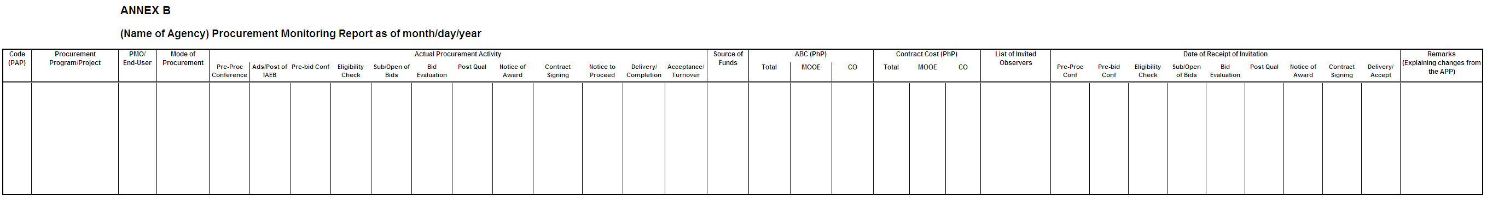
PROCUREMENT MONITORING REPORT (PMR)

Slide 144
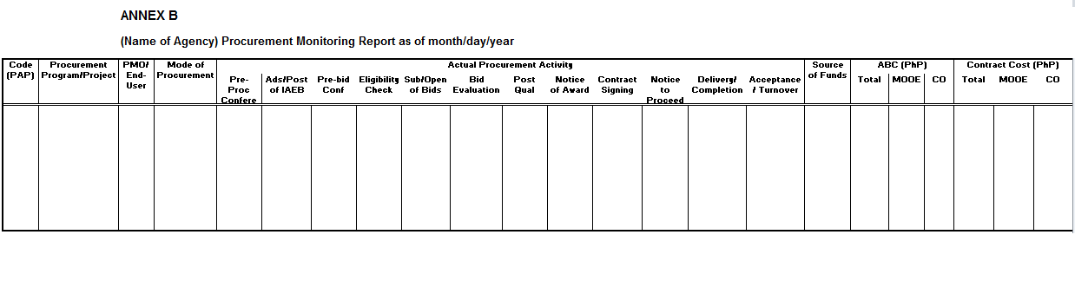
Filling-out the PMR
Proc of Office Furniture
OSEC, MID,
Public Bidding
4/20/2013
4/24/2013
5/2/2013
5/14/2013
5/14/2013
5/15/2013
5/19/2013
5/20/2013
5/22/2013
5/22/2013
5/27,29/2013
5/27,29/2013
900,000
221
GAA
890,000

Slide 145
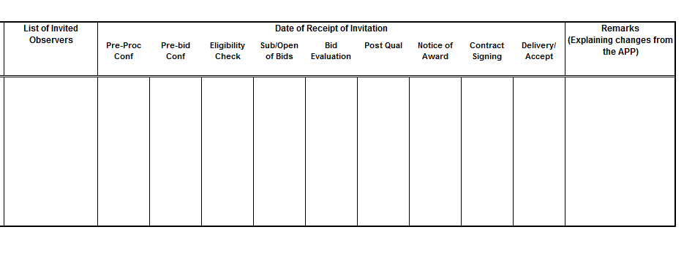
Filling-out the PMR
1. CBCP-Laiko
2. G-Watch,
3. COA
4/17/2013
4/20/2013
5/11/2013
5/11/2013
5/16/2013
5/19/2013
5/19/2013
5/19/2013
5/19/2013

Slide 146

SUBMISSION & POSTING REQUIREMENTS
Submission of approved APP to GPPB on or before the end of January of the budget year, and shall be posted in accordance with E.O. 662, series of 2007, as amended. Changes in the APP, if any, for the budget year shall be submitted to GPPB in July of the current budget year, and in January of the following budget year.
Submission of approved PMR to GPPB (Section 12.2 of IRR of RA 9184) and posting in the PE’s website within 14 cd after the end of each semester following the form and format downloadable from the GPPB website (Section 1.2 of the IRR of EO 662).

Slide 147
School based Procurement guidelines

Slide 148
School-Based Procurement Guidelines
Shopping for readily available goods
Negotiated Procurement
(Small ValueProcurement)
for all types within the threshold.
Amount does not exceed Php500,000 , otherwise, public bidding shall be used
The method of procurement to be used must be as indicated in the approved APP

Slide 149
School-Based Procurement Guidelines
1. The end-user submits pertinent documents to the School Bids and Awards Committee (BAC).
Approved Purchase Request (PR) with Certified Availability of Funds (CAF)/Allotment;
PR indicate the minimum Technical Specifications, Schedule of Requirements, Packing Requirements (if applicable) and other conditions of the Purchase Order (PO).
The SBAC, through the SBAC Secretariat
prepares Request for Quotation (RFQ)

Slide 150
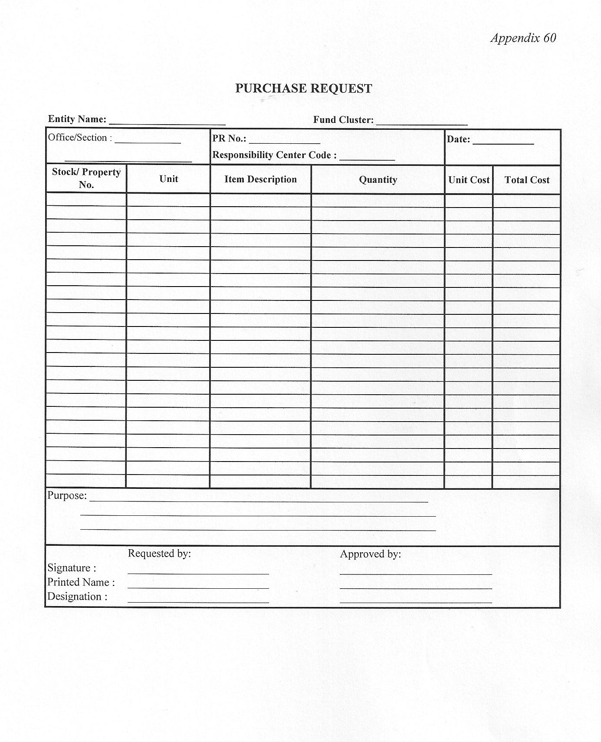
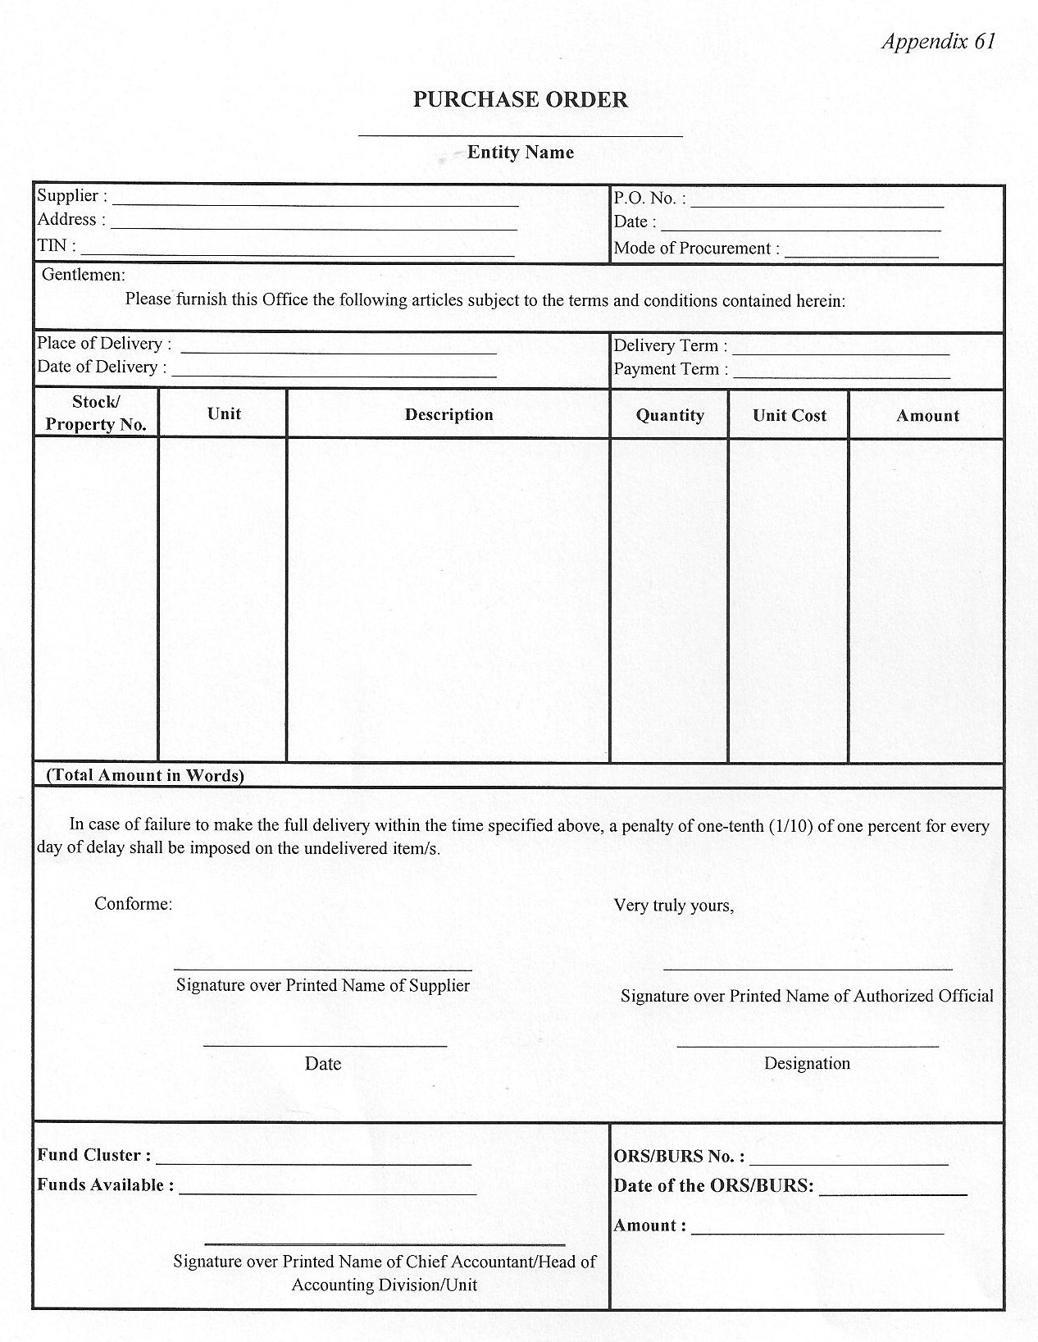
Prescribed PR & PO Forms

Slide 151
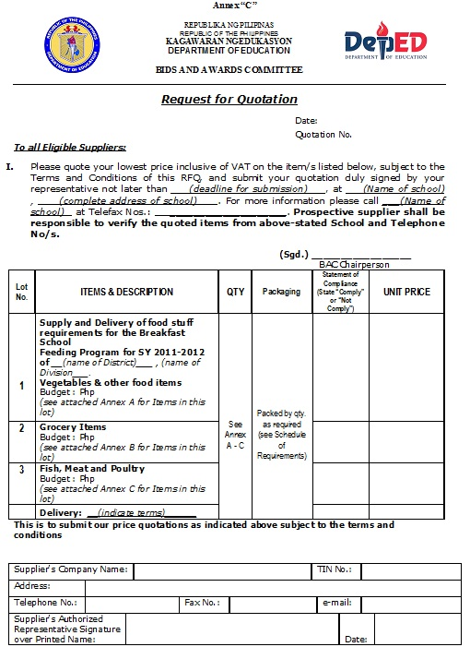


Slide 152
Terms and Conditions
A. Submission of Requirements
  1.Sealed/Open quotations and other requirements stated below shall be submitted to the Bids and Awards Committee (BAC ) at (state the complete address / email address or fax no).
  2. Supplier shall submit the following requirements:
    Duly signed Request for Quotation. Prices shall be quoted in Philippine Peso.
3. For verification prior to Award
    Valid and Current Mayor’s Permit/Municipal License
    Philippine Government Electronic Procurement System (PhilGEPS )Registration No. (at least Red Member)
    Tax Identification Number (if applicable)
B. Evaluation of Quotations
Quotations shall be compared and evaluated on the basis of criteria, such as a) Completeness of Submission; b) Compliance with Technical Specifications; and c) Price.

Slide 153
Terms and Conditions
C. Award
  The supplier who submitted the lowest calculated and responsive quotation shall be awarded the Purchase Order after evaluation by the BAC.
D. Delivery
  Delivery of Goods shall be made within 7 wd from receipt of PO.
  (To ensure the quality of vegetables, fish, poultry and milk products and other perishables, delivery shall be made on a staggered basis refer to the Schedule of Requirements)
Deliverables shall be delivered to the School site, (name and complete address of the school) hereto defined as Project Site, costs to the account of supplier. Risk of title shall pass from the supplier to the purchaser upon receipt and final acceptance of the Goods at Project Site.
Upon delivery of the Goods to the Project Site, the supplier shall notify the Purchaser and present the following documents to the Purchaser:
    a. Supplier’s Invoice c. Delivery Receipts
    b. Statement of Accounts d. Approved PO
For the purpose of these conditions, Purchaser’s representative at the Project Site is (Name and designation of authorized representative)

Slide 154
Terms and Conditions
  E. Instructions
  Supplier shall be responsible for the source(s) of its Goods, and shall make the deliveries in accordance with the schedule, and specifications of the award or purchase order. Failure of the supplier to comply with this provision shall be ground for cancellation of the award or PO issued to the supplier.
  Supplier who accepted a purchase order but failed to deliver the required Goods within the time called for in the purchase order shall be disqualified from participating in DepEd or any of DepEd units’ future procurement activities. This is without prejudice to the imposition of other sanctions prescribed under RA 9184 and its revised IRR against the supplier.
  Rejected deliveries shall be construed as non-delivery, and shall be replaced by the supplier within three (3) days otherwise it will be subject to liquidated damages for delayed deliveries.

Slide 155
Terms and Conditions
  4. Liquidated Damages
    A penalty of one-tenth of one percent (0.001) of the total value of the undelivered items shall be charged as liquidated damages for every day of delay of the delivery.
F. Packing
  The supplier shall provide such packing of the Goods appropriate to prevent their damage or deterioration during transit to the Project Site. Goods shall be packed in (appropriate food grade containers).
  Grocery items must be properly labelled to include the following : 1) Batch/Lot number, 2) Manufacturing date, 3) Expiry date, 4) Name of manufacturer, 5) Address, 6) License to operate number, if applicable.

Slide 156
Terms and Conditions
G. Inspection
All deliveries by suppliers shall be subject to inspection, and acceptance by the DepEd School Inspection Team and the end-user. All cost of the necessary laboratory tests undertaken by DepEd on the Goods shall be to the account of the suppliers.
H. Payment
One hundred percent (100%) of the Contract Price shall be paid to the supplier after acceptance of the Goods at the Project Site and submission of the documents provided under C. Delivery.

Slide 157
School-Based Procurement Guidelines
3. The BAC, through the BAC Secretariat, posts for information purposes the procurement opportunity, for a period of seven (7) c.d.
In the PhilGEPS (if above P50,000)
Website of the Procuring Entity (PE), if any
Bulletin Board within the premises of the PE
Send RFQ to at least three (3) prospective suppliers of known qualifications.

Slide 158
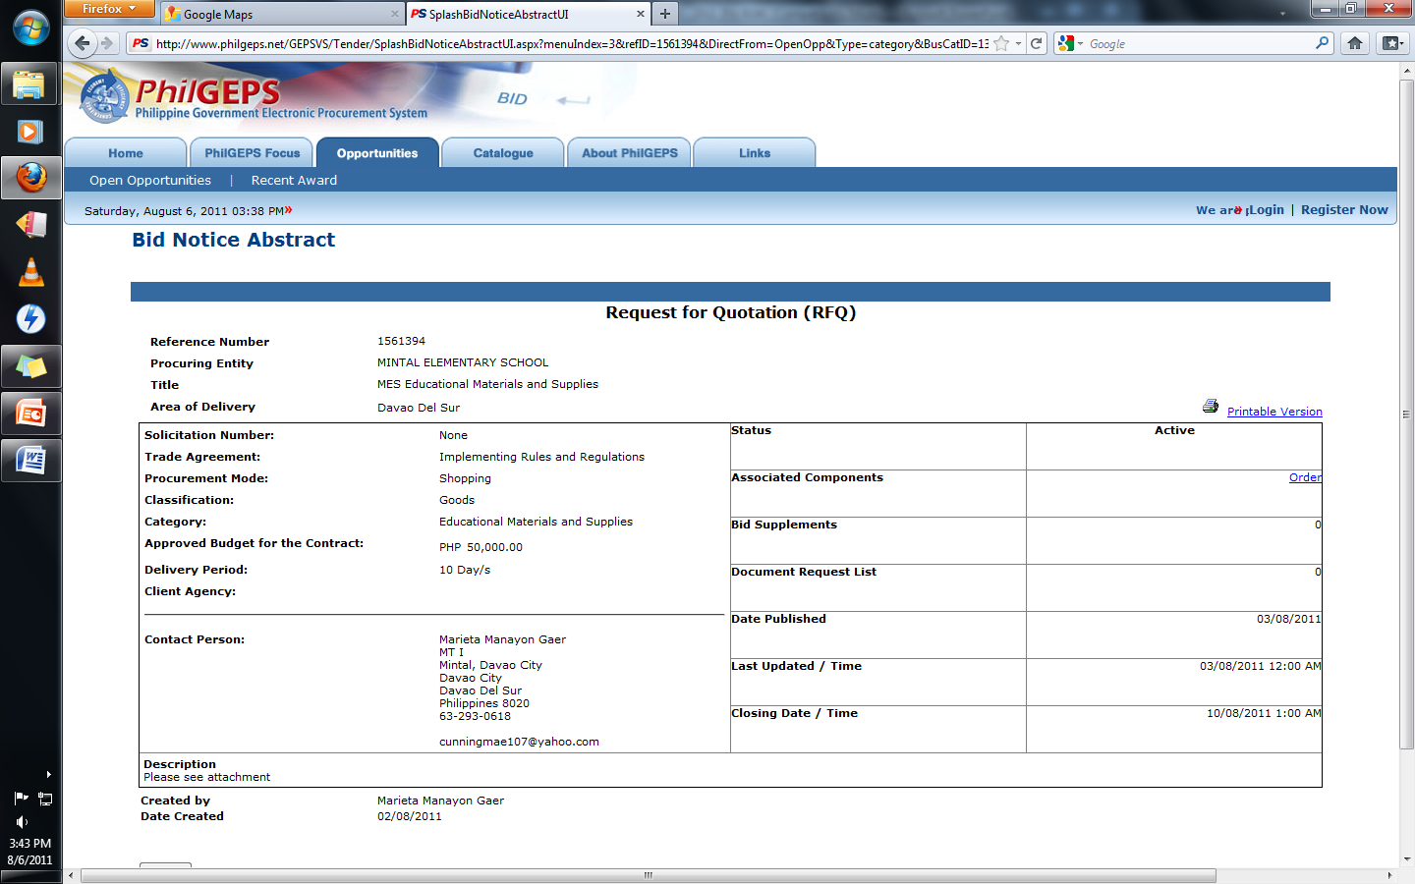

Slide 159
School-Based Procurement Guidelines
5. Prepare Abstract of Quotations. Extend deadline if no quotation was received.
6. Evaluate the quotations submitted to make sure it complies with the technical specifications, price and other requirements stated in the RFQ and to correct mathematical errors, if any.
7. Post qualify bidder with the Lowest Calculated Quotation based on requirements submitted to the BAC, which must be submitted within 3 c.d. upon receipt of Notice by the bidder from the BAC.

Slide 160
Abstract of Quotation
End-User:
Quotation No.:
Date:
Venue:
Items & Description |  |  |  | Suppliers / Unit Prices
Supply and Delivery of food stuff requirements for the Breakfast Feeding Program for SY 2012-2013
 | Lot 1: | Vegetables & other food items
 |  | Budget: Php__________
 | Lot 2: | Grocery Items
 |  | Budget: Php__________
 | Lot 3: | Fish, Meat and Poultry Items
 |  | Budget: Php__________
 |  |  | TOTAL PRICES
 |  |  | Remarks
(Name of School, District, Division)
Bids and Awards Committee
SBFP Core Group
13-01
June 19, 2012
Pandanan Elementary School, (District) (Division)
Supplier A
Supplier B
Supplier C
Supplier D
Supplier E
14,750.00
14,999.50
13,750.00
14,000.00
14,625.00
15,000.00
7,500.00
7,675.00
6,900.00
7,500.00
7,099.50
6,950.00
21,050.00
22,355.00
22,325.00
21,500.00
21,050.00
22,500.00
43,475.00
44,254.50
43,575.00
42,599.50
42,625.00
Chairperson
Vice-Chairperson
Member
Member
Member
Approved by:

Slide 161
School-Based Procurement Guidelines
8. Award to Lowest Calculated & Responsive Quotation and prepare Purchase Order (PO)
Have it signed by the supplier
Transmit to head of accounting office for signature as instrumental witness
Have it signed approved by the HOPE

Slide 162
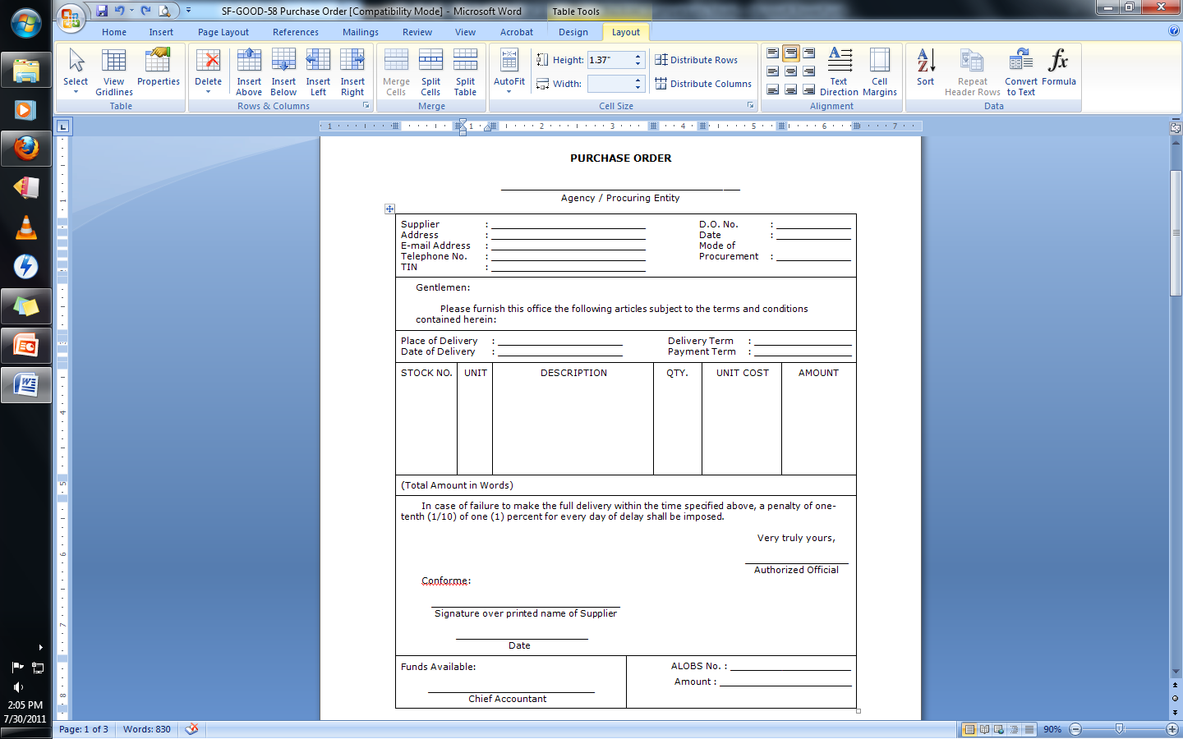
Pandanan Elementary School, (District), (Division)
Supplier A
13-01
Near Pandanan Elem. School
June. 20, 2016
supplier@yahoo.com.ph
Small Value Procurement
999-9999
Pandanan Elem. School
Staggered Delivery
Within 7 cd upon receipt of PO
Cash for every delivery
Lot 3
Fish, Meat and Poultry items
(Please see attached PO Annex A)
(Please see attached PO Annex A)
(Please see attached PO Annex A)
P21,050.00
Twenty One Thousand Fifty pesos & /00 only

Slide 163
School Head
Supplier Authorized Representative
Special Disbursing Officer
P21,050.00

Slide 164
School-Based Procurement Guidelines
9. The BAC Secretariat shall post the NOA, Contract/PO and NTP (if applicable)
In the PhilGEPS
Website of the Procuring Entity (PE)
Bulletin Board within the premises of the PE
Above procedures must be completed within a maximum period of 30 c.cd.
CONTRACT IMPLEMENTATION

Slide 165
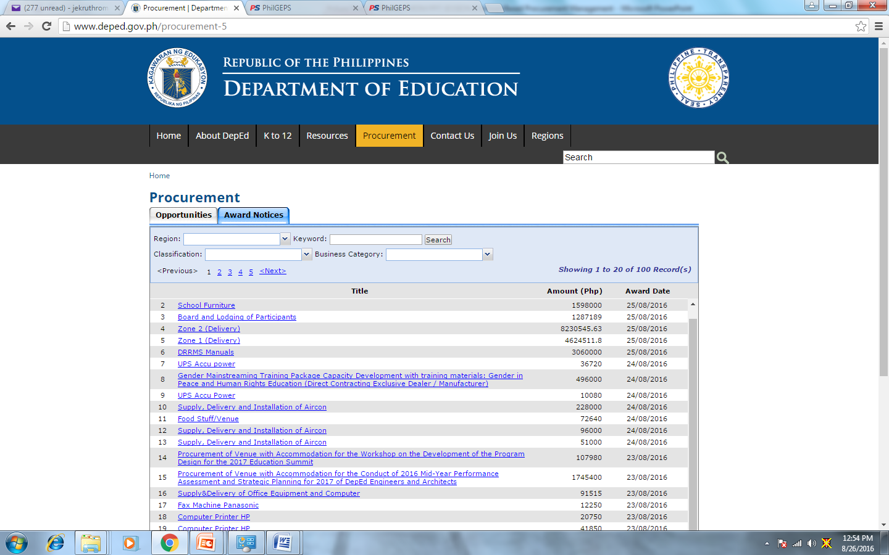

Slide 166
