Slide 1
Session 4.0
SCHOOL-BASED FINANCIAL MANAGEMENT

Slide 2
Session Overview
Implementing Unit and Non-Implementing Unit
List of Activities for School-Based Financial Management (SBFM)

Slide 3
Learning Objective
To improve school performance and to equip the school head with at least the minimum knowledge about concepts, methods and procedures of a simplified fund management system

Slide 4
Implementing unit (iu) and non-implementing unit (non-iu)

Slide 5
Implementing Unit vs. Non-Implementing Unit
Particulars | Implementing Unit | Non-Implementing Unit
Schools | Secondary schools | Elementary and secondary schools
Receives allocations from the national budget directly from the DBM regional office? | Yes | No, allocations to Non-IU were received through School Division Office in the form of Cash Advances
Centralized lump sums released by DepEd central office are downloaded directly to them? | Yes | No

Slide 6
con’t... Implementing Unit vs. Non-Implementing Unit
Particulars | Implementing Unit | Non-Implementing Unit
With minimum required set of financial staff? | Yes | No, the School Head and a designated staff, if any, handle the Cash Advance. Some Non-IU have designated staff/s
Separation of functions: cashiering and disbursement? | Yes | No
Maintains complete set of books? | Yes | No

Slide 7
con’t... Implementing Unit vs. Non-Implementing Unit
Particulars | Implementing Unit | Non-Implementing Unit
Submits financial reports to school division office (SDO)? | Yes, for the purpose of consolidation | Yes, (liquidation report, etc..)
May be required to submit additional management reports to SDO for monitoring and evaluating school performance | Yes | Maybe required to submit reports like the details of expenses for the cash advance and report on Non-Financial resources available in the school..

Slide 8
con’t... Implementing Unit vs. Non-Implementing Unit
FINANCIAL REPORTING
Implementing Unit (IU)
Prepare and submit the required standard financial statements and reports required by DBM, DOF, COA and other government regulatory bodies to report on its financial operations
Non-Implementing Unit (Non-IU)
Non-IU schools financial operations are included in the financial statements and other required reports prepared and submitted by the Division Office
Notes:
FOR INCORPORATE REFER TO SLIDE 6

Slide 9
School-Based Financial Management (SBFM)
What is SBFM?
School-based Financial Management refer to activities undertaken or pursued by a school head and his/her designated staff who assist in the management of financial and relevant non-financial resources available to the school.
These are pursued aimed at maximizing the benefits that may be derived from the utilization of these resources and minimizing the attendant negative costs or effects of such activities.

Slide 10
con’t...
School-Based Financial Management (SBFM)
Activities involved in SBFM are the following, but are not limited to:
1. Fiscal Planning, budgeting
2. Cashiering and disbursement
3. Accounting and recording
4. Procurement
6. Physical and financial reporting
5. Asset and liability management, and
Notes:
Detailed discussion on
Fiscal Planning – c/o Planning Division
Budgeting – c/o Budget Division
Procurement – Procurement Division with emphasis on procurement process
Asset Management – Asset Management Division

Slide 11
FISCAL PLANNING
Includes the estimation of financial resources a school may get from all sources (i.e GAA budget allocation), local government, PTA donations, income generating projects (IGP), private sector donations and contributions, and all other sources
Includes identifying output or target-setting and identification of activities needed to be undertaken to achieve the outputs and/or targets

Slide 12
con’t... FISCAL PLANNING
Includes matching of resources estimated to be received considering the timing of when the activities must be pursued and when the resources becomes available
A school involves its stakeholders (e.g. Civil Society Organizations (CSO), LGUs, NGO, PTA or School Governing Council, to encourage active participation in the school’s management concerns such as improvement of the learners’ performance and sourcing of needed funds

Slide 13
con’t... FISCAL PLANNING
WHAT IS SCHOOL IMPROVEMENT PLAN (sip)?
SIP a medium term fiscal plan which in essence is the major fiscal planning activity of the school
Covers three (3) years of planned operation
DO No. 44, s. 2015 details the guidelines for the preparation of the SIP

Slide 14
School’s Sources of Funds
Implementing Unit | Non-Implementing Unit
Allocation from the national budget downloaded directly by the DBM regional office | Allocation from the national budget downloaded by its division office
Income Generating Projects or IGP (e.g., school canteen, agricultural production, arts and crafts, fund raising activities, etc.)
Donations (PTA, alumni, non-government organizations, private companies, private individuals, etc.)
Other government sources (e.g. SEF, LGU general fund, sponsorship by members of congress from other national funds, etc.)
Other sources
Notes:
The school’s share in MOOE from the national budget is determined by DepEd central office with a formula using EBEIS data on enrollment, number of classrooms, number of teachers, and number of graduates. The latest formula used was referred to as the Boncodin formula with a fixed component, and variable factors for each of the datum identified in the EBEIS. A newly developed formula that considers costs, norms and standards in the delivery of programs and services of DepEd and referred to as the Normative Funding Formula will replace the current one

Slide 15
Other Sources
income earned by national elementary and secondary schools from fees, charges and assessments collected in the exercise of their function such as, but not limited to, certification or authentication of Forms 137 and 138 and diplomas, sale of scrap materials, charges for lost identification cards, and such other services
- income from these source will be used to augment the schools' instructional programs and MOOE. (Special Provision, GAA 2016, Volume III, No. 1, p.268)
Notes:
Disbursements may be made in accordance with the guidelines issued by DepEd and budgeting, accounting and auditing rules and regulations.

Slide 16
Other Sources
income earned by national elementary and secondary schools from manufacturing and production programs, including auxiliary services pursuant to LOI No. 1026 dated May 23, 1980
- income will be used to (1) cover expenses directly incurred in said programs; (2) augment scholarship to students who are directly involved in said programs; and (3) cover student loan essentials to support school-student projects or enterprises. (Special Provision, GAA 2016, Volume III, No. 1, p.268)
Notes:
Disbursements may be made in accordance with the guidelines issued by DepEd and budgeting, accounting and auditing rules and regulations.

Slide 17
BUDGETING
What is School budgeting?
School Budgeting is an annual process that involves matching the estimated resources for the ensuing budget year to the activities that will be funded considering timing of the availability of the resources.

Slide 18
What IS school annual implementation plan (AIP)?
The AIP is also referred to as the school operating budget (SOB).
DO No. 44, s. 2015 contains the explanation and details of AIP.

Slide 19
CASHIERING AND DISBURSEMENT
Involves cash management and payments whether by check or in cash
Notes:
Cash management includes not only actual handling but safekeeping of cash funds as well.

Slide 20
con’t... Cashiering and Disbursement
Cash Advances for Operating Expenses of Non-IUs
1
Non-IU schools may be granted Cash Advance covering one month of operating requirements for MOOE to finance their operations
2
It shall be granted only to the duly designated or appointed Disbursing Officer

Slide 21
con’t... Cashiering and Disbursement
Cash Advances for Operating Expenses of Non-IUs
Requirements for the Granting of Cash Advance
Disbursement Procedures for Non-IUs
Liquidation of Cash Advance
(See Appendix 40 form and Instruction of Volume II, GAM)
Notes:
Detailed discussion on Cash Advances for Operating Expenses of Non-IU including liquidation (Module for Cash Advance for Non-IU) – c/o Division Office

Slide 22
Disbursement for Non-IUs
Unique feature of cash advance in non-IUs is that liquidation can be made when 75% of the cash advance has been used. The unused balance is not returned but may still be used and liquidated with the succeeding cash advance. In effect the system is a “modified” cash advance system that allows non-IU schools to always have available cash to meet school needs. The cash advance is finally closed at year-end and any unspent balance shall be refunded or re-deposited to the division office.
Notes:
Cash Advances to Non-IUs differs from Petty Cash Advance

Slide 23
Bonding of the Accountable Officer
Bond
Is an undertaking that is sufficiently secured
Is one whose duties permits or requires the custody of funds or property for which he is accountable
Bonded Officer (School Head and/or Special Disbursing Officer)
Notes:
An officer whose fidelity bond is insured in the Fidelity Fund, shall, from the moment he/she assumes the office, be considered bonded to the government.
Guidelines for Bonding should be discussed thoroughly in DO/School Level

Slide 24
Duties of Bonded Official
Shall faithfully account for all funds and public property in his/her custody.
Shall exercise control over Cash Advance, collection, as well as lawful payment/ disbursement of all funds transfers in his/her custody
Notes:
Guidelines for Bonding should be discussed thoroughly in DO/School Level

Slide 25
Guidelines for Bonding
1.
Each accountable Officer (The School Head / Special Disbursing Officer) with a cash accountability beyond Php5,000.00 or more shall be insured with the Bureau of the Treasury- Fidelity Bond Division(FBD) as provided under Treasury Circular No. 02-2009 dated 06 August 2009, as previously mentioned;
2.
The Accountable official shall accomplish General Form No. 57A and request for application of fidelity bond to the Bureau of Treasury (BTr) duly signed by the head of the office

Slide 26
con’t... Guidelines for Bonding
3.
Bond Requirement:
2. Statement of Assets, Liabilities and Net Worth (SALN) as of the end of the preceding year; and
3. Certification of No Pending Administrative and criminal case
Note
Items 2 (General Form 57A) and 3 (Bond Requirement), shall be submitted, together with the application for bond, to the Office of the Schools Division Superintendent who shall fix and approve the amount of the bond and transmits the same to the Fidelity Bond Division of the Bureau of the Treasury.
1. Appointment and/or designation as accountable officer. With Character references by at least three (3) officials in the DepEd Division office, who is the Administrative Officer or Legal Officer, other than the appointing/designating official;

Slide 27
con’t... Guidelines for Bonding
4.
When the amount of accountability is increased, we should insure that the bond is also increased;
5.
The Accountable official/employee whose accountability ceases by reason of retirement, separation from the government, promotion, or transfer to another agency, suspension of the office or for any other cause, shall submit immediately a request to the BTr for bond cancellation in the respective CO,RO DO using the General Form 57(A), items 10 - 16;

Slide 28
con’t... Guidelines for Bonding
6.
If the School Head /designated Special Disbursing Officer is already bonded, he/she shall attach a copy of approved fidelity bond certificate on his/her request for cash advance; and
7.
SDO submits the “Requests for Cash Advance” together with approved fidelity bond certificate to the Schools Division Superintendent for his/her appropriate action.

Slide 29
ACCOUNTING AND RECORDING
Accounting and recording is a necessary activity to be undertaken as resources are received and utilized

Slide 30
con’t... Accounting and Recording
Implementing Unit (IU)
Non-Implementing Unit (Non-IU)
Involves maintaining of books of accounts and rendering of the required financial statements and other reports
IU transactions are audited by COA separately
Involves substantiation of disbursements with the appropriate documentation of transactions made and preparation of the liquidation reports as required for cash advances.
Liquidation reports are submitted to the division office and the transactions are incorporated into the division office books of accounts.

Slide 31
con’t... Accounting and Recording
Part of the accountability phase of financial management for schools is the rendering of physical reports as can be seen in the school report card (SRC).
Refer to DO No. 44, s. 2015 for more details

Slide 32
PROCUREMENT FOR IU
Involves acquisition of needed supplies and materials and other school needs and includes the constitution of a school bids and awards committee (SBAC) and a school inspection committee (SIC)
The presence of SBAC and SIC is very important to ensure impartiality and fairness of the procurement process to deter possible corruption and fraud.

Slide 33
con’t... PROCUREMENT
List of DepEd Orders:
DepEd Order | Coverage
DO No. 13, s. 2016 | Guidelines on the use of school MOOE that applies to schools, particularly the non - IU schools
DO No. 69, s. 2012 and DO No. 45, s. 2015 | Guidelines for utilization of SBM grants that are MOOE funds
As per GAM, school MOOE may be used to procure small value asset below P15,000
Notes:
Division Office - to include to their module the detailed discussion on the topics on this slide.

Slide 34
Procurement procedures for NON-IUs
1
Preparation/updating of the APP;
2
Identification of both the common-use and non-common-use items by the SBAC Secretariat and preparation of separate lists for each;
3
Performance of the function of the SBAC (conduct of canvass, bidding, etc.) for items not classified as common-use supplies and preparation of the Agency Procurement Request (APR) by the designated Supply/Property Officer for commonly use items to be submitted to DBM-PS in the region where it must be procured;
4
Payment of supplies is drawn from the Cash Advance for School MOOE
Notes:
Procurement Division should discuss the applicable rules on No. 4 on procuring small value OUT OF CASH ADVANCE
In all cases, procurement should be within the approved budget and consistent with the Annual Procurement Plan (APP) prepared by the school.

Slide 35
ASSET MANAGEMENT
Implementing Unit (IU)
Non-Implementing Unit (Non-IU)
Inventory Management
Receipt
Issuance
Recording
Disposal
The initiative lies with the Division Office, since non-IU are part of division office books
School participation is minimal / indirect and only to the extent that the division office require or involve the schools in activities related to this financial management function
Notes:
NON IUs DETAILED DISCUSSION SHOULD BE HANDLED BY DO

Slide 36
Flowcharts on Inventory and PPE
  Inventory Receipt, Inspection and Acceptance
  Inventory Requisition and Issuance
  PPE Receipt, Inspection and Acceptance
  PPE Requisition and Issuance

Slide 37
Purchase of PPE with
PROMOTIONAL ITEM
If the promotional item received is the same as the PPE purchased, the total purchase cost shall be allocated to the total quantity purchased plus the promotional item
2. If the promotional item received is different from the PPE purchased, the cost of the promo item shall be its fair value. It shall be deducted from the total cost of the items purchased and the balance shall be allocated to the total quantity purchased

Slide 38
Example Problem 1
Promotional Item Same as PPE purchased
An entity purchased 10 units of motor vehicles at P330,000 per unit totaling P3,300,000. An additional unit was received as promotional item. Computation of the cost per unit is P3,300,000/11 units = P300,000

Slide 39
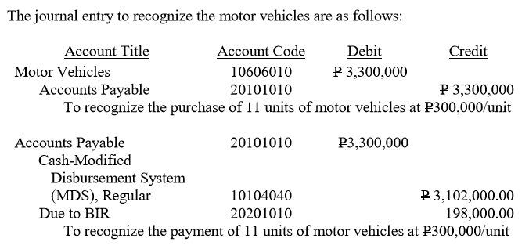
Accounting Entry

Slide 40
Example Problem 2
Promotional Item is different from PPE purchased
An entity purchased a motor vehicle at P330,000. A window-type air conditioning unit with fair value of P20,000 was received as promotional item. Computation of the cost of motor vehicle is P330,000 – P20,000 = P310,000

Slide 41
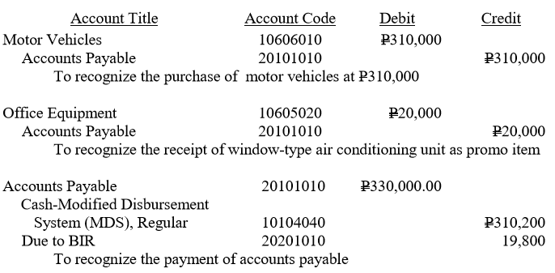
Accounting Entry

Slide 42
PPE Depreciation
Depreciation – is the systematic allocation of the depreciable amount of an asset over its useful life.
Depreciation shall be for one month if the PPE is available for use on or before the 15th of the month. However, if the PPE is available for use after the 15th of the month, depreciation shall be for the succeeding month
Except for land and not recognized heritage assets, all PPE shall be depreciated
Reference : Chapter 10, Section 27 of Volume I, GAM
Notes:
NOTE: CLICK ON REFERENCE: IT HAS LINK TO GAM PDF FILE THEN PRESS CTRL+F CHAPTER 10 THEN BROWSE SECTION 27

Slide 43
DERECOGNITION OF INVENTORY/PPE
The carrying amount of an item of PPE shall be derecognized on disposal or when no future economic benefits or service potential is expected from its use or disposal.
A JEV shall be prepared by the Accounting Division/Unit to derecognize the asset from the books of accounts only after its disposal;

Slide 44
con’t... DERECOGNITION OF INVENTORY/PPE
Disposal procedures of unserviceable property shall be in accordance with applicable rules and regulations on Supply and Property Management Manual, and Sec. 79 of P.D. No. 1445.
Original Copy of Inventory and Inspection Report of Unserviceable Property (Appendix 74 (form), Appendix 74 (instruction) will be submitted to Accounting Division as basis of adjusting the affected accounts
Notes:
N0TE: JUST CLICK ON THE LINK P. D NO. 1445 AND APPENDIX 74 (FORM), APPENDIX 74 (INSTRUCTION)

Slide 45
AGRICULTURE
AGRICULTURAL ACTIVITY
is the management by an entity of the biological transformation and harvest of biological assets for sale, including exchange or non-exchange transactions,
for conversion into agricultural produce,
or into additional biological assets.
(Par. 9, PPSAS 27)

Slide 46

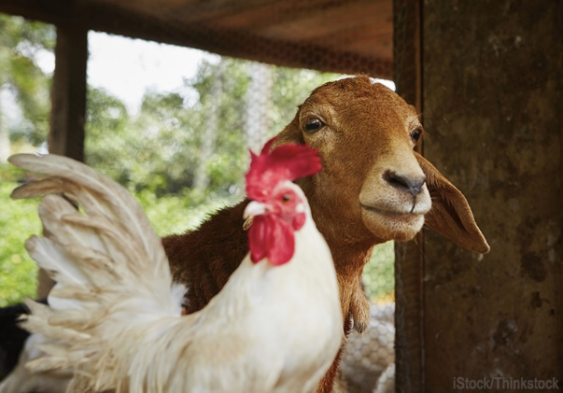
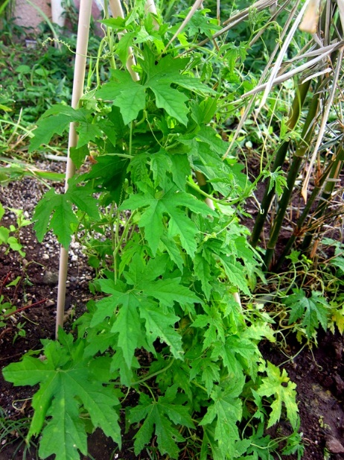
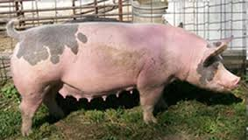



BIOLOGICAL ASSETS
is a living animal or plant. (Par. 9, PPSAS 27)

Slide 47
Classification of Biological Assets
Consumable
Bearer
Held for harvest as agricultural produce or for sale or distribution at no charge or for a nominal charge
Used repeatedly or continuously for more than one year in an agricultural activity
Self - generating

Slide 48
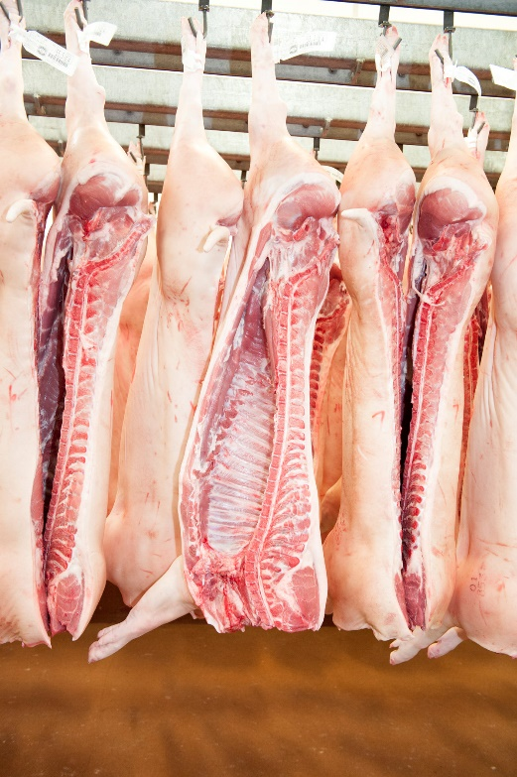



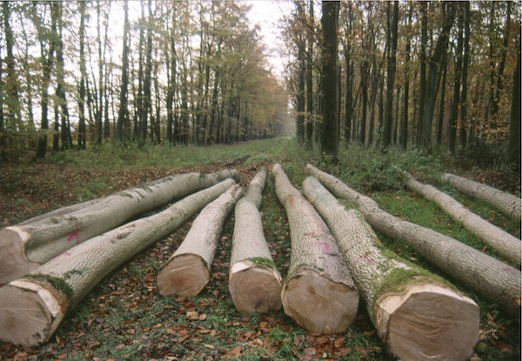
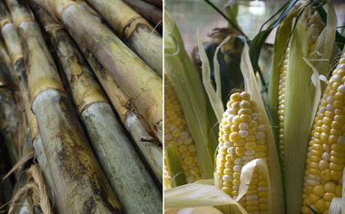

AGRICULTURAL PRODUCE
the harvested product of the entity’s biological assets (Par. 9, PPSAS 27)

Slide 49
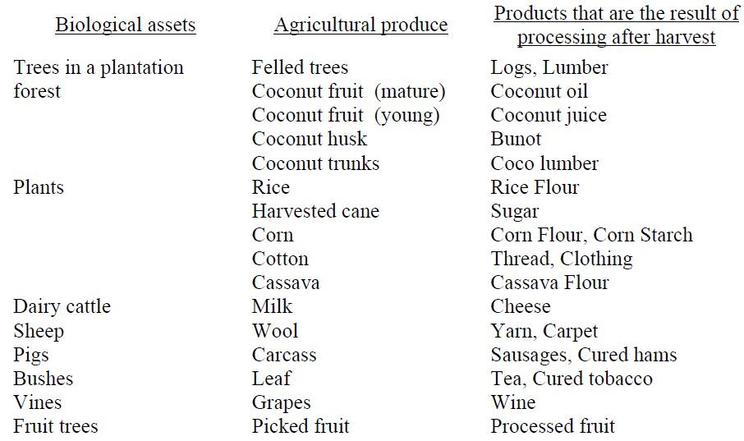
Example of Biological Asset,
Agricultural Produce and Products

Slide 50
Measurement
A. Biological Assets
1. Initial Recognition and at each reporting period
Fair value (FV) less costs to sell
2. FV is clearly unreliable
Cost less any accumulated impairment losses

Slide 51
con’t... Measurement
B. Agricultural Produce
Fair Value less cost to sell at the point of harvest

Slide 52
Determination of Fair Value
1
Group according to significant attributes
2
Existence of contracts
3
Deduct from the fair value of combined assets
4
Existence of the active market

Slide 53
con’t... Determination of Fair Value
If an active market does not exist:
1.
Recent market transaction price
2.
Market prices for similar assets
3.
Sector benchmarks

Slide 54
Accounting Entries – Biological Assets
Initial Recognition
On January 1, 2015 - Purchased two year old breeding stocks at FV less cost to sell of P 3,000.00
Account Title | UACS Code | Debit | Credit
Breeding Stocks | 10701010 | 3,000.00
Cash in Bank - LCCA | 10102020 |  | 3,000.00
To recognize purchase of two year old breeding stocks.

Slide 55
con’t... Accounting Entries – Biological Assets
Recognition of Changes in FV (due to physical change)
On July 1, 2015, born two breeding stocks with FV less cost to sell of P 2,000.00 each
Account Title | UACS Code | Debit | Credit
Breeding Stocks | 10701010 | 4,000.00
Gain on Initial Recognition of Biological Assets | 40501050 |  | 4,000.00
To recognize two new born breeding stocks with FV less cost to sell at P 2,000.00 each

Slide 56
con’t... Accounting Entries – Biological Assets
For detailed discussion and illustrative example, please refer to Chapter 11, Agriculture, Sec. 12. Illustrative Accounting Entries, p. 221 – 224, Volume I, GAM

Slide 57
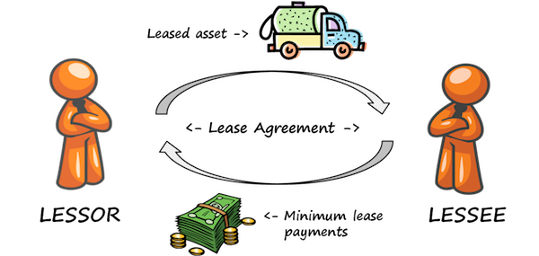
LEASES
is an agreement whereby the lessor conveys to the lessee, in return for a payment or series of payments, the right to use an asset for an agreed period of time.

Slide 58
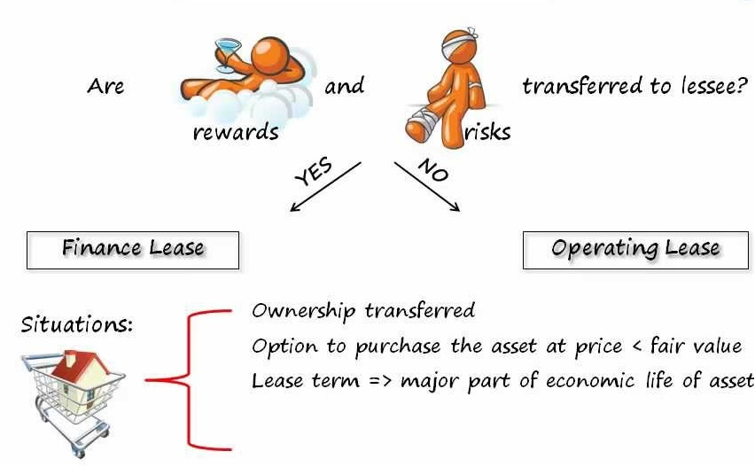
Classification of Leases
Present value of MLP = > close to fair value
Leased assets are of such a specialized nature

Slide 59
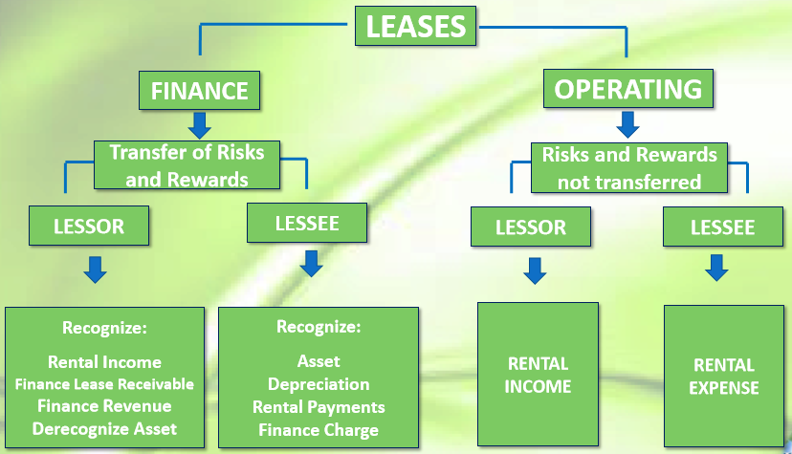
con’t... Classification of Leases
Notes:
Source: COA-GAS Presentation, December 7 – 11, 2015, Department of Agriculture, Quezon City

Slide 60
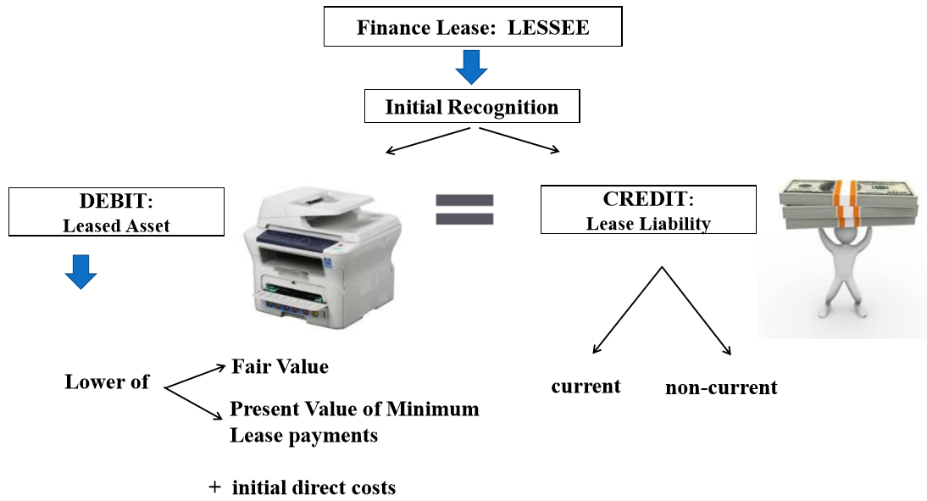
FINANCE LEASE
Finance Lease is an example of Modes of Acquisition of PPE. (Chapter 10, Section 18, p. 181, Volume I, GAM) ex. Rent To Own
Notes:
Source: COA-GAS Presentation, December 7 – 11, 2015, Department of Agriculture, Quezon City

Slide 61
Sample Problem
Lease Term – 5 years
Useful Life – 5 years
FV of Equipment – P100,000
Annual Payment – P26,380 (due every Dec. 31, 2014 - Dec. 2018)
Implicit interest rate (known to lessee) – 10%
PV of an ordinary annuity of 1 = 3.79079
Notes:
Source: COA-GAS Presentation, December 7 – 11, 2015, Department of Agriculture, Quezon City

Slide 62
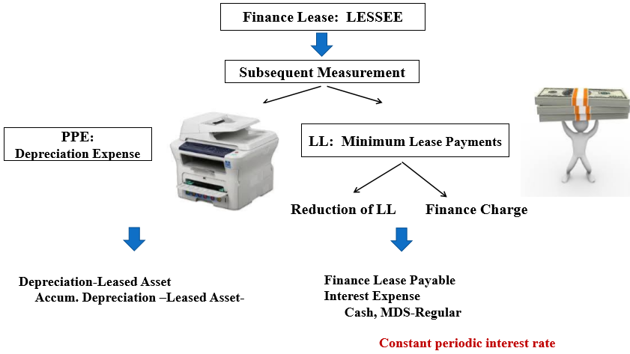
Accounting for Finance Leases
ACCOUNTS | UACS Code | LESSEE
Leased Assets, Machinery and Equipment | 10608030 | 100,000
Finance Lease Payable | 20101070 |  | 100,000
To recognize lease payable (Jan. 2, 2014)
Notes:
Source: COA-GAS Presentation, December 7 – 11, 2015, Department of Agriculture, Quezon City

Slide 63
Sample Schedule of Amortization
Date | Payment/ Receipt | Interest (10%) | Decrease in Balance | Outstanding Balance
01/01/14 |  |  |  | 100,000
12/31/14 | 26,380 | 10,000 | 16,380 | 83,620
12/31/15 | 26,380 | 8,362 | 18,018 | 65,603
12/31/16 | 26,380 | 6,560 | 19,819 | 45,783
12/31/17 | 26,380 | 4,578 | 21,801 | 23,982
12/31/18 | 26,380 | 2,398 | 23,982 | -
100,000 x 10% = 10,000
100,000 – 16,380 = 83,620
26,380 – 10,000 = 16,380
Notes:
Source: COA-GAS Presentation, December 7 – 11, 2015, Department of Agriculture, Quezon City

Slide 64
con’t... Accounting for Finance Leases
ACCOUNTS | UACS Code | LESSEE
Finance Lease Payable | 20101070 | 16,380
Interest Expenses | 50301020 | 10,000
Cash – MDS Regular | 10104040 |  | 26,380
To record 1st lease payment – December 31, 2014
ACCOUNTS | UACS Code | LESSEE
Depreciation – Leased Assets (M&E) | 50501080 | 19,000
Accumulated Depreciation – Leased Assets, Machinery and Equipment | 10608031 |  | 19,000
To record depreciation for December 31, 2014 (100,000 – 5,000) / 5 = 19,000
Note: For the 2nd to the 5th year, the illustrative entries shall be the same using the amount of interest expense and the reduction of lease liability shall be based on per amortization table while the annual depreciation expense shall be uniform up to the 5th year.
Notes:
Source: COA-GAS Presentation, December 7 – 11, 2015, Department of Agriculture, Quezon City

Slide 65
LIABILITY MANAGEMENT
will be discussed separately on the next session
Notes:
will be discussed further on the next session

Slide 66
PHYSICAL AND FINANCIAL REPORTING
School report card (src)
SRC is the main document that is prepared to show information on accomplishments and financial resources

Slide 67
con’t... PHYSICAL AND FINANCIAL REPORTING
IMPORTANCE OF SRC
The SRC is a document to communicate to all school stakeholders the status of the school and the conditions under which it operates.
2
It is meant to encourage more participation in terms of support that may be given by stakeholders in whatever form as well as acknowldege that which they have already given
1
DO No. 44, s. 2015 details the guidelines on the preparation of the SRC

Slide 68
con’t... PHYSICAL AND FINANCIAL REPORTING
Deped order no. 44, S. 2015
Aims to standardize reporting done by schools as well as guide and encourage schools to pay particular attention to certain items of interest to management and all other stakeholders

Slide 69
con’t... PHYSICAL AND FINANCIAL REPORTING
In accordance with RA 9485 (Anti-Red Tape Act of 2007), schools are mandated by law to have a Transparency Board on MOOE posting all school expenditures using the allocated funds.
The transparency board must be located in a place open to public view and frequented by the school’s stakeholders
ACCOUNTING FORMS - SBFM

Slide 70
Thank You!

