Slide 1
Session 3.0
PROVIDENT FUND
Notes:
1- Service fees is not part of the estimates supporting DepEd budget (since it is not automatically appropriated to us).

Slide 2
Session Overview
Legal Basis
Beneficiaries
Accounting Entries

Slide 3
Learning Objective
To ensure that all service fees from PLI are duly collected, accounted, recorded and remitted to BTr in accordance with rules and regulations

Slide 4
A. Legal Basis
The Provident Fund of DepED has been established under Administrative Order No. 279, s. 1992. It started operation in January 1995 through receipt of seed money in the amount of Seventy five million pesos (P75 million) representing Collection of Service fee from GOCCs and PLIs deposited to BTr.
Notes:
Notes:
1- Include the process flow (application/release of loans and unit responsible at CO/RO/DO)
- Coordinate with the former Welfare Division at CO and the Board for the appropriate process flow
- Process of Payment – Accounting; Computation/Approval – Admin unit
- Recommendation/s: Board to review policy, guidelines and implementation arrangements
2- For discussion with the Board (Chaired by the USec. for Finance): Computation on the distribution of the collections made for service fees.
3. (issue on process flow from source of fund to release of loans)

Slide 5
con’t... Legal Basis
The fund is intended as a lending facility for regular teaching and non-teaching personnel, including contractual employees of DepEd nationwide. DECS Order 3, s. 1999 and DepEd Order No. 12, s. 2004 was issued as Implementing Guideliness for the DepED Provident Fund CO, RO, DO and IUs.

Slide 6
B. Beneficiaries
The beneficiaries of the Fund are teachers, administrative staff (non-teaching) and Officials of Central, Regional, Division and other Field Offices of DepEd who have permanent status of employment and under the regular payroll deduction scheme.

Slide 7
con’t... Beneficiaries
Casual, contractual and co-terminus employees are also entitled in the program provided that:
1
they have been in the service with the DepED for at least two (2) years and/or
2
they have earned one hundred (100) or more days of leave credits

Slide 8
FLOWCHART OF PROVIDENT FUND
Flowchart of Provident Fund
Notes:
Click the title to see the whole process

Slide 9
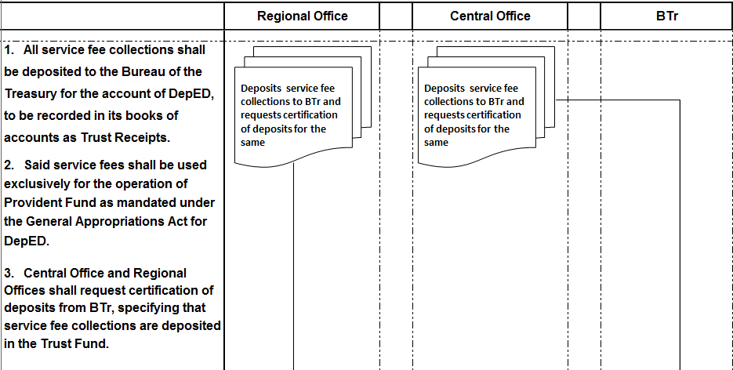
con’t… FLOWCHART OF PROVIDENT FUND

Slide 10
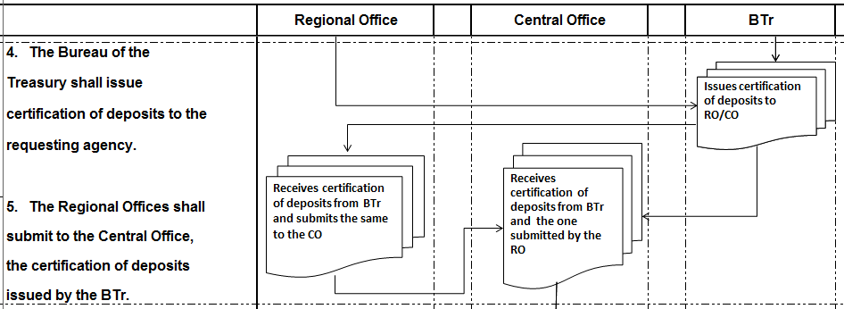
con’t… FLOWCHART OF PROVIDENT FUND

Slide 11
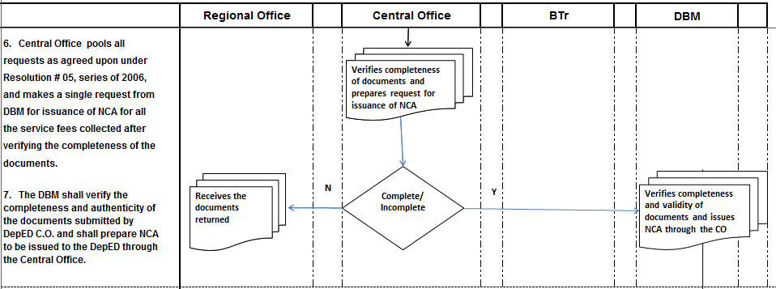
con’t… FLOWCHART OF PROVIDENT FUND

Slide 12
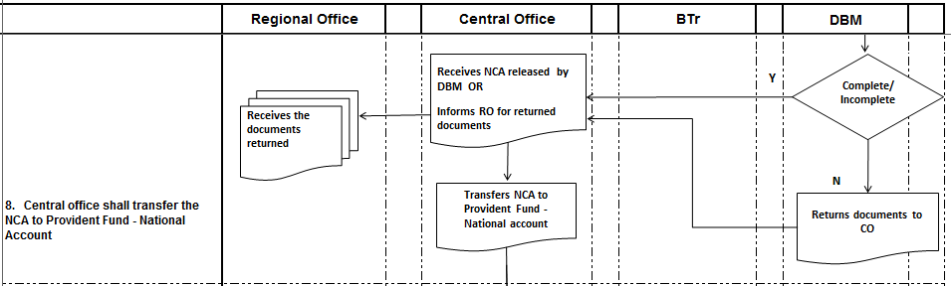
con’t… FLOWCHART OF PROVIDENT FUND
Notes:
YUN I SA INCOMPLETE

Slide 13
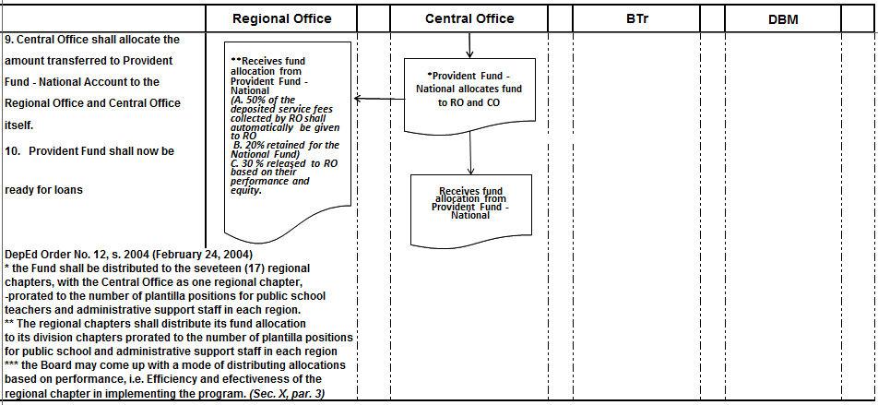
con’t… FLOWCHART OF PROVIDENT FUND

Slide 14
Accounting Entry for Provident Fund
ILLUSTRATIVE ACCOUNTING ENTRIES FOR FUND TRANSFER FROM DEPED - CO TO IMPLEMENTING UNITS

Slide 15
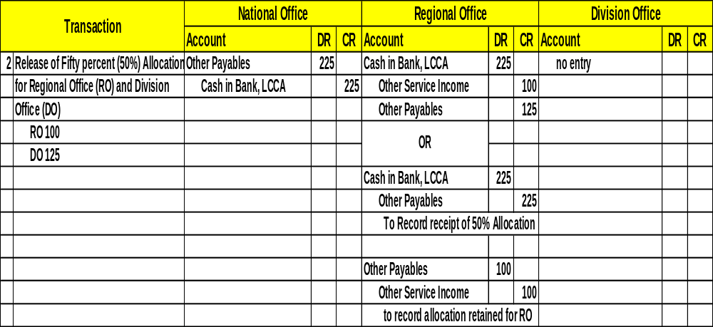
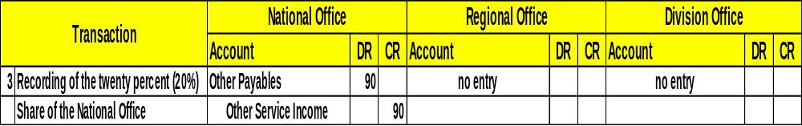
con’t... Accounting Entry ...

Slide 16
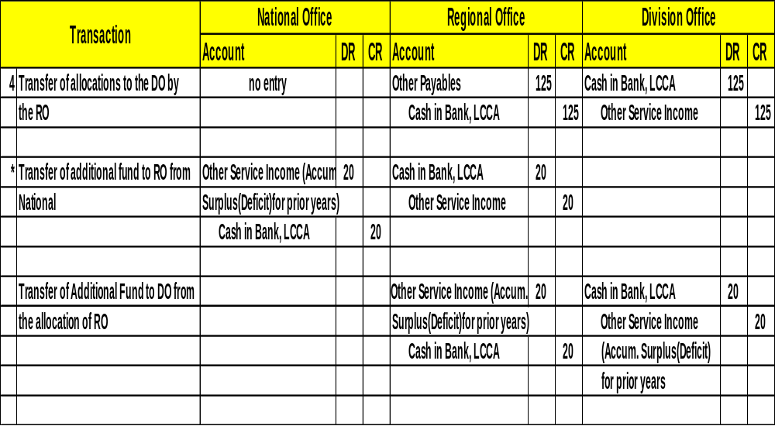
con’t... Accounting Entry ...

Slide 17
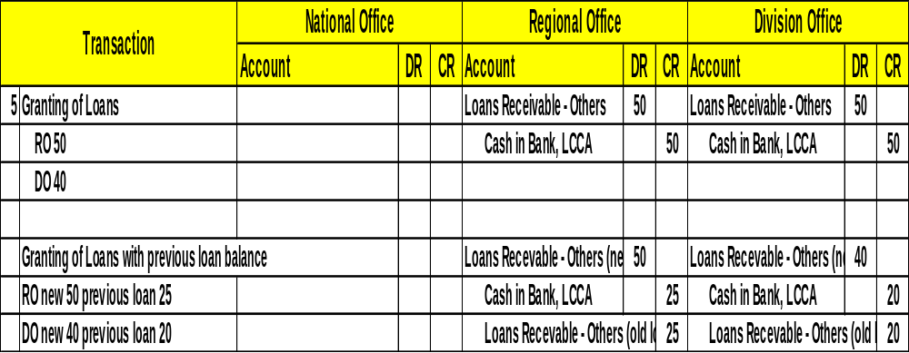
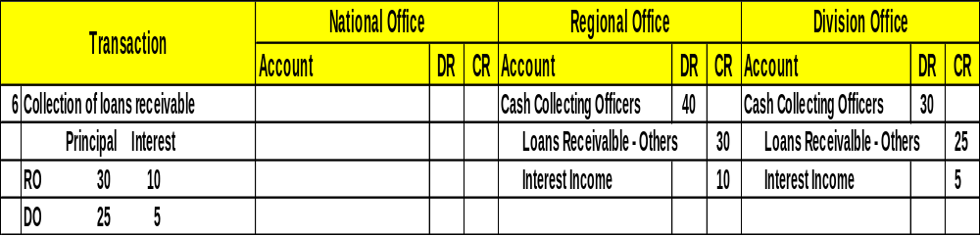
con’t... Accounting Entry ...

Slide 18
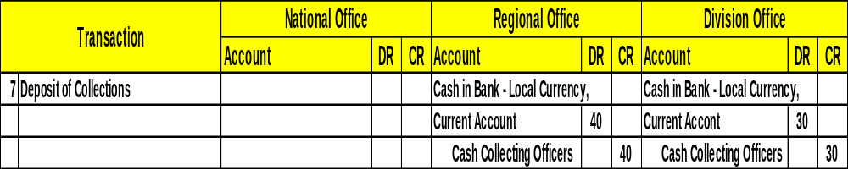
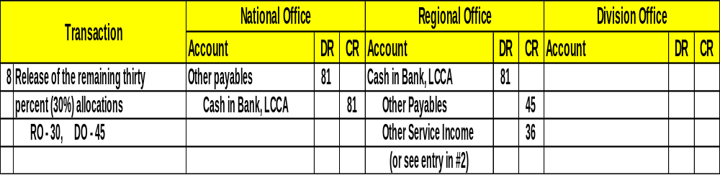
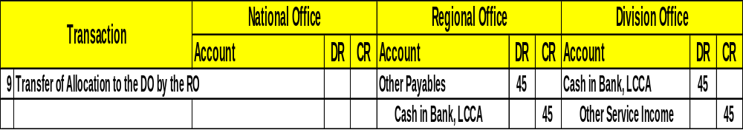
con’t... Accounting Entry ...

Slide 19
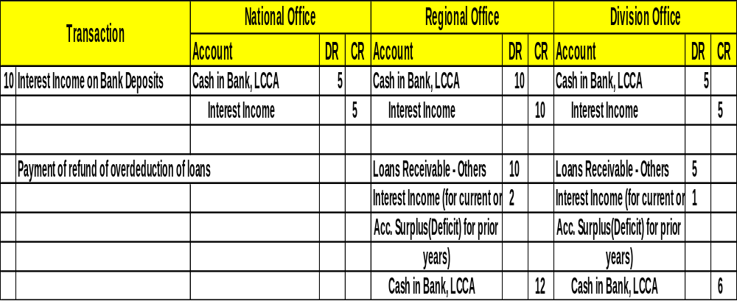
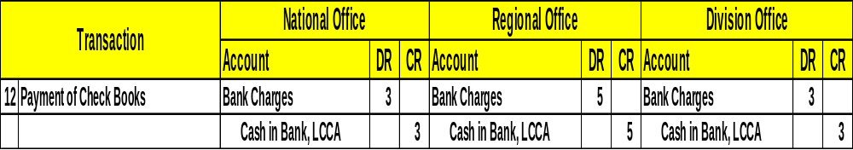
con’t... Accounting Entry ...
Notes:
11. Payment of honoraria were removed

Slide 20
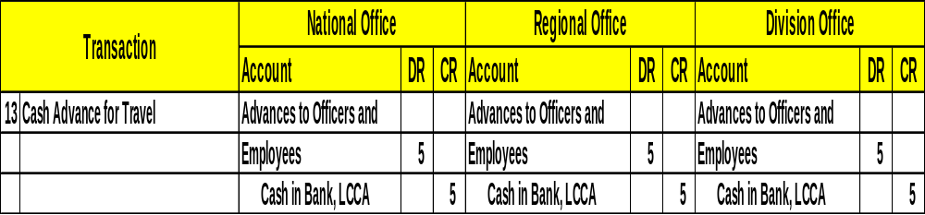
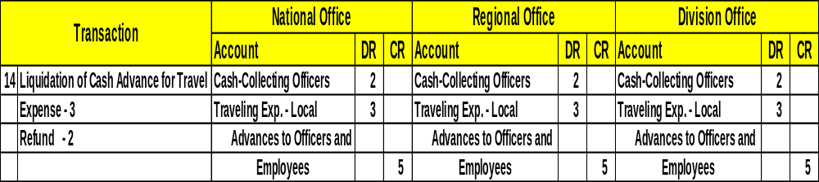
con’t... Accounting Entry ...
Notes:
NOTE: PLEASE EDIT ON YOUR HANDOUT ACCOUNTING ENTRY NO 13 VALUES

Slide 21
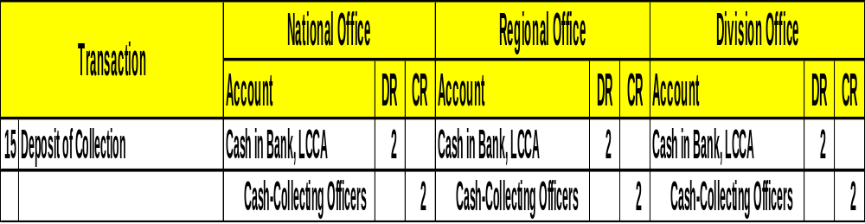
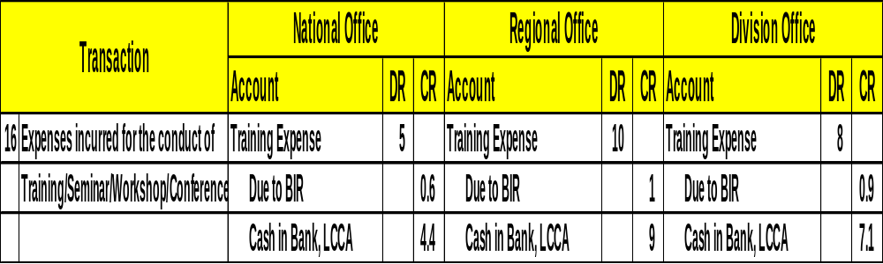
con’t... Accounting Entry ...

Slide 22
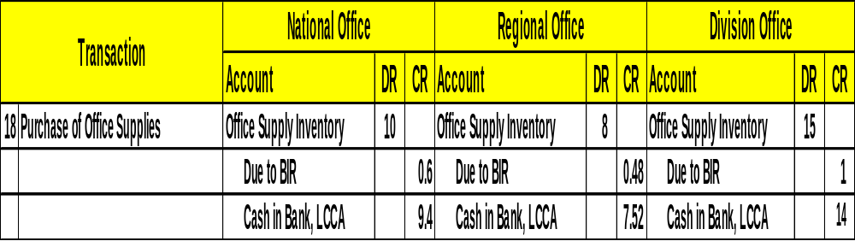
con’t... Accounting Entry ...

Slide 23
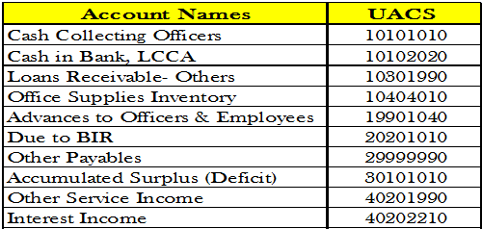

con’t... Accounting Entry ...
UACS CODE

Slide 24
Thank You!

