Slide 1
Session 1.0
FMOM Training Module on Budget Processes

Slide 2
Session Overview
Overview of Government Budget Cycle, Processes & Functions
(1 hour/A. Ruiz)
- Processes (Preparation, Legislation, Execution, Accountability)
- Functions/ Roles of Budget Units and Budget Officer
1
Learning Guides and Tools
(1 hour/G. Morong)
- Tools (e-BMS, Spreadsheets)
- Guides
2
Simulation Exercise (Practice Sets)
(1 hour & 30 minutes/G. Morong & G. Guledew)
- Financial Analysis
- Report Generation using the e-BMS
3

Slide 3
Session Overview
Development of an FMOM Training Module for DO Budget (1 hour/S. Briones)
- Presentation of Outputs (RO Budget Officers)
4
Development of Training/CB Plan for DO Budget Staff
(45 minutes/A. Ruiz)
- Presentation of Outputs (RO Budget Officers)
5

Slide 4
Learning Objective
To improve and establish a strong linkage between the processes of planning, budgeting and procurement.
Ensure that all levels of the organization understands the basic principles, standards, policies and guidelines in planning, budgeting and procurement processes.

Slide 5
Learning Results
Understand the basic concepts and fundamentals of financial management and budget processes.
Understand the functions/roles of the Budget Officers.
Strict compliance with current/existing policies and guidelines on budget processes.
Familiarity on various Budgetary Forms as prescribed in the Budget Call and the Government Accounting Manual (GAM).

Slide 6
Learning Results
Develop an effective training module using the FMOM responsive to the financial operations of the DOs → schools
Develop a monitoring tool/ instrument on the implementation or use of the FMOM
Identify technical assistance/support requirement of DO Budget Units
Develop training/capacity-building plan for Budget Officers

Slide 7
Learning Results
Develop a realistic work and financial plan at all levels of the organization.
Improve timely submission of budget accountability reports (BFARs and Monthly Flash reports) by maximizing the use of existing tools, e.g. Budget Monitoring System (BMS).
Compliance to the application of UACS in all financial transactions as prescribed in the GAM.

Slide 8
BUDGET CYCLE
These four phases of the budget cycle overlap in continuing cycles every year. For instance, while the Executive implements the budget for the current year, it also prepares the budget for the next fiscal year or defends it before Congress. Meanwhile, the execution and accountability phases are implemented simultaneously year-round.
          Preparation
          Legislation
          Execution
          Accountability

Slide 9









Preparation
Start
Budget Call
Stakeholder
Engagement
Technical Budget
Hearing
Executive Review
Presentation to the
President and Cabinet
Consolidation,
Validation &
Confirmation
President’s Budget

Slide 10





Legislation
House Deliberation
Senate Deliberation
Senate Deliberation
President’s Enactment and Veto
Reflection and
Enrollment

Slide 11








Execution
Release Guidelines
And Program
Budget Execution
Allotment and Cash
Documents
Release Programming
Allotment Release
Allocation
Disbursement
Incurring

Slide 12





Accountability
Performance Target
Budget Accountability
Quarterly Agency
and Outcomes
Reports
Performance Review
Year End Budget
Performance Assessment
Review

Slide 13
Functions of the Budget Division/ Unit
Government’s Budget Cycle
General Functions of the Budget Division /Units
Budget Preparation/ Legislation Authorization Phase
Budget Execution
Budget Accountability/ Reporting
Basic Coordination
Policy Guidance
Supervision of Budget Implementation

Slide 14
Detailed Function of the Budget Division/Unit
Budget Preparation and Legislation/ Authorization Phase
Develop and improve budgetary methods, procedures and justification;
Assist in the preparation of budget documents and ensure its submission to DBM in the ensuing year;
Review/ evaluate/ recommend budget proposals of various DepEd units
Fund allocation to DepEd units based on indicative budget ceiling
Oversee the submission of data/ documents in support of the budget proposal
Prepare and submit to DBM the consolidated budget proposal
Provide technical support to management in the presentation and defense on the agency’s budget proposal

Slide 15
Function of the Budget Division/Unit
Budget Execution Phase
Prepare Monthly Disbursement Program (MDP) based on GAARD
Provide technical assistance in the application and utilization of budgetary methods and procedures
Prepare special budgets on requests for fund release to implementing units
Process obligation of allotments and issuance of sub-AROs
Manage, record and control fund allocation and utilization
Process related budget communications

Slide 16
Function of the Budget Division/Unit
Budget Accountability/ Reporting Phase
Oversee the submission and consolidation of BEDs/ BARs and related documents
Prepare RAODs (PS, MOOE, FE & CO)
Prepare FARs
Assist DepEd units in the agency performance review
Provide Management with periodic reports and technical advice on Budget

Slide 17
Functions of a Budget Officer vis-à-vis Functions of the Budget Division/ Unit
Reviews, evaluates, and consolidates budget proposals of the different operating units, and as recommended by the Program Committee (ProgCom).
Attend budget hearings of the agency and receiving officials
Coordinates with oversight agencies related to the agency’s approval of its budgetary request
Budget Preparation, Legislation and Authorization

Slide 18
Functions of a Budget Officer vis-à-vis Functions of the Budget Division/ Unit
Coordinates the prioritization and allocation of funds/ resources based on budget ceilings and allocable amounts
Monitors actual expenditures vis-à-vis budget releases
Assists operating units in their budget implementation
Budget Execution

Slide 19
Functions of a Budget Officer vis-à-vis Functions of the Budget Division/ Unit
Prepares/ submits timely financial accountability reports to management and oversight agencies
Monitors actual expenditures vis-à-vis budget releases
Communicate to the various operating units status of their budget allocations
Reviews and analyze budgetary request and prepares corresponding action
Budget Accountability/Reporting

Slide 20
Applications of the BMS for the Practice Sets
Learning Guides & Tools
FMOM
UACS
GAM
e-BMS
Process Documents
GAARD & NEP
ORS: Salary/PS MOOE (incl. Training, Travelling, Supplies/Materials and Cash Advance), CO (ICT, Furniture and Fixtures, Office equipment)
Simulation Exercise
(Outputs)
DVs, RCI,
ADA, TRA, JEV
RAOD, PS, MOOE
FE, CO
FARS:
1, 1A, 1B
Report Analysis:
Utilization Rate

Slide 21
Application of the BMS Training Module for DOs
BMS Overview
BMS Training Module

Slide 22
Simulation Exercise
Pre-requisites
All pax should be familiar with the basic principles on Budget, Accounting, Audit and Procurement processes
Each pax/ RO should bring their own laptop installed with MS Access
Practice set/ process documents prepared by CO to RO → DO → Schools

Slide 23
Development of the FMOM Training Module for DOs
Module Overview
Objectives
Activities/ Strategies / Methods
Practice Sets
Learning Objectives
Learning Results
Simulation Exercise
Training Module for DO → Schools

Slide 24
Development of a Training/CB Plan for Professional Development of DOs
Purpose/ Rationale
Overview
Objectives
Linkage with Office Function (OPCRF)
Skills requirement
Staff Competency Profile
List of Trainings
e.g. Financial Analysis
e.g. Statistical Analysis
e.g. Computer Applications

Slide 25
THANK YOU

Slide 26
ASSET MANAGEMENT
Session 2.0

Slide 27
Asset
Are resources controlled by an entity as a result of past events, and from which future economic benefits or service potential are expected to flow to the entity.
If an expenditure is instead consumed within the current Period, it is classified as an expense.

Slide 28
Classification of Asset
Short-Term Asset
Cash
Marketable Securities
Accounts Receivables
Prepaid Assets
Long-Term Asset
Land
Buildings
Office Equipment
Furniture and Fixtures
Softwares

Slide 29
Asset Management
Is a systematic process of deploying,
operating, maintaining, upgrading and
Disposing of assets cost effectively.

Slide 30

State Policy
“All resources of the government shall be managed, expended or utilized in accordance with law and regulation, and safeguarded against loss or wastage through illegal or improper disposition, with view to ensuring economy, efficiency and effectiveness in the operation of the government”

Slide 31



Phases of Property and Supply Management
Acquisition
Procurement
Delivery
Inspection
Acceptance of Delivery
Utilization
a. Recording & maintaining
SC & PC
b. Preparation of Issuance
Documents (RIS, PAR & ICS)
c. Preparation of Inventory
Report (Semi-Annual & Annual)
Inventory
Taking
Disposition
Transfer of Property
Sale of Unserviceable

Slide 32

Modes of Acquiring Government Property
The following are the modes of acquiring property, whether supplies, materials, equipment or land, in government:
1. Purchased
2. Constructed
3. Acquired (Transfer/Donation)
Non-Exchange Transaction
  Donation without Condition
  Donation with Condition
  Grant
  Intra-Agency Transfer
  Inter-Agency Transfer
Exchange Transaction

Slide 33




Role of Supply Officer / Property Custodian
1. Accepts delivery / transfer / donations
(duly signed PO / Contract / Deed of
Donation and MOA)
2. Signs Inspection and Acceptance Report
3. Records delivery / transfer / donations thru Property Card and Stock Card (duly inspected from a perfected PO or Contract, formal turn-over thru IRP or duly accepted or signed Deed of Donation)
4. Prepares Issuance Documents Property Acknowledgement Receipt (PAR) and Inventory Custodian Slip (ICS)
5. Conducts Inventory Taking and Maintains PC & SC
6. Prepares Inventory Report including (monitoring the actual location of asset, condition of asset and Person Accountable) as required by COA

Slide 34



Procedures on:
Delivery
Inspection &
Acceptance

Slide 35


The delivery of supplies, materials and equipment must be made by the supplier/Manufacturer/contractor :
In accordance with the
specifications, terms and
conditions provided in the
Contract/Purchase Order
Within the stipulated period
and at the place/s indicated
in the PO or contract

Slide 36


Failure to deliver within the prescribed period, the supplier / manufacturer / contractor shall be liable for penalty, usually in the form of :
“LIQUIDATED DAMAGES”
1/10 OF 1%
Once the accumulative amount of
Liquidated damages reaches 10%
of the contract, the procuring entity
can rescind the contract

Slide 37
Extension of time to deliver may be
granted for the following reason:
Force Majeure
Fortuitous Event
Beyond the control of the contractor
Delay is attributable to the purchaser
or the like

Slide 38


The Supply Officer / Designated Property Custodian shall receive all the deliveries and signs the Delivery Receipt (DR) if the delivered goods are in accordance with the contract or Purchase Order (PO).
Supply Officer/Designated Property Custodian signs “Received” portion of the original and copy 2 of Delivery Receipt (DR)
If not, he/she may reject the deliveries
until the supplier complies with the end-users specifications

Slide 39
Inspection
All items to be inspected shall be accepted first by the Property Officer/School Property Custodian, as the case may be (Section 114, COA Circular 92-386)
The above provision pertains only to the receipting/signing on the delivery receipt (DR) and temporary recording of the deliveries upon arrival of goods or articles. The deliveries are still subject to inspection for conformity with specifications on the order.

Slide 40

Supply Officer/Designated Property Custodian forwards Original DR & Copy 2 of Approved PO to Inspection Committee for inspection of deliveries

Slide 41

The Head of Office or school shall constitute an Inspection Committee to inspect and validate deliveries

Slide 42

The School Inspection Committee shall be composed of :
Regular Members:
a). Team Leader – at least 2nd ranking permanent official of school
b). One (1) school personnel designated by the principal who has knowledge/technical expertise relevant to the goods delivered
Provisional Member:
a). One (1) representative from PTA or NGOs

Slide 43
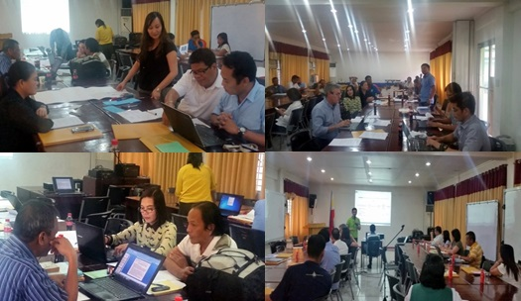
The Division Office Inspection Committee shall be composed of :
Regular Members:
a). Team Leader – at least 3rd ranking permanent official of the procuring entity
b). One (1) representative from any of the regular offices under the Office of the Schools Division Superintendent (SDS) such as, but not limited to the following
* Administrative Unit
* Budget Unit
* Legal Unit
* Physical Facilities Unit
Provisional Member:
a). Representative from the procuring entity who has knowledge/technical expertise relevant to the goods delivered

Slide 44
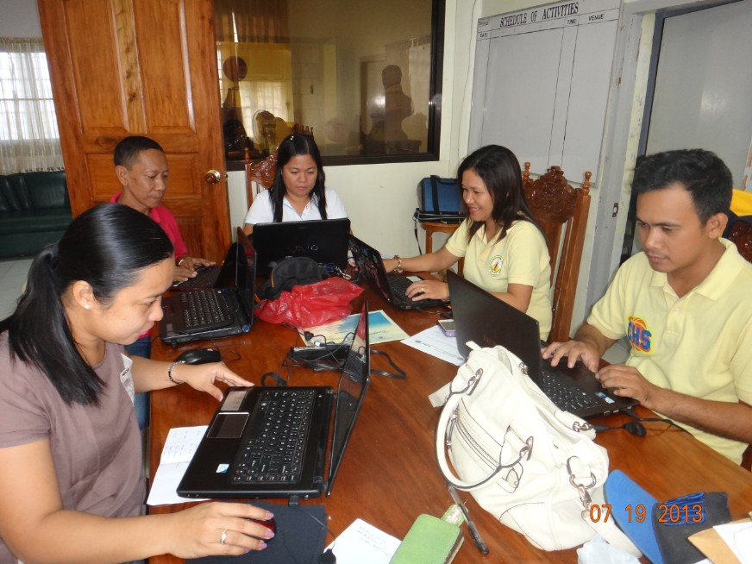
The Inspectorate Team and the Supply Officer / Designated Property Custodian shall prepare the Inspection and Acceptance Report (IAR)
Note: Distribution of IAR shall be as
follows
Original – Property and/or Supply Division/Unit (to be attached
        To DV, together with the
        Original DR
2. Copy 2 – Property Inspector /
Inspection Team
3. Copy 3 - Accounting Division/Unit
(attached in setting up
payables)
4. Copy 4 - Property and/or Supply
Division/Unit File

Slide 45

The Office/School inspection Committee shall sign the Inspection and Acceptance Report prior to acceptance by the Supply Officer/School Property Custodian.

Slide 46
Utilization Phase
Recording

Slide 47
Procedures in the Requisition and Issue of Inventory Items and PPE
Requesting Office
Requesting Personnel prepares RIS in 3 copies and fills-up necessary information
Requesting Personnel forwards the RIS to authorized official for review
Authorized Official signs RIS after determining the reasonableness of the quantity and nature of item/s being requested and ensures that the same does not exceed the planned usage for the period
Property and/or Supply
Division/Unit
Receives RIS from Requesting Personnel. Reviews and verifies the completeness of information. Indicates “P” in the Stock Available? Yes Column if item being requisitioned is/are available on stock, or “X” in the stock available? No column if not available
Requesting Personnel forwards signed RIS to Property/Supply Unit/Division

Slide 48
Utilization Phase
Issuance
is the act of transferring the custodianship of property from one person to another

Slide 49
POLICIES ON THE APPLICATION OF THRESHOLD
Tangible Items below the capitalization threshold of P 15,000.00 shall be accounted as semi-expendable property.
** Minimum cost of the individual asset
*** Individual item below the threshold but work together as one network of asset, the amount exceeds the threshold
**** the P15,000.00 shall not be applied to the aggregate value of PPE acquired in bulk

Slide 50
Accountability over Semi-expendable Property
“it shall be issued to end-user to establish accountability over them. Accountability shall be extinguished upon return of the item to the
Property and Supply Division/Unit or in case of loss, upon approval of the relief from property accountability”

Slide 51
Recording deliveries thru Stock and Property Card
Stock Card
Expendable, Semi-Expendable and equipment < P 15,000.00
threshold
Inventory Custodian Slip (ICS)
Property Card
Property, Plant and Equipment > P 15,000.00 threshold
Property Acknowledgement Receipt (PAR)

Slide 52
Preparation of Issuance Documents
RIS
Requisition and Issue Slip
The RIS shall be distributed as follows:
1. Original - Accounting Division/Unit
2. Copy 2 - Requesting Office
3. Copy 3 - Property and/or Supply Division/Unit
Note: For use of Report of Supplies and Materials Issued (RSMI)

Slide 53





Activities in Property Utilization
Issuance and acknowledgement of items
PAR
ICS
Property Acknowledgement Receipt
Inventory Custodian Slip
Property, Plant & Equipment (IT Equipment, Office Equipment, office furniture and Library Books more than
P15,000.00)
Non-Consumable Supplies (including textbooks, school furniture)
(Office furniture & Office/ICT equipment less
than P 15,000.00)
Note: 2016 GAM indicates Accountability Over Semi-Expendable Property

Slide 54
DISPOSAL

Slide 55
DISPOSAL – is the end of the life cycle of
a government property

Slide 56
Disposal Objectives
to avoid continuing carrying/inventory costs
to prevent further deterioration thereby obtaining the fair return in case of sale
to relieve accountable officers of unnecessary accountability
to make available space for the agency

Slide 57
Determination of Disposable Property
Can no longer be repaired or reconditioned
Maintenance/repair costs more than or outweighs the benefits and services
Has become obsolete or outmoded
Has been rendered unnecessary due to change in the Agency’s functions/mandate
In excess of requirements
Has become dangerous or hazardous to use

Slide 58
Modes of Disposal
Condemnation / Destruction
Transfer of Property
Donation of Property
Sale of Unserviceable Property

Slide 59
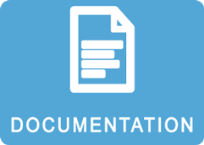

Slide 60

Inventory and Inspection Report of Unserviceable Property (IIRUP)
This form is used for :
  disposal of vehicles,
  office equipment,
  furniture, and
  other properties, plant and equipment
  which can no longer be repaired or
  reconditioned and whose maintenance
  cost of repair more than outweighs the
  benefits and services that will be
  derived from its continued use.

Slide 61
Inventory and Inspection Report of Unserviceable Property (IIRUP)

Slide 62
Waste Materials Report
This form shall be used:
  to report all waste materials previously taken up in the books as assets so that they may be properly disposed of and dropped from the accounts
  in the disposal of waste materials which result from the consumption or utilization of expandable materials, and covers damaged equipment parts, empty containers, and remnants salvaged from destroyed or damaged property, plant and equipment.

Slide 64
Thank You

