Slide 1

Enhanced SIP, SRC, & RPMS Integration

Slide 2
School Effectiveness Division Charter
Purpose: The School Effectiveness Division supports and enables schools to continuously improve its own governance and delivery of quality basic education services that are responsive to the diverse needs of its learners.
Summary of Functions/Scope:
Formulation of School Effectiveness Framework
Establishment of standards for governance to support effective schools
Application and monitoring of school performance management standards
Accreditation of Schools and Learning Centers

Slide 3
Overview of Current Thrusts
School Effectiveness Framework
Continuing the School-Based Management Initiatives
  District Synthesis
  School Governing Council
  User Guide on SBM Assessment
  External Accreditation of Schools
  School Re-structuring using School Typology
  School Process Improvements using Continuous Improvement Program
  School Improvement Planning and School Report Card

Slide 4
Policy Bases
The SIP is a roadmap that lays down specific interventions that a school, with the help of the community and other stakeholders, will undertake within a period of three consecutive school years.
D.O. 44, s. 2015
The School Report Card is a tool for advocating and communicating the school situation, context, and performance to internal and external stakeholders
D.O. 44, s. 2015
The RPMS shall align the performance targets and accomplishments with the DepEd’s mandate, vision, mission and strategic goals… The OPCRF shall reflect the Office KRAs, Objectives and performance indicators
D.O. 2, s. 2015

Slide 5

Features of Self-Managing Schools
The learner is at the center of everything we do
Photo from UNICEF Website
Notes:
I’d like to share with you DepEd’s Vision, that is to put the learner at the center of our institutional existence.
We want to transform the image of the public education system as a factory that mass produces learners based on a uniform standard to some sort of a studio where inner beauty of individual learners are brought out and cultivated.

Slide 6

Features of Self-Managing Schools
Investment addresses various needs of learners
Notes:
New approaches to resource allocation are required under these new expectations from schools.
A simple formula of budget to schools based on the size and nature of the school, with sub-allocations based on equity considerations, is not sufficient.
SHARE DEPED EXPERIENCE ON MOOE. DEPED IS STILL ON THIS STAGE.
But we want to have a budget that takes into account of development in personalizing the education services for our learners.

Slide 7

Features of Self-Managing Schools
Maximizes its intellectual
and social capital
Notes:
As mentioned previously, knowledge is a valuable resource but so is social capital. Social capital are social relationships that produce benefits like good will, reputation, partnership, trust, belief in common good.
These are the resources not fully optimized by schools.
With the current thrust of DepEd to maintain budget levels with focus on improving internal efficiency, it is really important to look into ways of tapping these other forms of resources.
There are already existing mechanisms like public-private partnerships but we have to put this in front of our school strategy.

Slide 8

Features of Self-Managing Schools
School governance is participatory
Notes:
School governance is relatively new concept in managing schools. The core idea is education is not the sole responsibility of the school but also of the entire community because only an educated child can build a strong and prosperous nation.
Governance involves interaction between government institutions and civil society. In this kind of governance, power and authority, and influence to enact policies and decisions concerning public life and economic and social development are shared with community members.
Mention PTA and School Governing Council as example.

Slide 9

How can schools become effective organizations?
Notes:
You all know this. A school has to have a vision, mission and concrete objectives about the future.

Slide 10
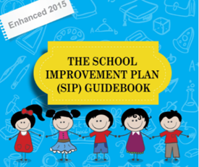
DepEd Order 44, s. 2015
Notes:
An SIP is a medium term fiscal plan. It covers three (3) years of planned operation. During this planning activity, a school involves its stakeholders, e.g., CSOs, LGUs, NGO, PTA or School Governing Council, to encourage active participation in the schools’ management concerns such as improvement of the learners’ performance and sourcing of needed funds.
In DepEd, we have enhanced our school improvement planning process using quality management tools and techniques.
Part of the enhancement is we have integrated relevant policies to it so that it wouldn’t be seen as additional activity that has to be complied with.
Policies we have integrated include:
Assessment of School Hazard
Mapping of children
Assessment of school child friendliness
Performance Management System
School Report Card Policy

Slide 11
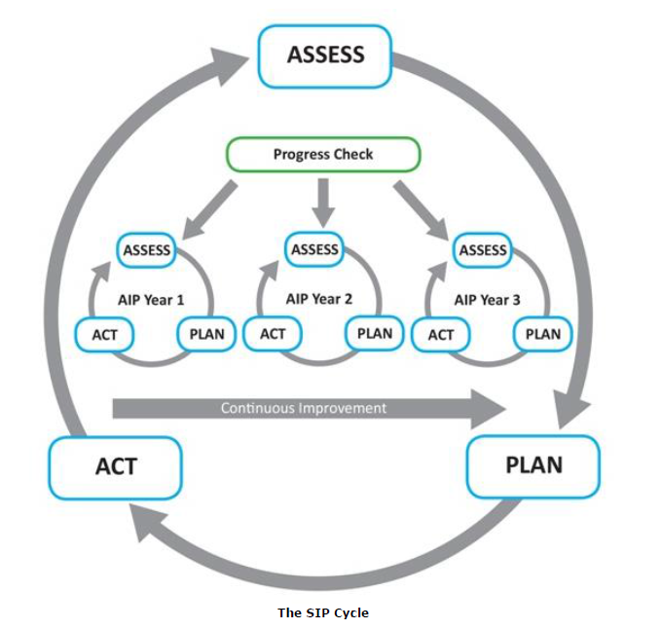
Enhanced SIP Cycle
Plan Monitoring and Evaluation
Situation Analysis
Identification of Strategies,
PAPs, Resource Requirements
Plan Implementation
Notes:
The Annual Implementation Plan (AIP), which identifies the budgetary
requirements of the activities and projects on an annual basis
shall be made out of the SIP prepared, any item not accomplished
for the year shall be included in the AIP of the following year

Slide 12
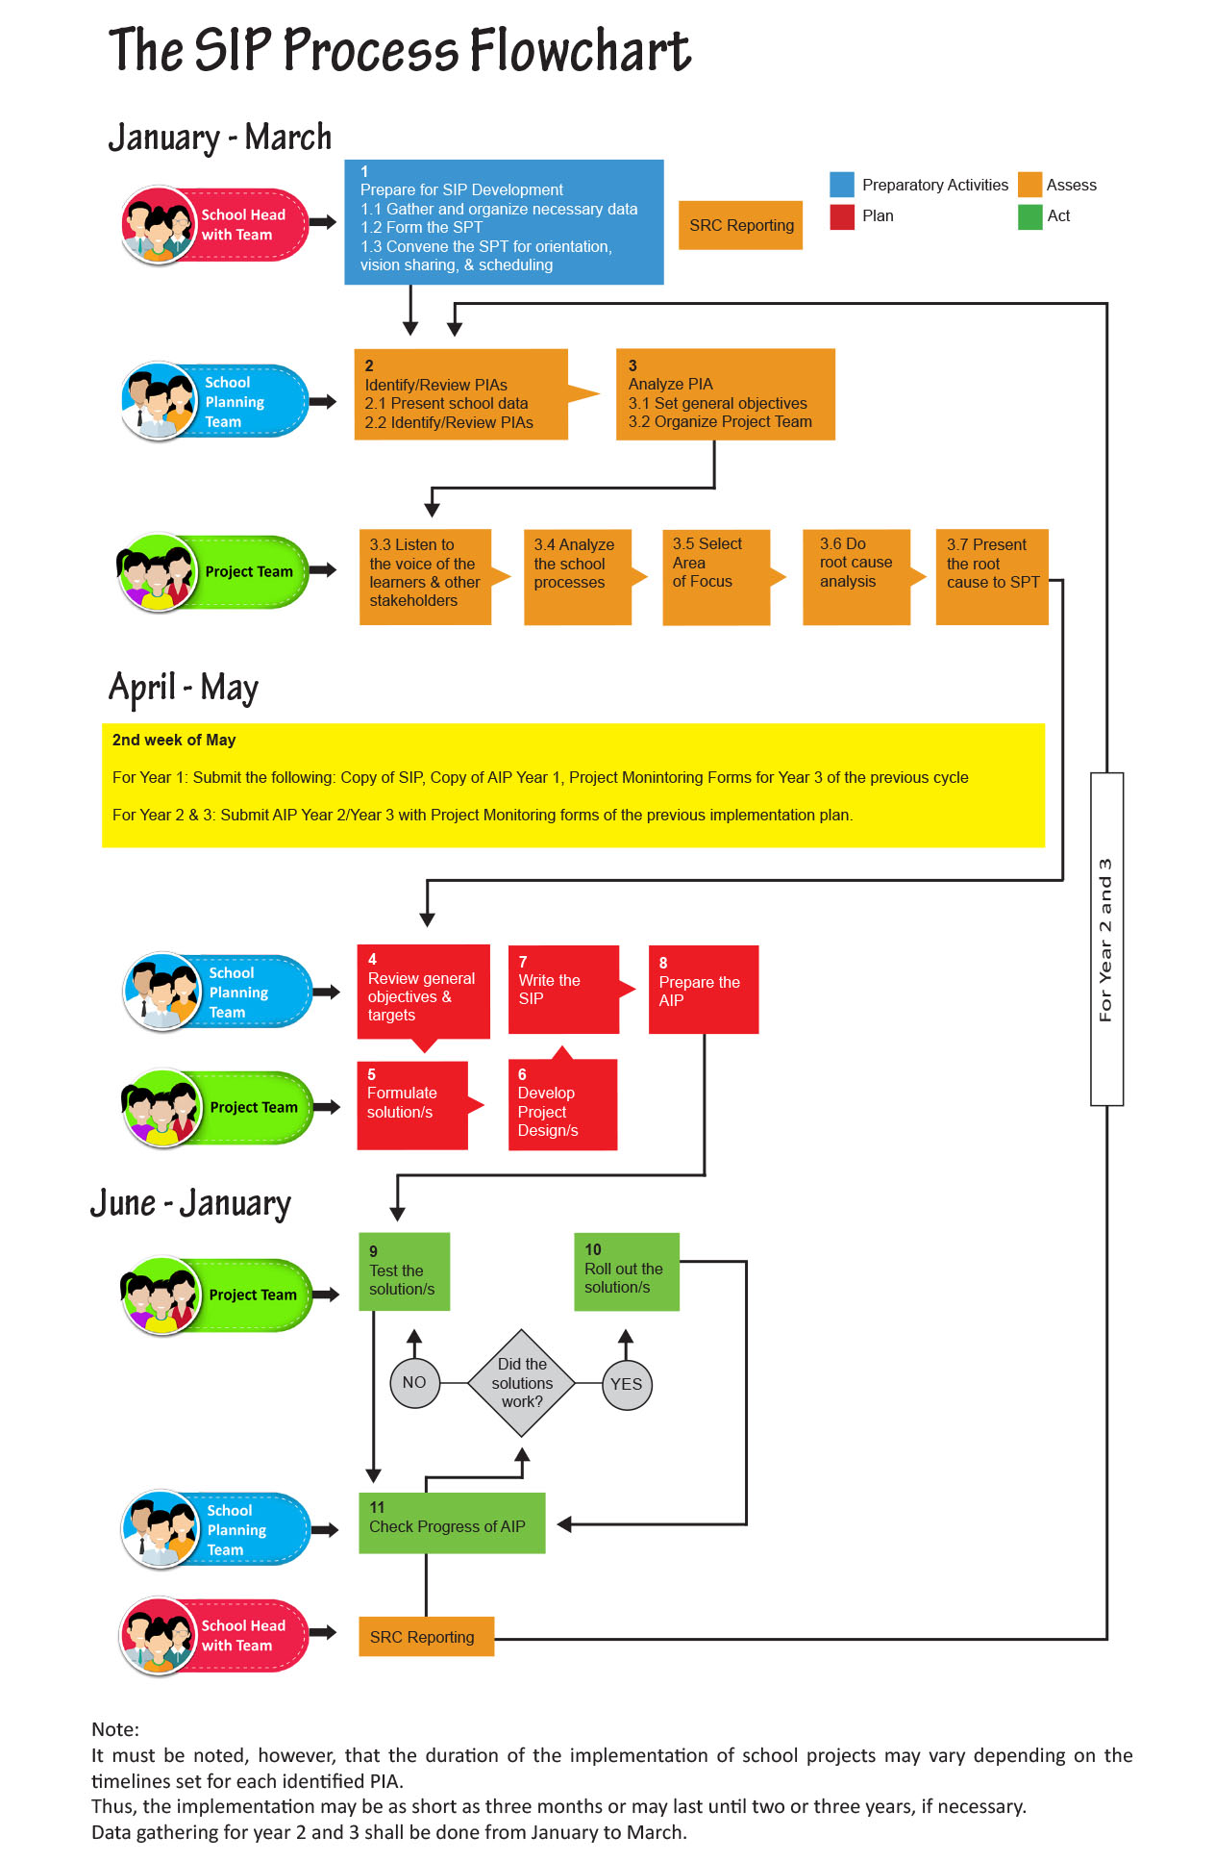
Notes:
Talking point/s:
This is the SIP Process Flowchart you’ll see in the SIP Guidebook.
This is for your quick reference.
Steps were grouped per phase and the months when each step should happen were also indicated.
You will also see who’s in-charge of each step (whether it’s the School Head with a Team, the School Planning Team, or the Project Team).

Slide 13
Enhanced SIP Process
Integrated Policies
A. Preparatory Activities
Gather and organize necessary data
Form the SPT
Convene the SPT for orientation, vision sharing and scheduling
Child Protection Policy
D.O. No. 40 s. 2012
Early Registration
D.O. No. 1 s. 2015
B. Assess
Identify/Review PIAs
Analyze PIAs
  Listen to the voice of the learners
  Analyze school proceses
  Select Area of Focus
  Do root cause analysis
Present the root cause to the SPT
Student-Led School Watching and Hazard Mapping
D.O. No. 23 s. 2015
Result-Based Performance Management System
D.O. No. 2 s. 2015
C. Plan
Review general objectives & targets
Formulate solutions
Develop Project Designs
Write the SIP and prepare the AIP
D. Act
Test and roll out the solution/s
Communicating with stakeholders
Check progress of AIP
SBM Assessment
D.O. No. 83 s. 2012
Notes:
Talking point/s:
As mentioned earlier, policies related to certain steps in the planning process were incorporated.
We are happy about this because we now see actual applications of certain policies and how it is relevant to planning. It made the policies more meaningful for the people in the school.
We hope that this will minimize doing things for the sake of compliance.
<click to show SIP’s link to certain policies>
Child protection policy
Early registration
School-led School Watching and Hazard Mapping
Results-based Performance Monitoring System
SBM Assessment
These will also be discussed in detail in the next days.

Slide 14
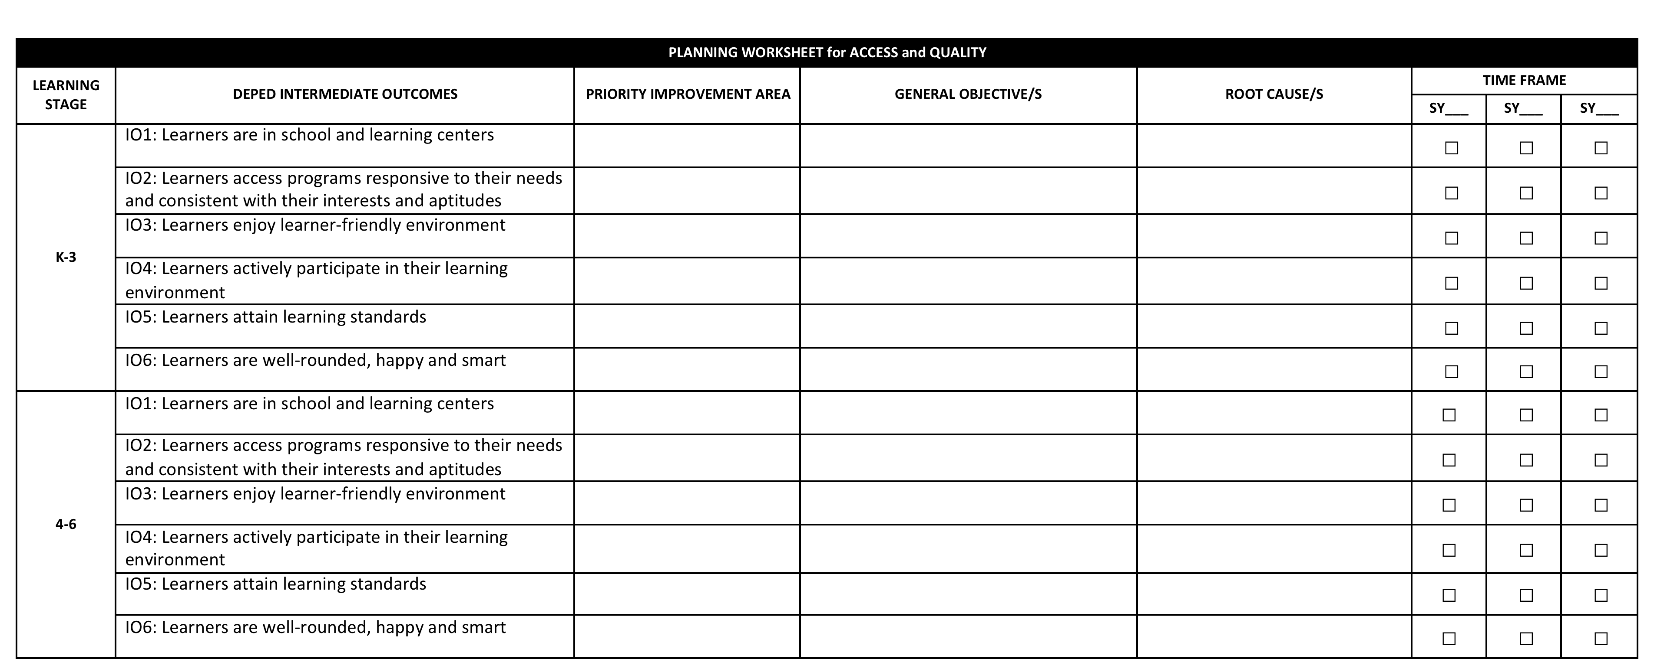
SIP is linked with BEPS via Intermediate Outcomes

Slide 15

Results-based Performance
Management System (RPMS)
How can schools become effective organizations?
Notes:
Another tool for school head is the performance management system.
In DepEd we call it results based performance management system. This RPMS is link to our hiring system, rewards and incentives as well as promotion.
It is really an entire system aligned to the performance management system of Civil Service.

Slide 16
RPMS Linkages to Other HR Systems
Agency Planning and and Directions
(SIP, DEDP, REDP, Natl Plan)
Career Succession
HR Planning and Recruitment
RPMS
Training and Manpower Development
Job Design and Work Relationships
Rewards and Recognition
Compensation and Benefits
Employee Relations
Notes:
If implemented correctly, the RPMS will provide a great deal of information that can be used for other functions, like the ff.:
1. HR Planning and Recruitment
2. Job Design and Work Relationship
3. Compensation and Benefits
4. Employee Relations
5. Rewards and Recognition
6. Training and Manpower Development
7. Career Succession
8. Agency Planning and Directions
Performance management takes information from other processes and sends information to those other processes.
Competencies can serve as the point of integration for all HR systems. Competencies used in RPMS should be the same competencies used for Recruitment, Training, Manpower Development and Career Succession.

Slide 17

The DepEd RPMS is aligned with the CSC SPMS that has 4 Phases.
4 RPMS PHASES
Input: SIP, PIA
I. Performance Planning & Commitment
Output: IPCRF and OPCRF
During adjustment
Output: Development plan
IV. Performance Rewarding and Development Planning
II. Performance Monitoring & Coaching
Output: Monitoring Form
III. Performance Review & Evaluation
Output: Rating sheet
Notes:
The Plan (SIP, DEDP, REDP) serves as input in developing the OPCRF. At the school level, SH formulates the Priority improvement areas in SIP which is the same as the Key Result Areas in RPMS.
A review from the RPMS 4 Phases:
Performance Planning and Commitment – where the Unit and the individual’s Key Result Areas, Objectives, Performance Indicators and corresponding weight are established and agreed upon. This should be done before the performance cycle starts.
Performance Monitoring and Coaching – as soon as Phase 1 is done, raters are expected to monitor performance of their respective ratees. Coaching should be done from this point until the desired level of performance and results are achieved.
Performance Review and Evaluation – there are two sets of review:
a) Midyear Review – year-to-date performance is evaluated and do action plans for objectives that are not achieved thus far.
b) Year-end Review and Evaluation – final rating is established for the Unit and each individual.
Performance Rewarding and Development Planning – The RPMS results are linked to the rewards (i.e. PBB) and can also be used for the Performance Development of Units and individuals. Planning for the succeeding years can also be based on the current and previous years performances.
DepEd’s RPMS was approved by the Civil Service Commission and is now a Department Order.

Slide 18
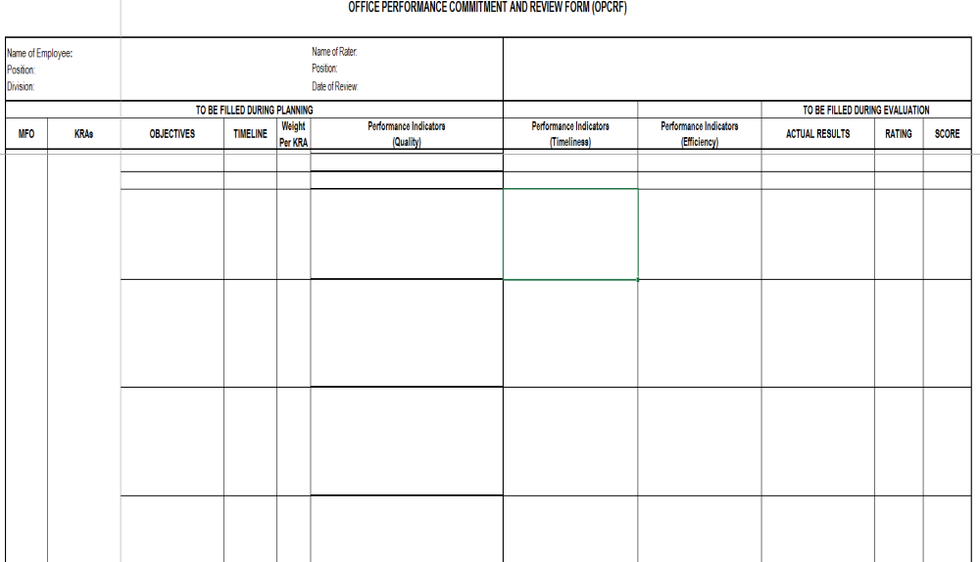
SIP and OPCRF
Major Final Output (MFO) | Key Result Areas (KRAs)/ Priority Improvement Areas OPCRF (Principal) | Key Result Areas (KRAs) IPCRF (Head Teacher) | Key Result Areas (KRAs) IPCRF (Master Teacher) | Key Result Areas (KRAs) IPCRF (Teachers)
Basic Education Services | 1. Instructional Leadership | 1. School Curriculum Monitoring and Evaluation Plan | 1. Instructional Supervision 2. Instructional Competence | 1. Teaching Learning Process
 | 5. Human Resource Management and Development | 5. Human Resource Management (School Based INSET) | 5. Personal and Professional Development (Action Research) | 5. Personal and Professional Development
Key Results Area = Priority Improvement Area

Slide 19
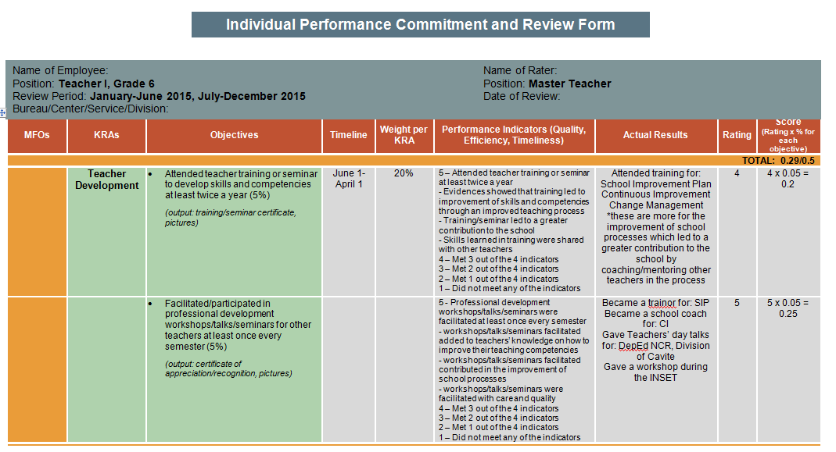

Slide 20
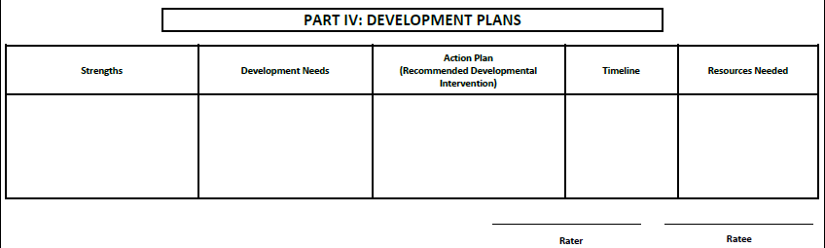
Discuss Strengths and Improvement Needs

Slide 21
The DepEd RPMS is aligned with the CSC SPMS that has 4 Phases.
4 RPMS PHASES
Input: SIP, PIA
I. Performance Planning & Commitment
Output: IPCRF and OPCRF
During adjustment
Output: Development plan
IV. Performance Rewarding and Development Planning
II. Performance Monitoring & Coaching
Output: Monitoring Form
III. Performance Review & Evaluation
Output: Rating sheet
Notes:
The Plan (SIP, DEDP, REDP) serves as input in developing the OPCRF. At the school level, SH formulates the Priority improvement areas in SIP which is the same as the Key Result Areas in RPMS.
A review from the RPMS 4 Phases:
Performance Planning and Commitment – where the Unit and the individual’s Key Result Areas, Objectives, Performance Indicators and corresponding weight are established and agreed upon. This should be done before the performance cycle starts.
Performance Monitoring and Coaching – as soon as Phase 1 is done, raters are expected to monitor performance of their respective ratees. Coaching should be done from this point until the desired level of performance and results are achieved.
Performance Review and Evaluation – there are two sets of review:
a) Midyear Review – year-to-date performance is evaluated and do action plans for objectives that are not achieved thus far.
b) Year-end Review and Evaluation – final rating is established for the Unit and each individual.
Performance Rewarding and Development Planning – The RPMS results are linked to the rewards (i.e. PBB) and can also be used for the Performance Development of Units and individuals. Planning for the succeeding years can also be based on the current and previous years performances.
DepEd’s RPMS was approved by the Civil Service Commission and is now a Department Order.

Slide 22
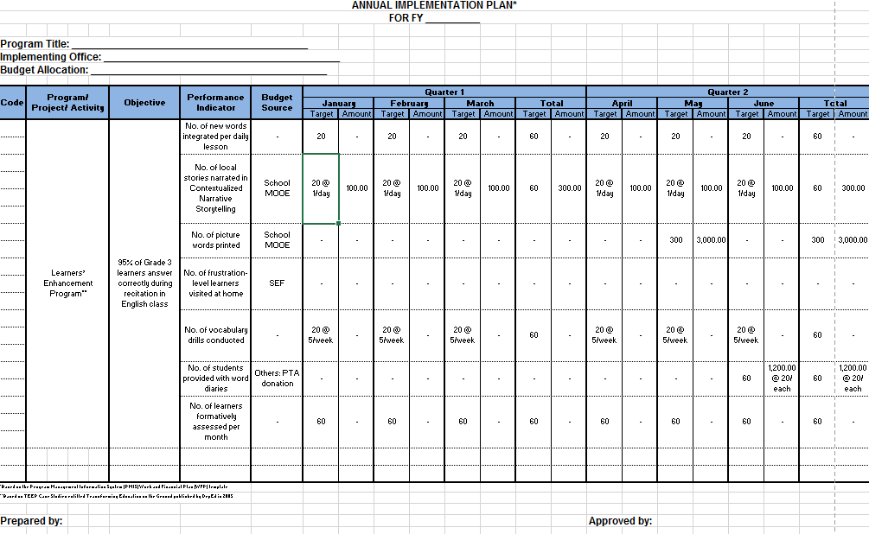

SIP-OPCRF-AIP Integration
1
2
3
SIP
OPCRF
AIP/WFP

Slide 23
Annual Implementation Plan
Adopts the WFP format of Program Management Information System (PMIS)
Follows Fiscal Year Calendar (plus 1st quarter of the succeeding FY)
AIP/WFP is the basis for Monthly Disbursement Program and Annual Procurement Plan

Slide 24
Annual Implementation Plan
Q1 + Q2

Slide 25
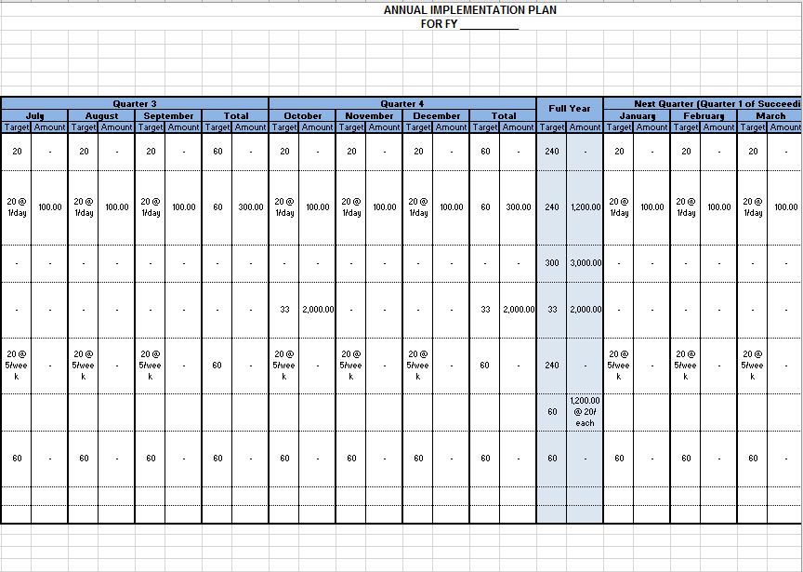
Annual Implementation Plan
Q3 + Q4 + Q1

Slide 26
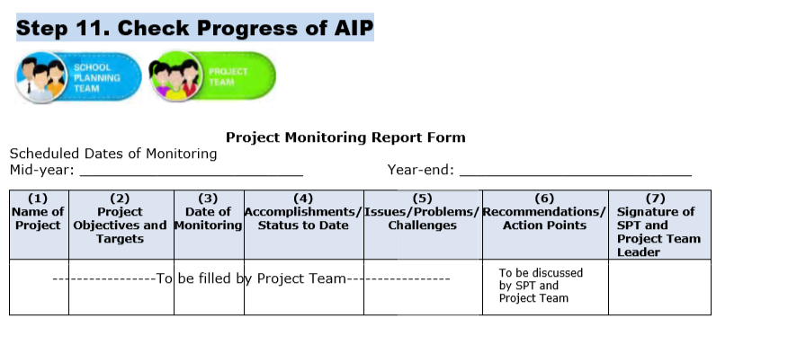
SIP Monitoring

Slide 27

For the first two years of SHS implementation, Senior High Schools are required only to develop AIP/WFP.
FY 2016 AIP/WFP shall include preparatory activities, spill-over activities from previous years and centrally-led projects and activities.

Slide 28

Communicating to stakeholders
Notes:
Note to facilitator:
This should be short but fun.

Slide 29

School Report Card (DO 44, s. 2015)
OBJECTIVE
To increase community participation and involvement in school operations and activities by providing stakeholders a snapshot of the status of the school and advocating for areas that need their involvement
Notes:
Talking points:
Research from WB shows that if stakeholders are informed about the process and performance of the schools, they are able to help the school more.
The SRC provides the mechanism for stakeholders to celebrate their own successes because it does not only communicate accomplishments of schools but also of other stakeholders like parents, school governing body and even community.

Slide 30
SRC is aligned with FOI EO
“Every Filipino shall have access to:
Information
Official records
Public records and to
Documents and papers pertaining to official acts, transactions or decisions,
Government research data used as basis for policy development”
- Section 3, Executive Order 02, s. 2016

Slide 31

Features of Refined SRC
Focus is on advocacy and communication;
Streamlined indicators (19 indicators, not 32).
Includes school accomplishment of other stakeholders.
Integrated with SIP
Notes:
Talking points:
I would like to emphasize that the current SRC is shorter than the previous SRC. It only contains 19 indicators unlike the old SRC where there were 32 indicators before. Also, we no longer ask schools to provide multiyear data about each indicator.
There was also findings by WB that there were more SRC than SIP which indicate misunderstanding of school heads about these two aspects of SBM. Now under the new policy, we have integrated these two together and have shown their relationship.

Slide 32




Benefits of using enhanced SRC
Greater stakeholder participation in school activities
Better understanding of stakeholders on school situation
Transparency of school activities and performance
Notes:
Talking points:
When you used the enhanced SRC, it would result to:
Greater stakeholder participation in school activities;
Better understanding of stakeholders on your school’s situation; and
Transparency of your school’s activities and performance

Slide 33




Ways of Disseminating the SRC
Presentation to stakeholders during School Meetings and Assemblies (October & March)
Posting of SRC in school/Division websites, bulletin boards, and other public areas
Allocating space in School Journal or Newsletter
Reproduction of enough copies for distribution to the general public
Notes:
Talking points:
The following are ways in which you can disseminate your SRC:
Present it to your stakeholders during school meetings/assemblies
Post it in public areas
Publish it in your school journal/newsletter
Reproduce copies for the general public

Slide 34
19 SRC Indicators
SCHOOL PROFILE [6]
PERFORMANCE INDICATORS [11]
STATUS OF SCHOOL PROJECTS [2]
Enrolment
Health and Nutritional Status
Learners materials’
Teachers’ professional development
Funding sources
School awards and recognitions
Access
  Number and rate of dropouts by cause
Quality
  Percentage of learners who completed the School Year (Promotion Rate)
  National Achievement Test (NAT) – by Mean Percentage Score (MPS)
  Literacy level
Governance
  School-Based Management Assessment Level
  Child-Friendly School Survey result
  Stakeholders’ participation
  Learner-Teacher ratio
  Learner-Classroom ratio
  Learner-Toilet ratio
  Learner—Seat ratio
Status of Annual Improvement Plan (AIP)/Continuous Improvement Projects)
Other Stakeholders' Accomplishments
Notes:
Talking points:
The current SRC is shorter than the previous SRC. It only contains 19 indicators unlike the old SRC where there were 32 indicators before. Also, we no longer ask schools to provide multiyear data about each indicator.

Slide 35

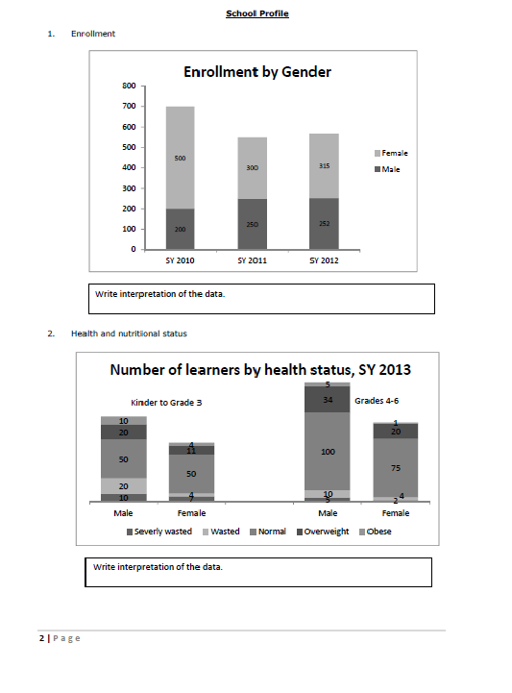
Basic SRC Template
Notes:
Talking points:
For the SRC, you are given 2 templates. The first one is called the Basic SRC Template.
We understand that not all schools are able to produce colored/creative SRCs. If this is the case, they may use the Basic SRC template that can be created using Microsoft Word or Excel.
What is important is that the schools are able to input all 19 indicators in their SRC.

Slide 36
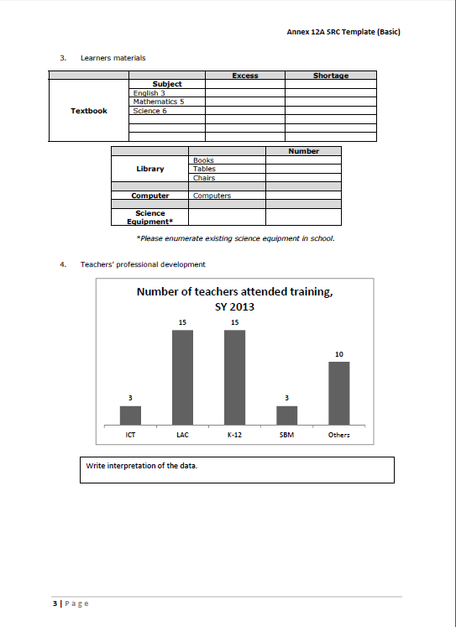
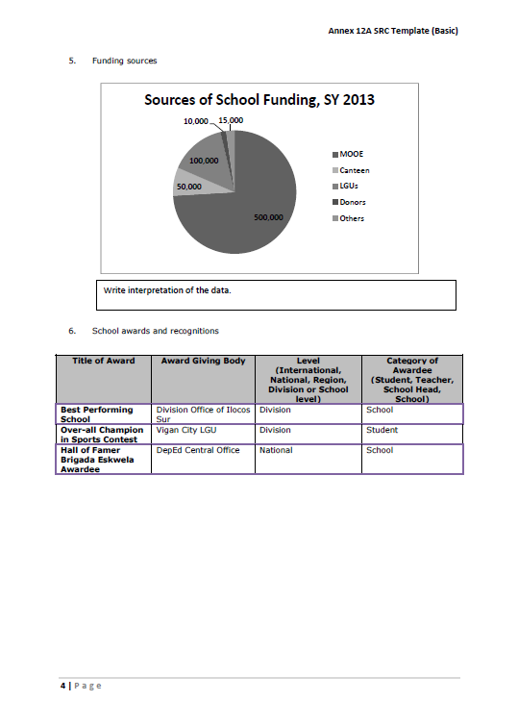
Basic SRC Template
Notes:
Talking points:
We understand that not all schools are able to produce the Advanced SRC. If this is the case, they may use the Basic SRC template that can be created using Microsoft Word or Excel.
What is important is that the schools are able to input all 19 indicators in their SRC.

Slide 37

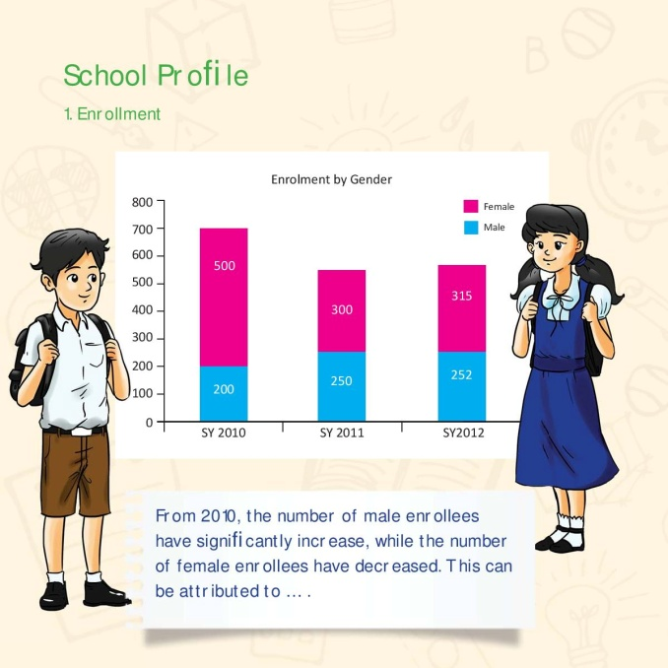
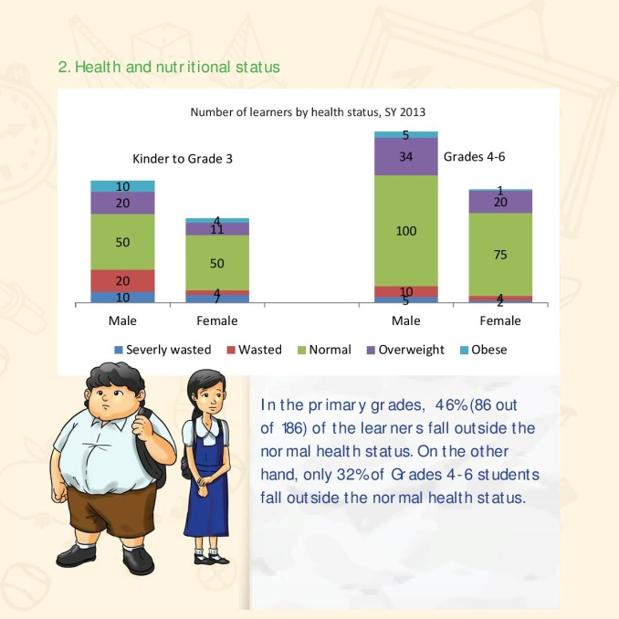
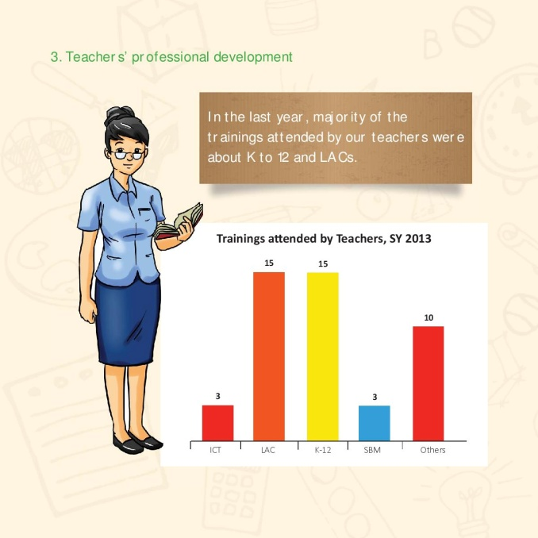
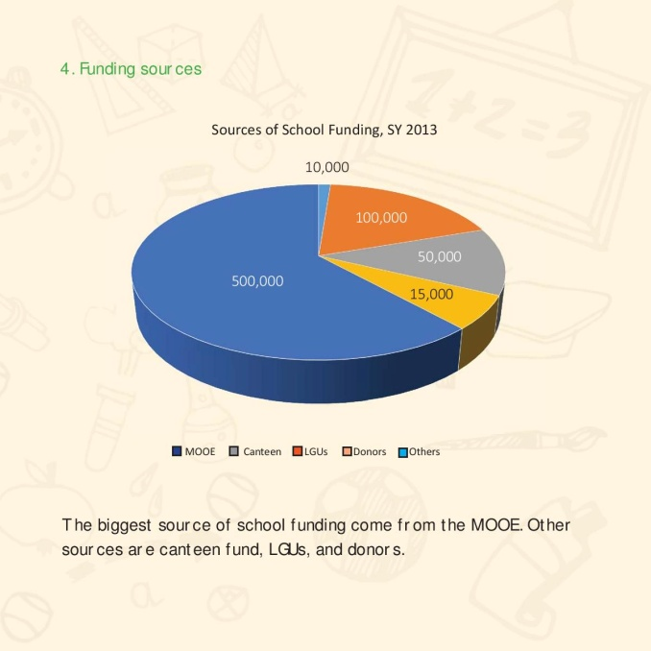

Advanced SRC Templates
BOOKLET
Notes:
Talking points:
The Advanced SRC Templates come in 3 kinds:
Booklet
Brochure
Poster
We will provide the schools with the icons if they opt to use the advanced template. This, however, is not intended to limit the schools’ ability to
create their own SRC. This is merely a guide/sample. With the help of the icons, they may come up with their own layout/style that best reflects
their school.

Slide 38




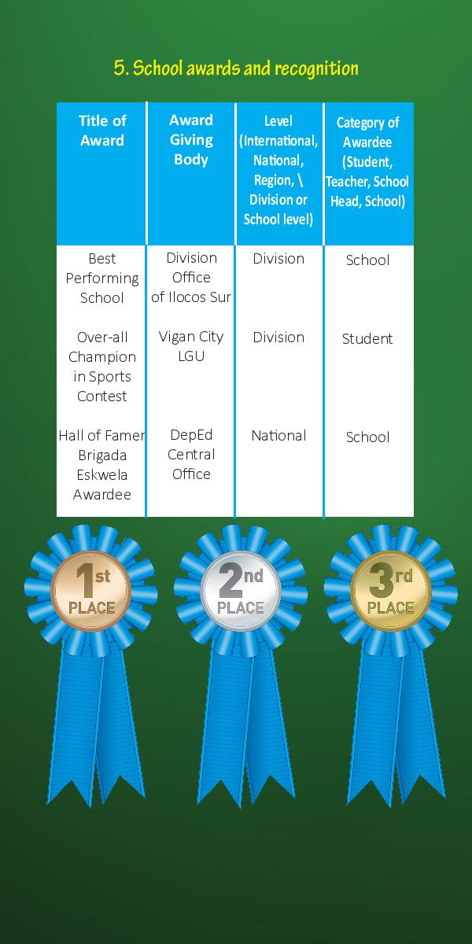
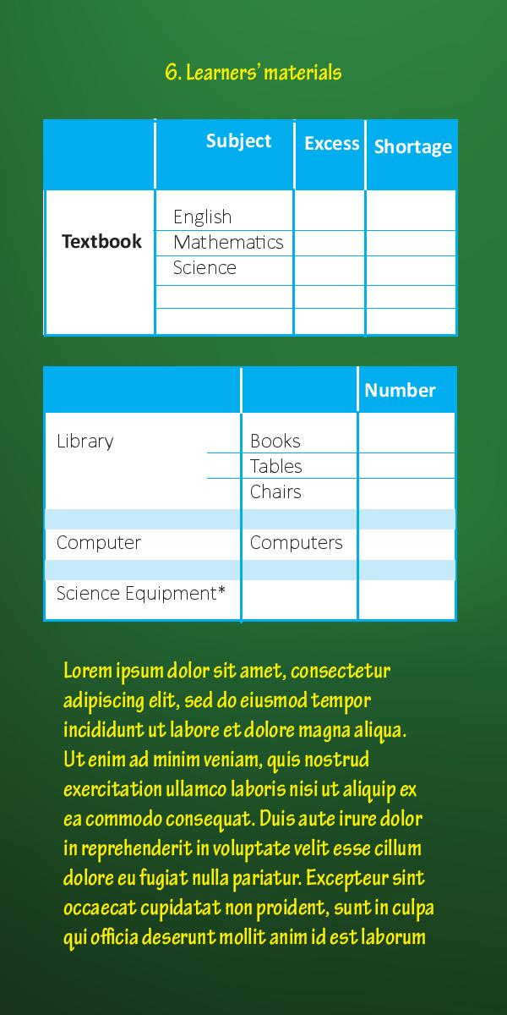
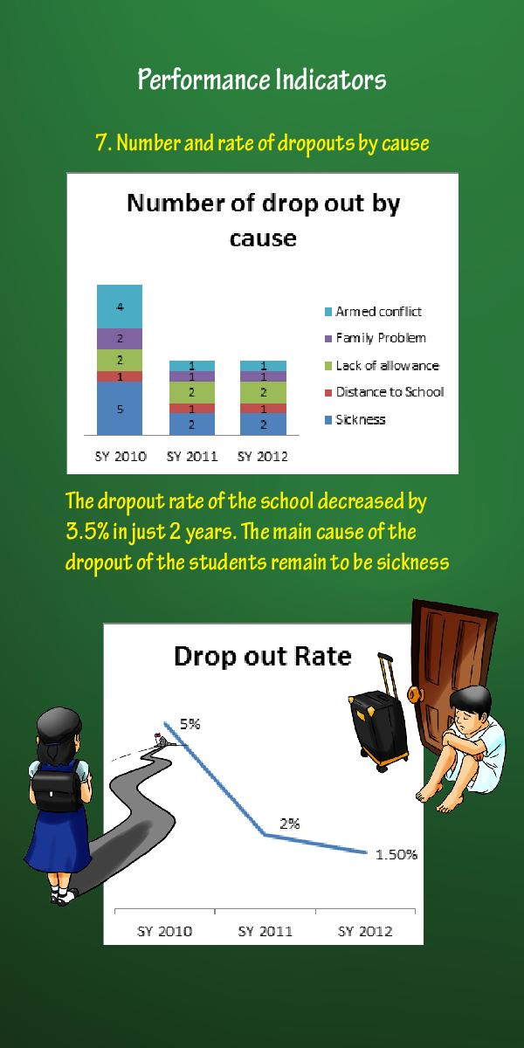
Advanced SRC Templates
BROCHURE
Notes:
Talking points:
The Advanced SRC Templates come in 3 kinds:
Booklet
Brochure
Poster
We will provide the schools with the icons if they opt to use the advanced template. This, however, is not intended to limit the schools’ ability to
create their own SRC. This is merely a guide/sample. With the help of the icons, they may come up with their own layout/style that best reflects
their school.

Slide 39
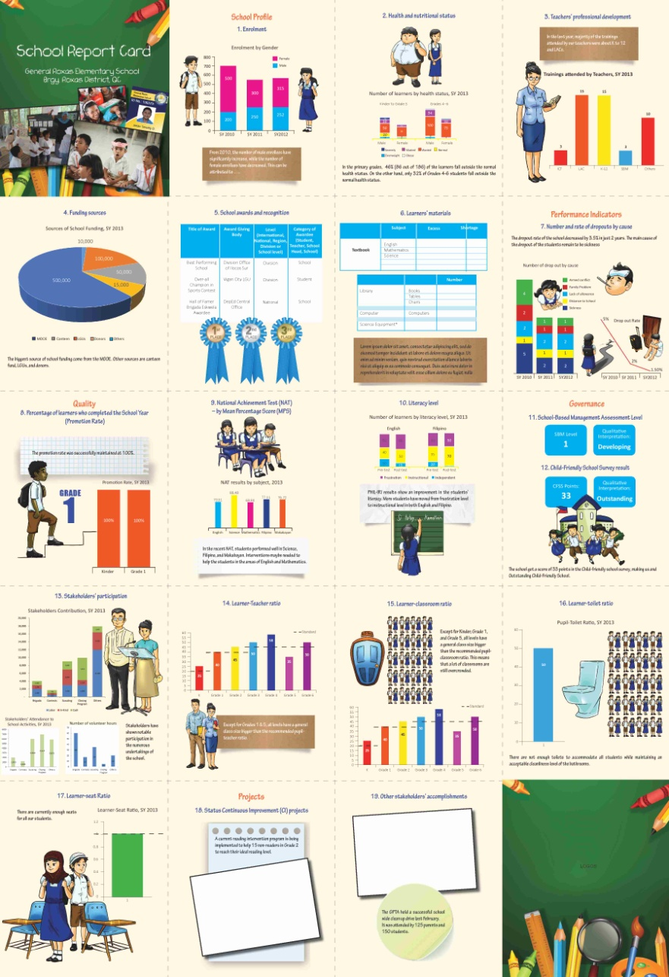
Advanced SRC Templates
Poster
Weblink for SRC Templates & Infographics:
bit.ly/sip_src_templates
Notes:
Talking points:
The Advanced SRC Templates come in 3 kinds:
Booklet
Brochure
Poster
We will provide the schools with the icons if they opt to use the advanced template. This, however, is not intended to limit the schools’ ability to
create their own SRC. This is merely a guide/sample. With the help of the icons, they may come up with their own layout/style that best reflects
their school.

Slide 40
Navotas NHS
SCHOOL REPORT CARD
2016 – 2017

Slide 41
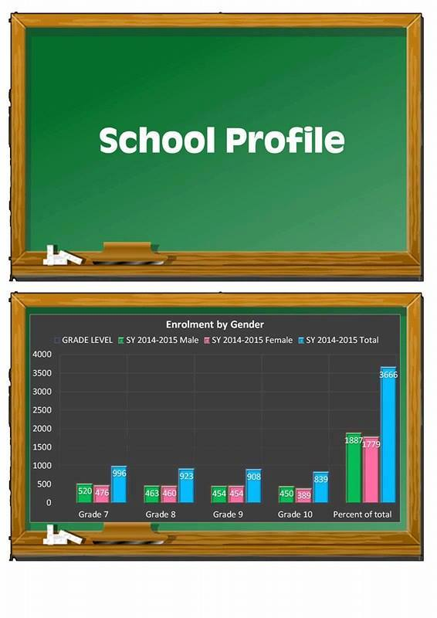
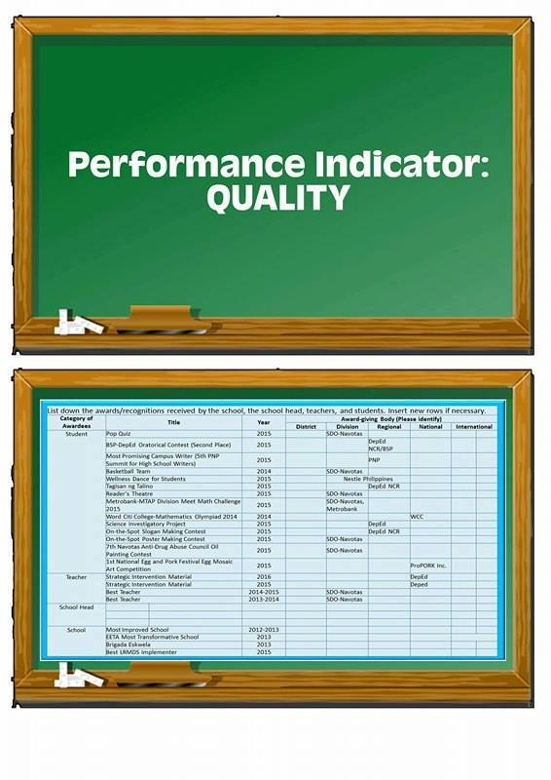
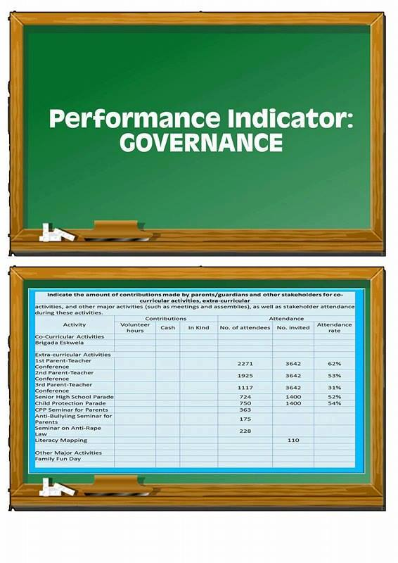
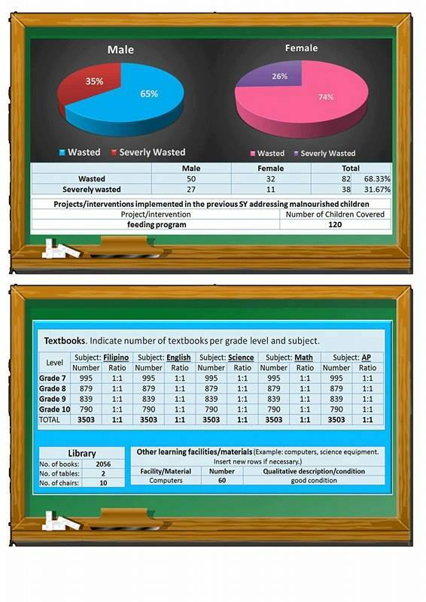
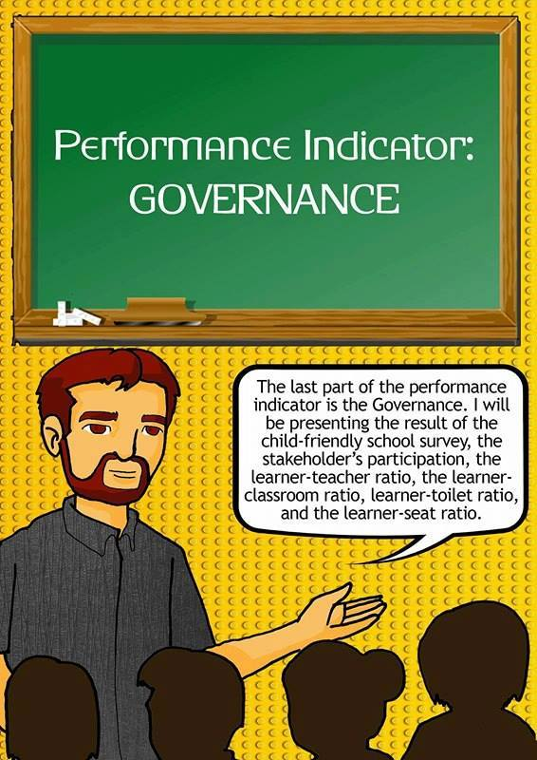


Navotas NHS SRC

Slide 44



Any 1 LM per subject = 1 Learner

Slide 45
Fund Source | Amount
MOOE | PhP 3,468,000.00
GAA | NONE
LGU | NONE
Canteen Funds | 40% of the Canteen Shares

Slide 46
Title of Award | Award Giving Body | Level | Category
Best LRMDS Implementer | DepEd SDO-Navotas | Division | School
Metrobank-MTAP Regional Meet Math Challenge 2015 (3rd Place) | Metrobank, DepEd NCR | Regional | Student
National Science Quest -SIM | DepEd | National | Teacher

Slide 50
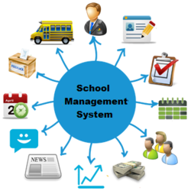
SBM Level
ON GOING

Slide 51


Child-Friendly School
Survey Results
Child Friendly

Slide 52
Schedule of SRC Reporting
DepEd Order 44, s. 2015 –
  School Report Card shall be reported twice in a School Year during months of October and March
  SIP and SRC activities may be included in the Results-Based Performance Management System (RPMS)
DepEd Order 23, s. 2016 – School Calendary SY 2016-2017

Slide 53
Schedule of SRC Presentation
Activity | 2016 | 2017
Preparation of School Report Card | Sept 15-30 | Feb 15-28
Presentation of SRC in school assemblies | Oct 1-14 | Mar 1-11
Submission of school feedback on SRC use | Oct 7-14 | Mar 7-11
GIVE FEEDBACK USING:
bit.ly/src_monitoring_form

Slide 54
End of Presentation
bhrod.sed@deped.gov.ph

