Slide 1

ENHANCED FINANCIAL REPORTING SYSTEM (eFRS)
GAM Compliant
Presented by :
HAROLD P. MAGADIA

Slide 2
Objectives / Expectations:
To be familiar on the reports required for a certain period including the uniformity of the information to be provided in the prescribed formats and templates.
To be able to appreciate the crucial roles of field offices in submitting accurate and reliable reports; and
To fully grasp the proper usage / application of the Enhanced Financial Reporting System.

Slide 3







Financial Report Application Flow Chart
1
2
Hardware
3
Encoding
Documents
Reports Created:
4
Journal Entry Voucher
ChkDJ, CRJ and CDJ
General Journal
Subsidiary Ledger
General Ledger
Trial Balance
Financial Statements
General Ledger Summary
MS Access Database
Management Responsibility
Other Schedules

Slide 4
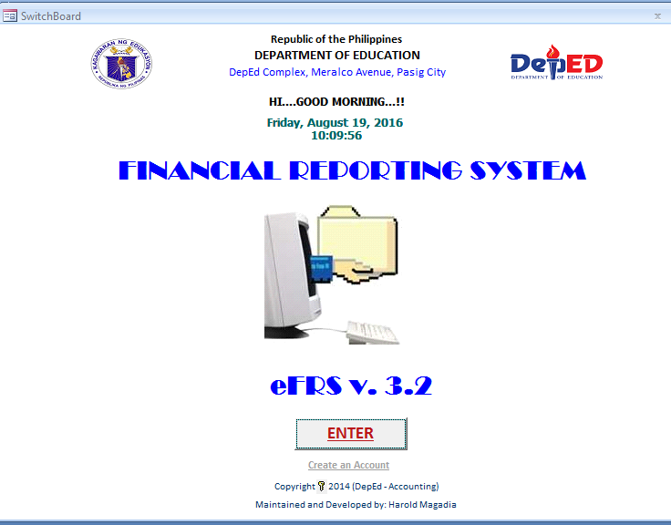
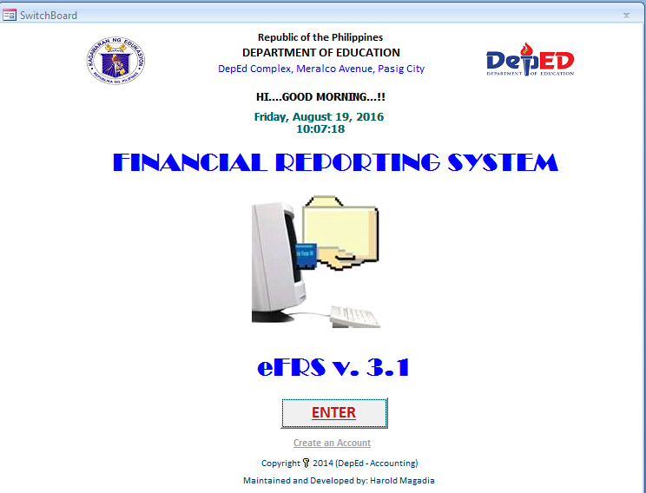
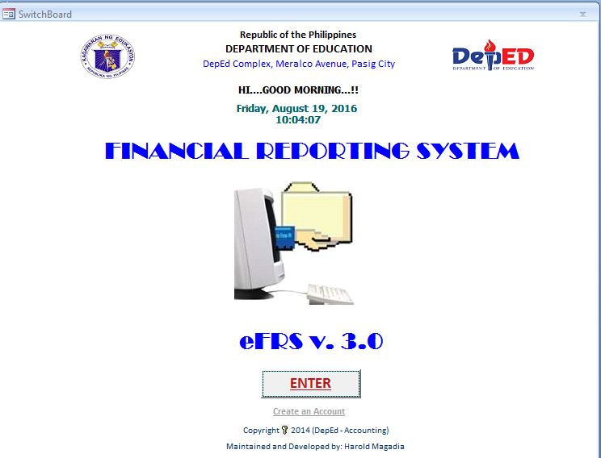
eFRS Versions

Slide 5

What ?
eFRS stands for Enhanced Financial Reporting System;
It is based on FRS – an accounting system used by “some” organizational units of DepED;
FRS’s primary use is to generate financial reports needed by accounting units;
eFRS = FRS version 3.0

Slide 6
Why?
DBM-COA-DOF Joint Circular 2013-01
Because of GIFMIS ;
UACS with its 46-digit code format;
Difficult to cope manually;

Slide 7

Data Entry Discipline
Must encode ALL required data fields
Must have a 1 JEV = 1 DV = 1 CHQ Mindset
ORS num must be part of the data capture process
If not sure, ASK and don’t leave it blank!
Always remember
“GARBAGE IN,
GARBAGE OUT”

Slide 8
ADVANTAGES
Saves Time
Easy to produce reports
Easy to access and install
Can be set up as Multi User
Handy
User-friendly
eFRS is free

Slide 9
Changes in eFRS v.3.2
Payee name became Debitors/Creditors.
Additional Code for Fund Cluster.
Additional fields for Major and Sub Categories of Cash Flow.
FS format changed to PPSAS format.

Slide 10
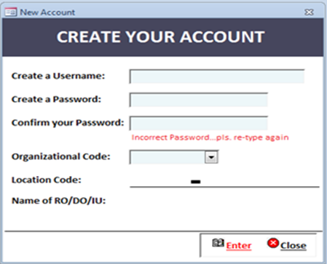
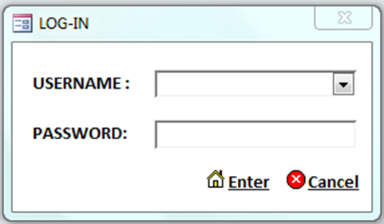
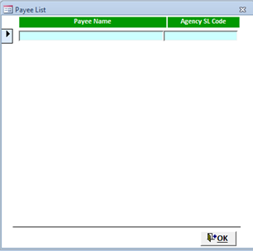
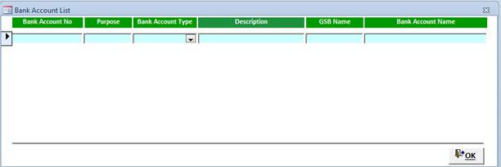
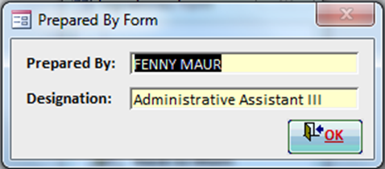
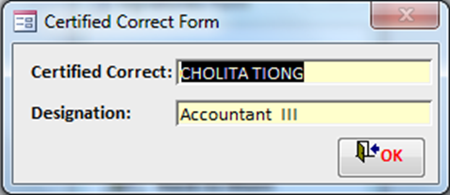
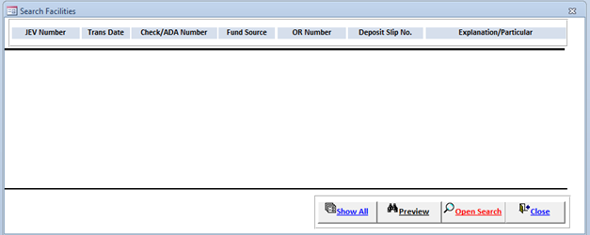
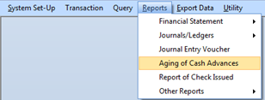
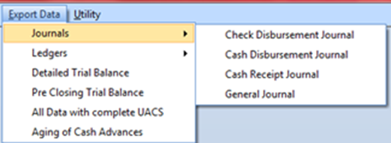
Features
Creation of Account
Log In Function
Set Up Facility
Capture Financial Records
Search and Edit Facility
Print Reports
Query and Export Data Facility

Slide 11
Transaction Classification
Bank Disbursement (Check/ADA, Staled/cancelled, Fund Transfer, Bank Charges)
Cash Disbursement (Petty Cash, Liquidations, CA Payroll)
Cash Collection (RA Receipt, Due to BTr NG)
Bank Deposit (Deposit of Collections RA, Deposit to BTr NG, Other Deposits)
Other Transaction (Remittances to BIR, Non-Cash Expenses, Adjustment, Closing Entries, NCA Receipt, NCA Lapsing, Others)
SU’s MOOE Liquidation (Liquidation of MOOE Downloading (Elem /HS Non IUs))

Slide 12
System Requirements
Hardware
Software
A computer with at least Pentium 4 to latest version (CPU@2.50GHZ) Processor and 2.0 GB memory capacity (RAM)
Hard drive with at least 320 GB to 500 GB of (disk space)
Local Area Network (if used in a computer network)
MS Windows XP or latest version
MS Access 2007 or latest version

Slide 13
IMPROVING TIMELINESS AND ACCURANCY OF THE REPORT
Strategy — Determine the desired result, develop a plan, and monitor progress.
Structure — Align the finance function to enable the strategy of the office
Process — Streamline, simplify and standardize processes throughout the cycle.
Technology — Optimize your ability to leverage current systems.

Slide 14
Introduction to eFRS v.3.2

Slide 15
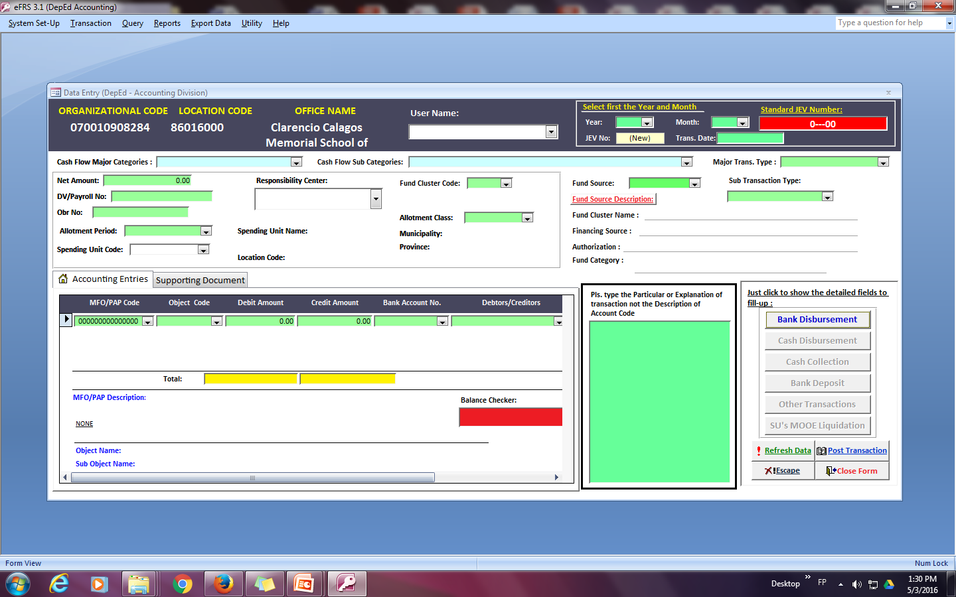
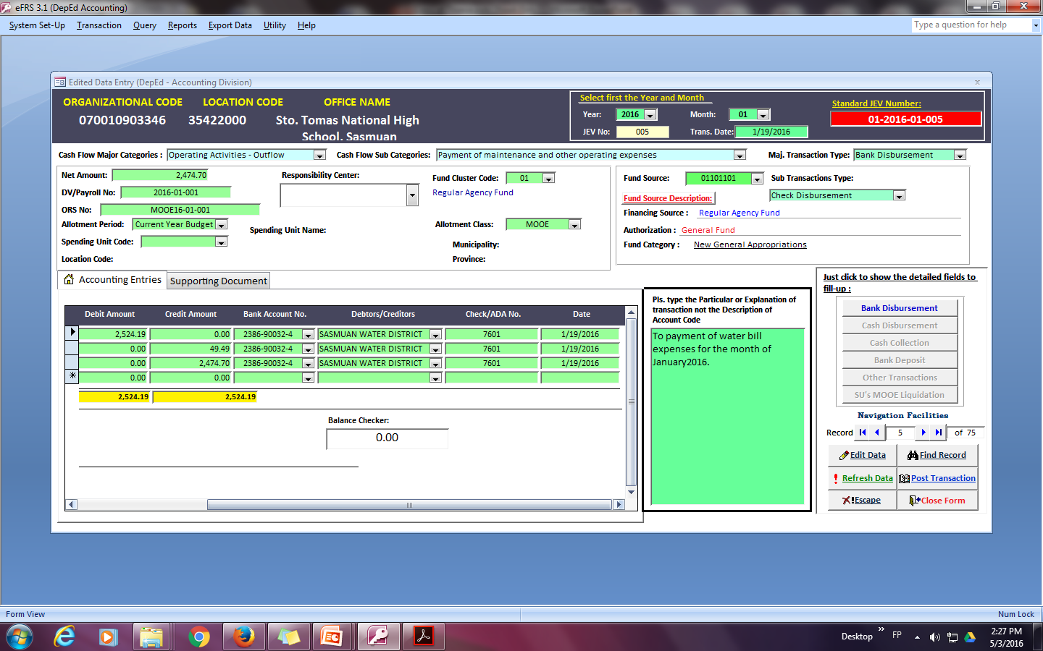
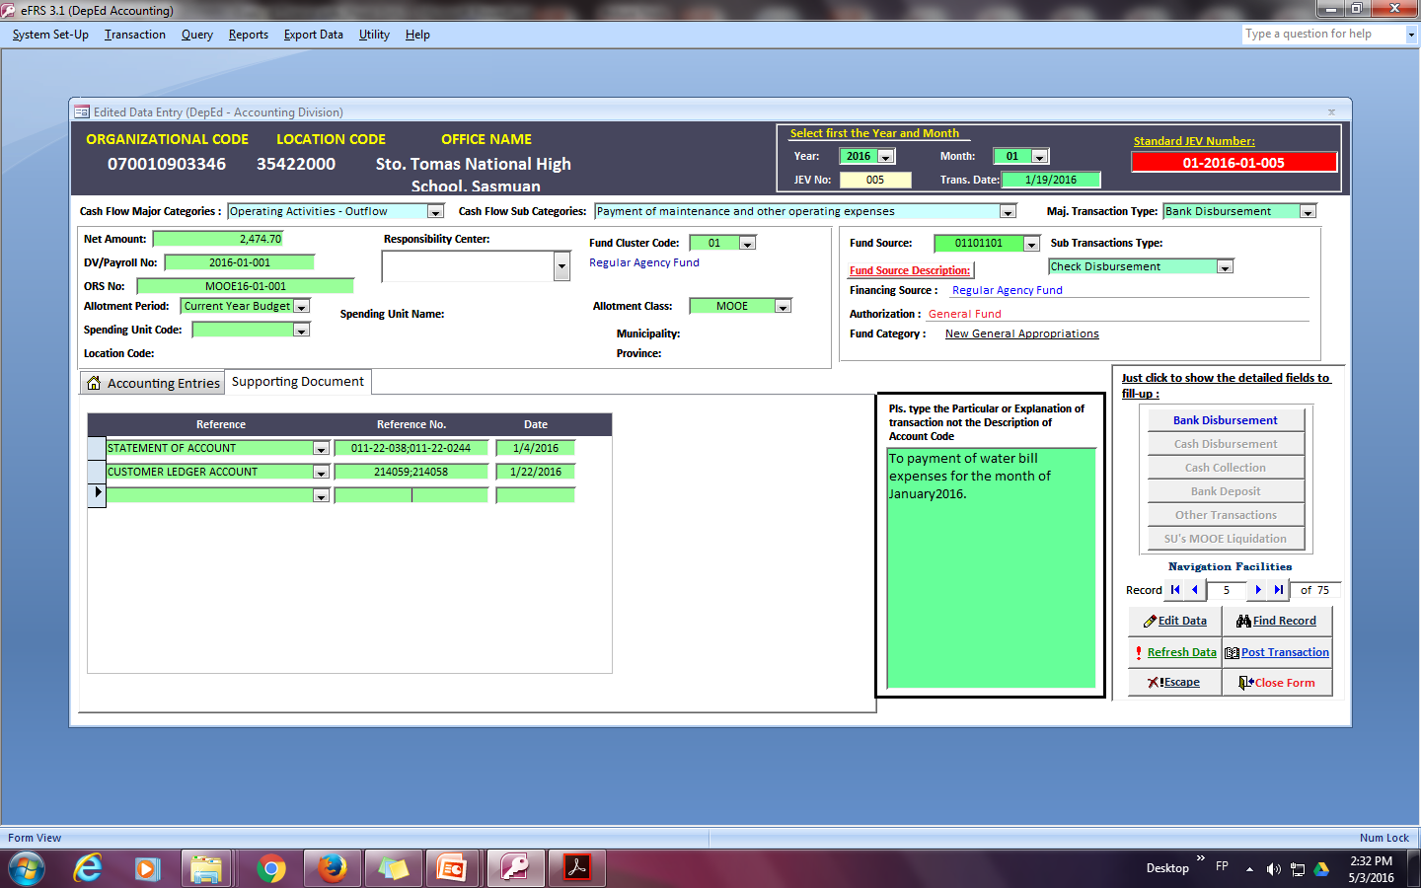
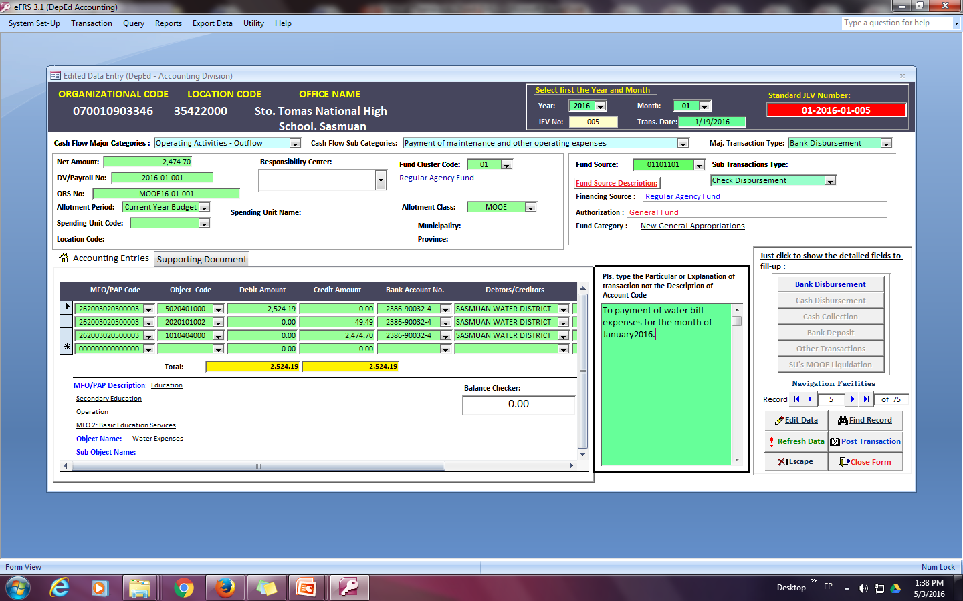
BANK DISBURSEMENT
Leave it blank

Slide 16
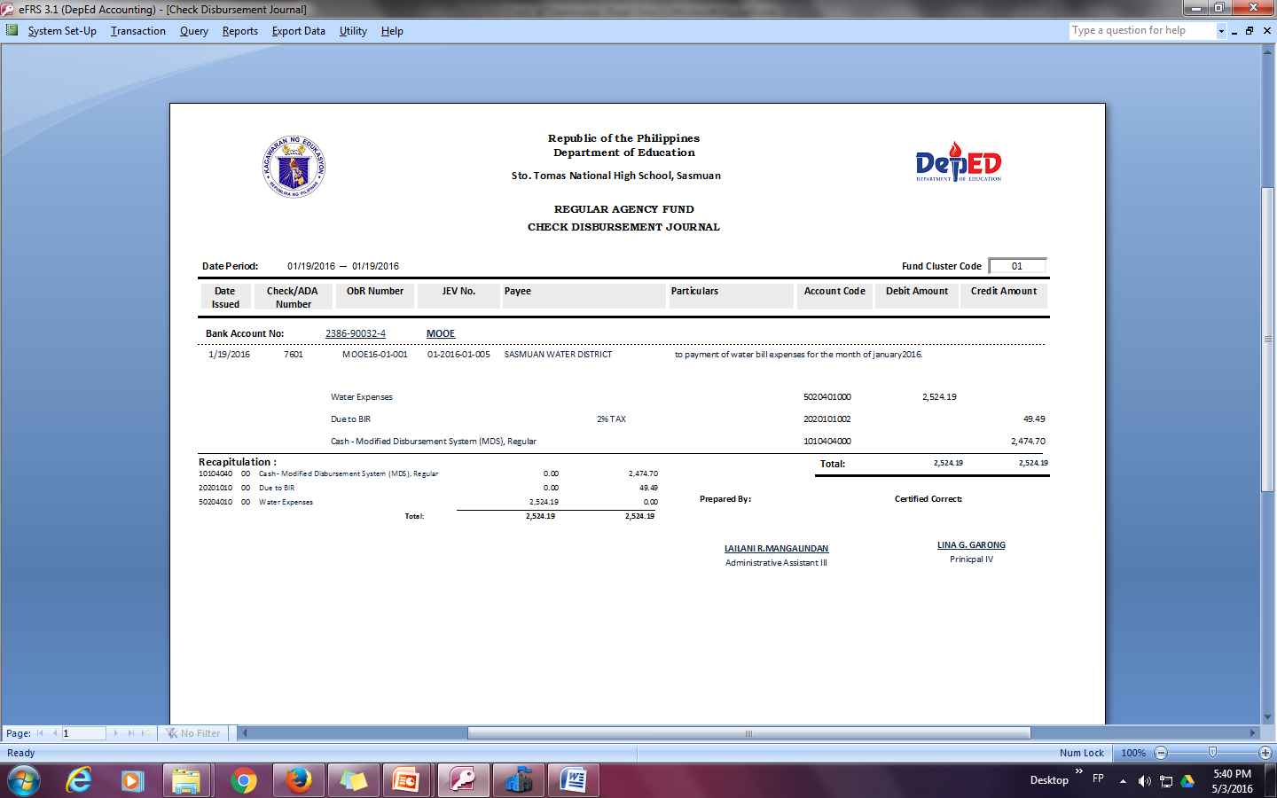
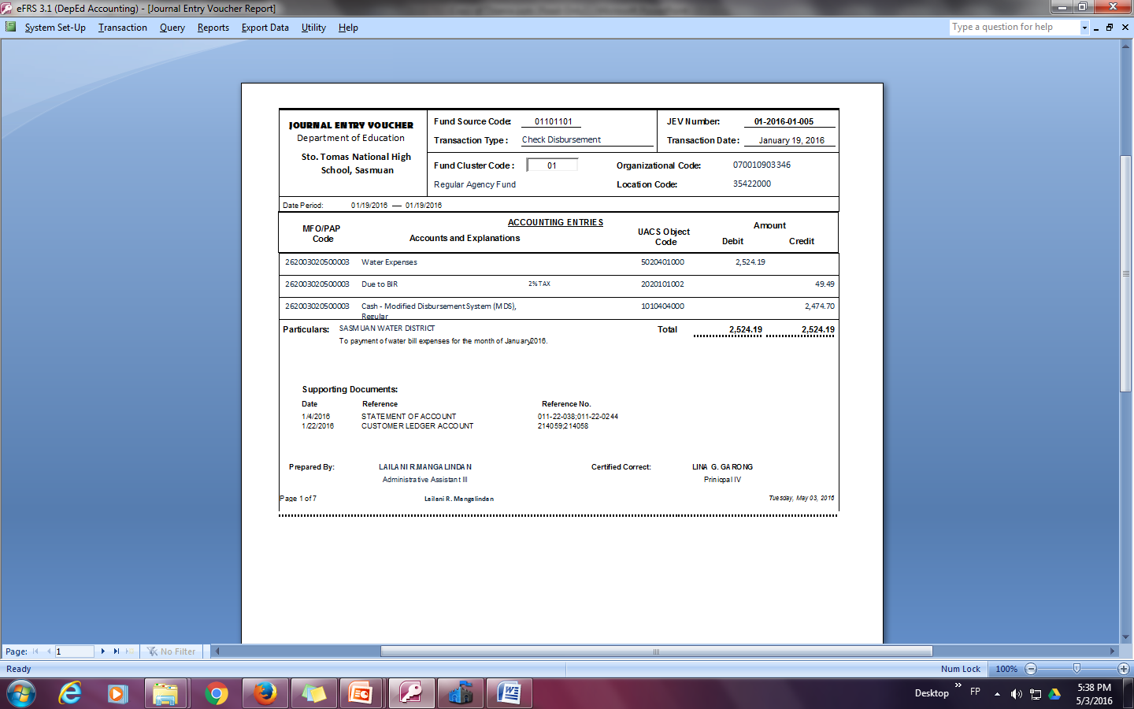
Report Generated

Slide 17
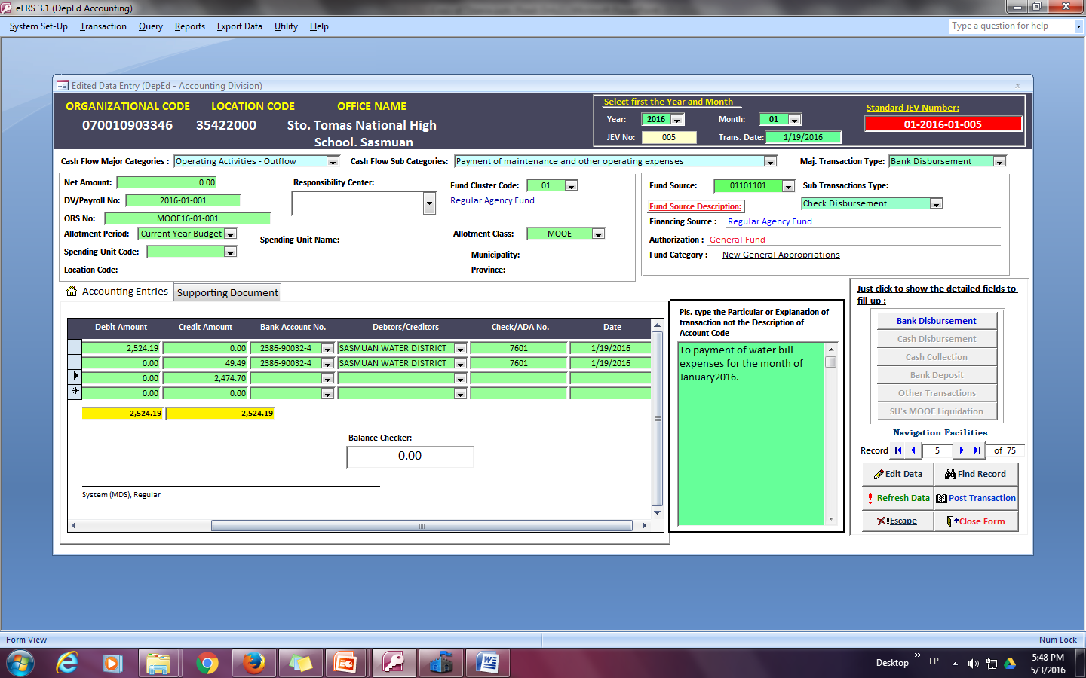
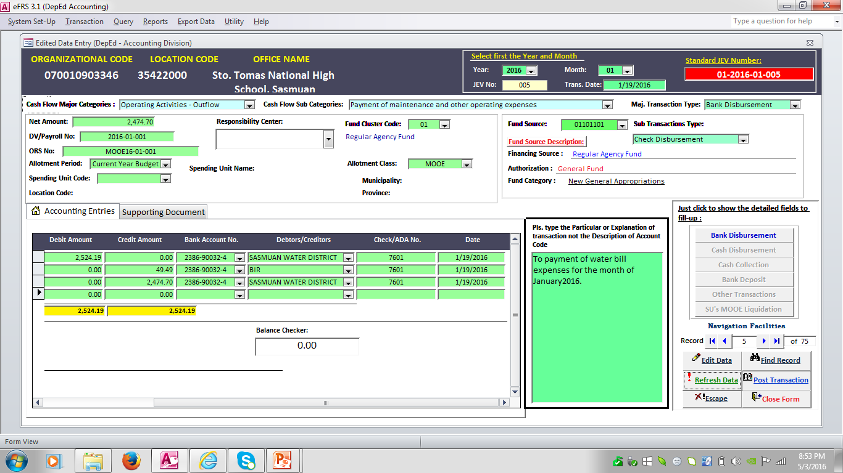
Incomplete Data and Wrong Encoding

Slide 18
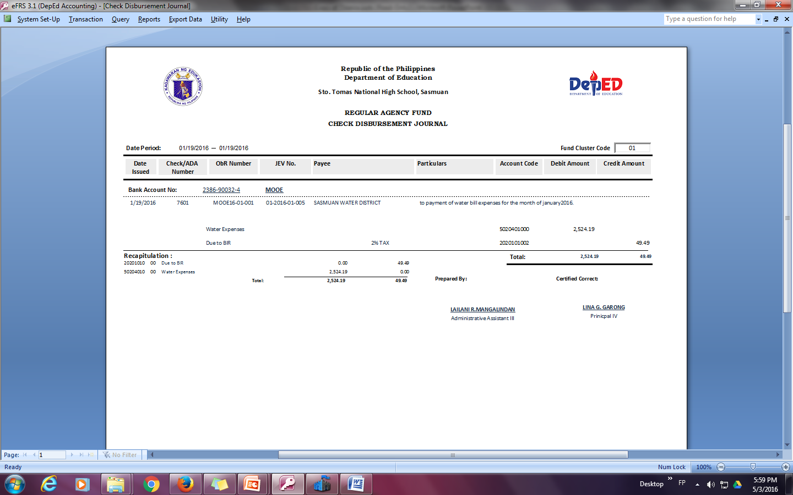
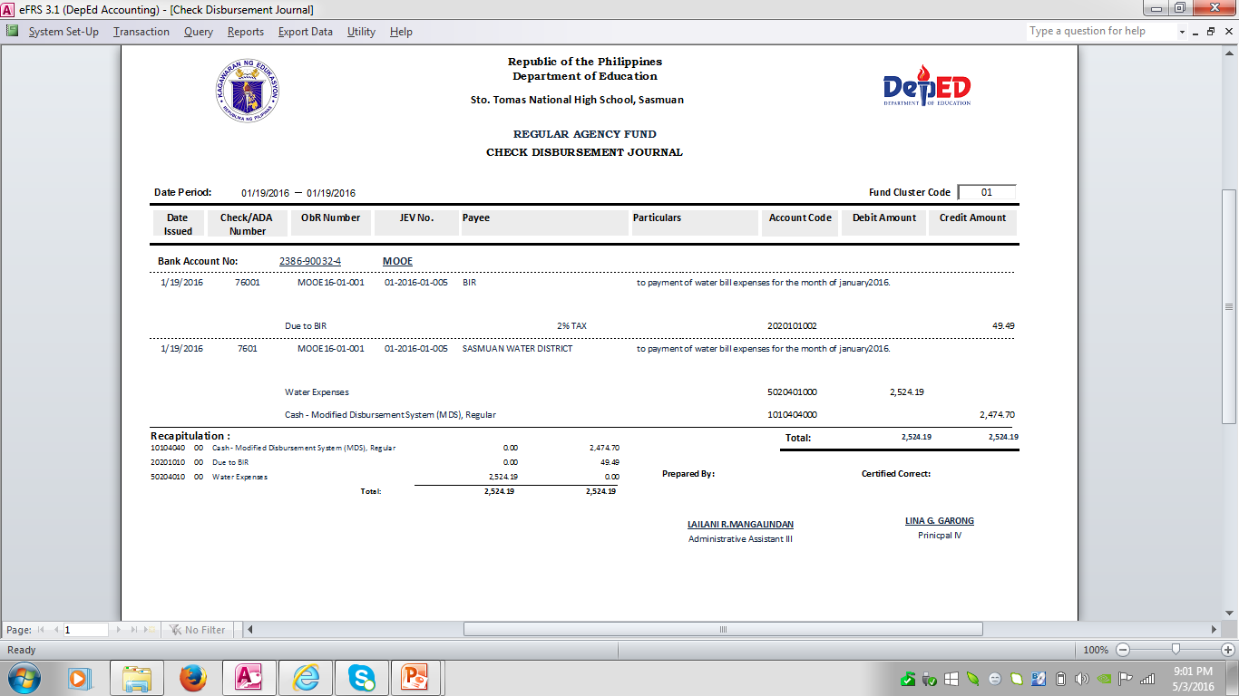
Report Generated

Slide 19
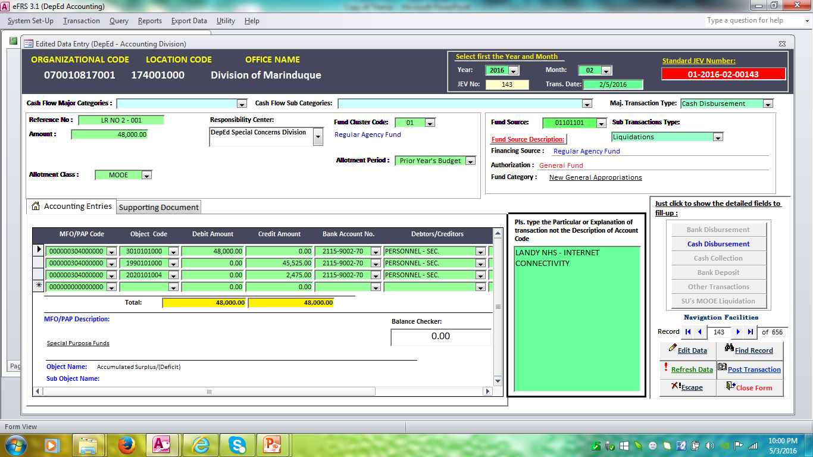
CASH DISBURSEMENT

Slide 20
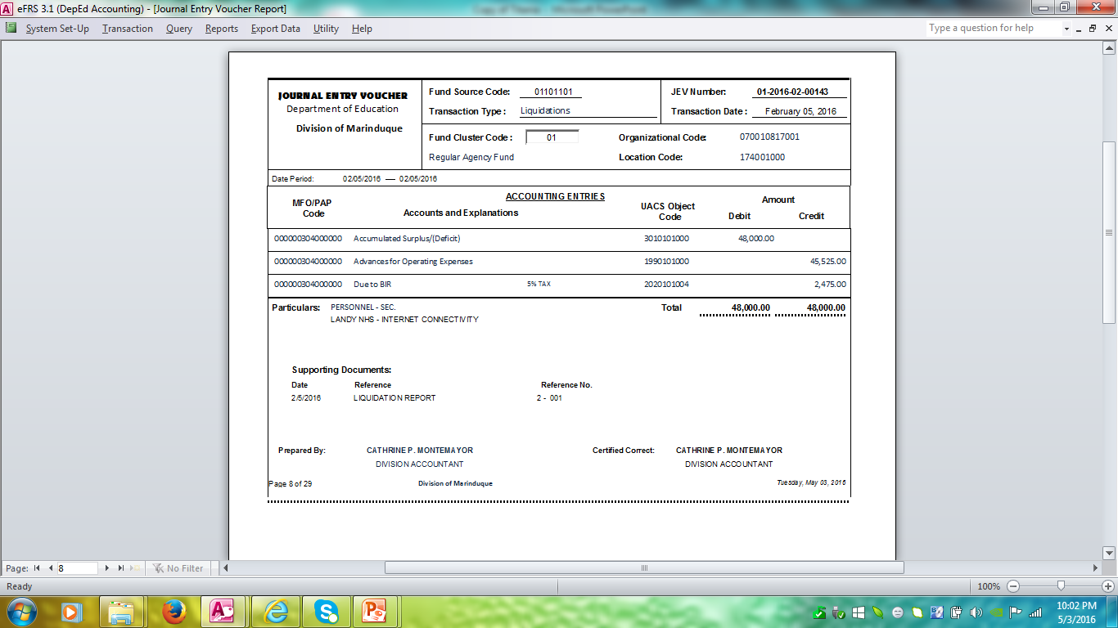
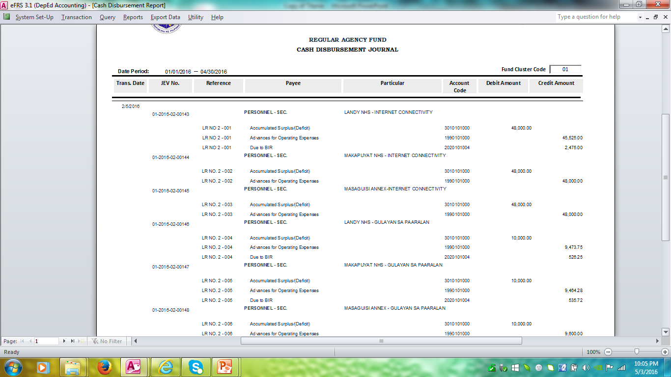
Report Generated

Slide 21
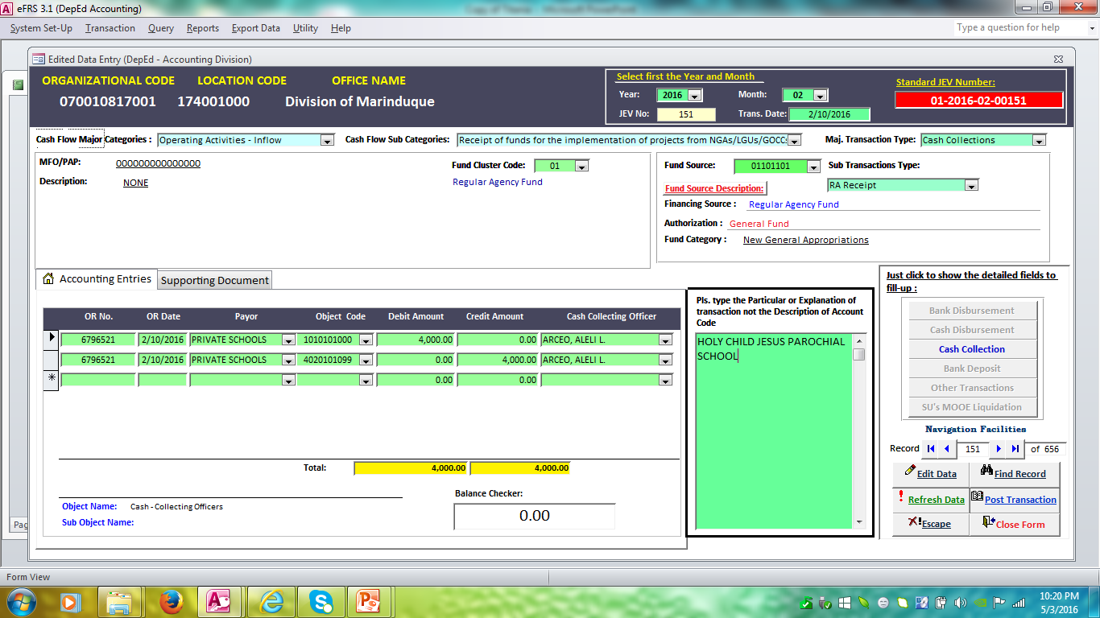
CASH COLLECTIONS

Slide 22
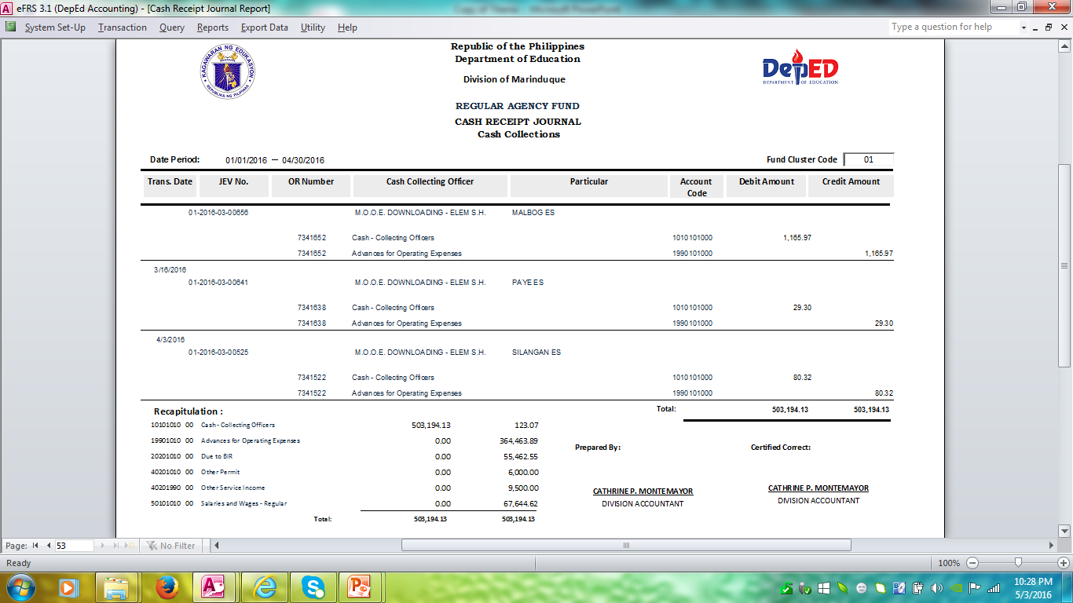
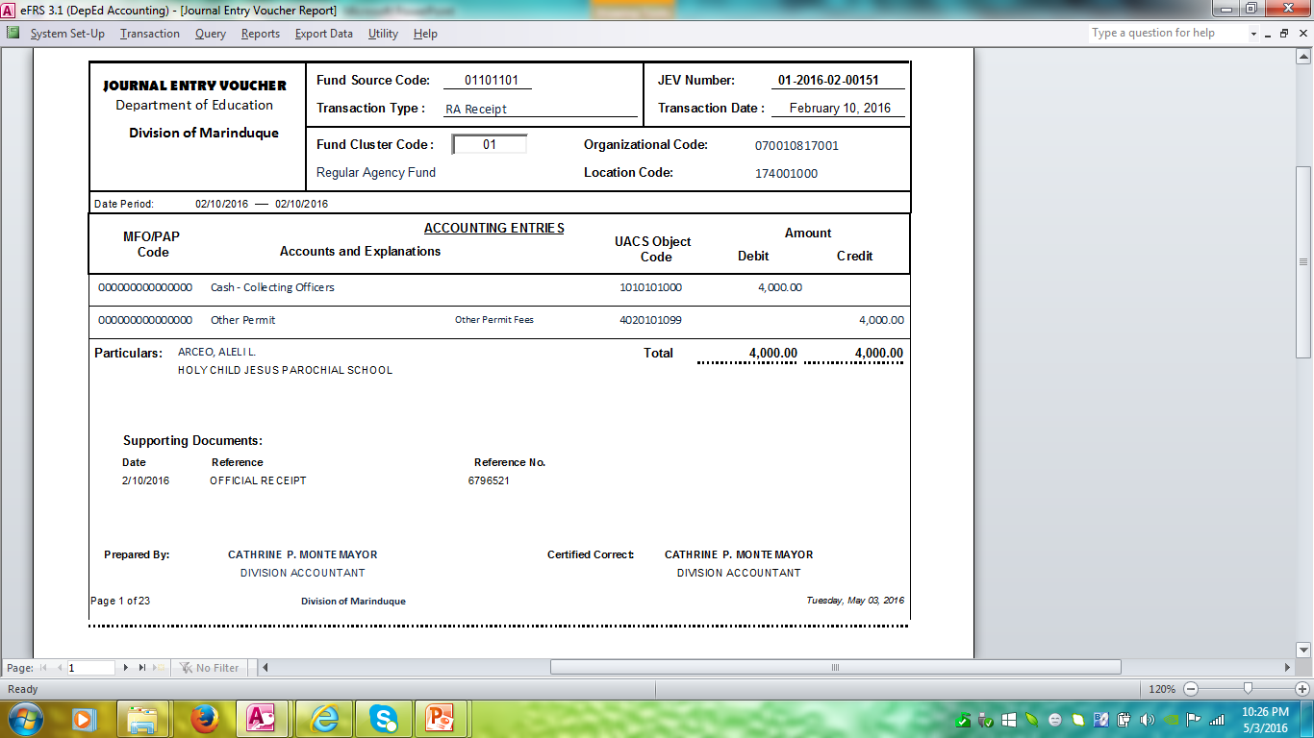
Report Generated

Slide 23
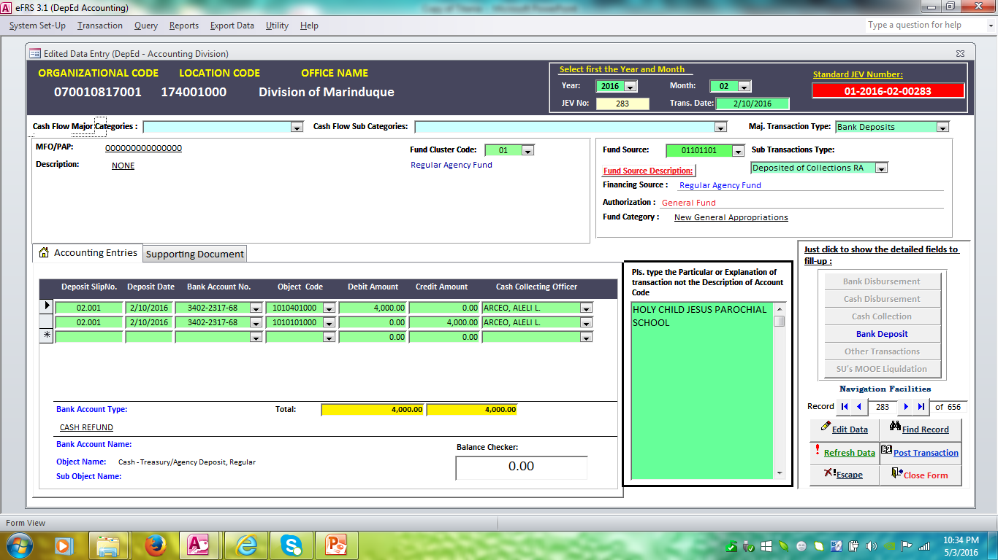
BANK DEPOSITS

Slide 24
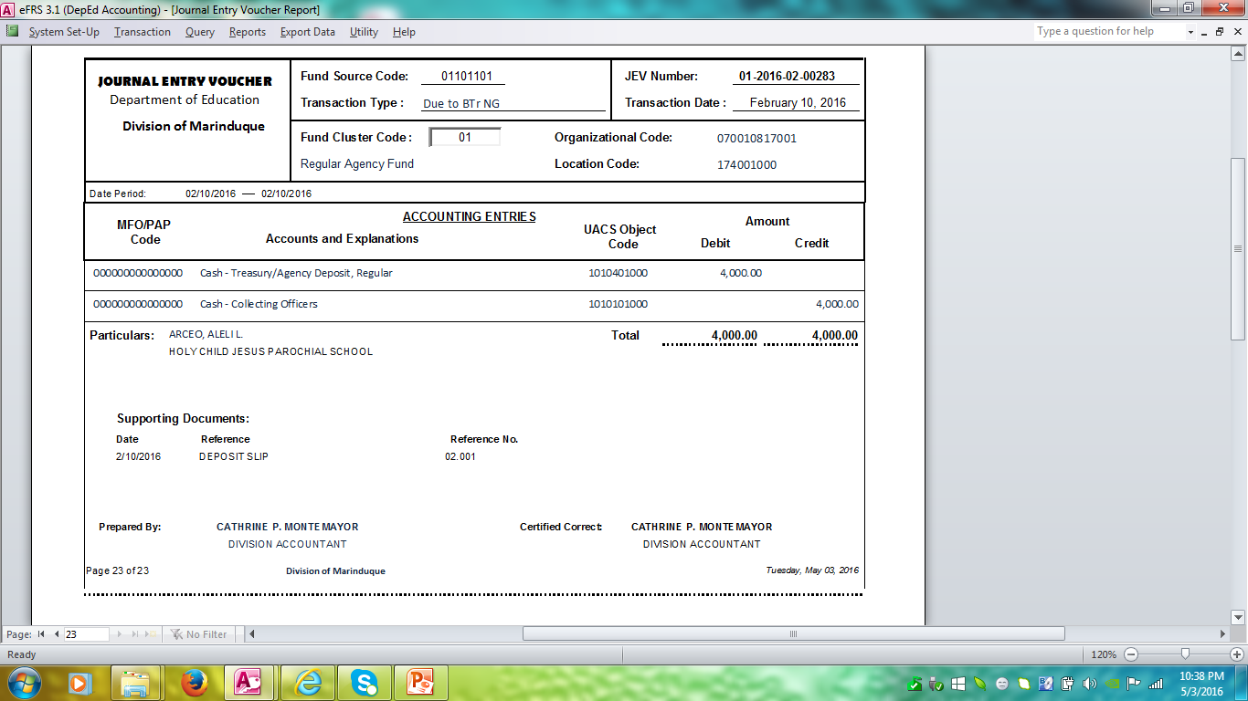
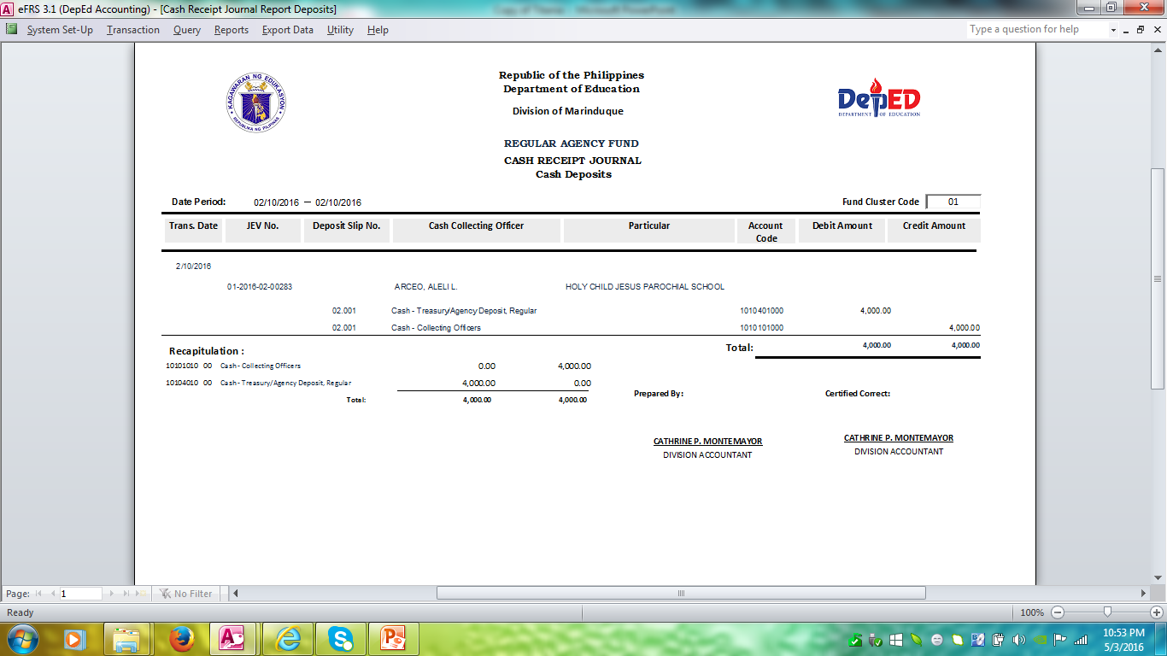
Report Generated

Slide 25
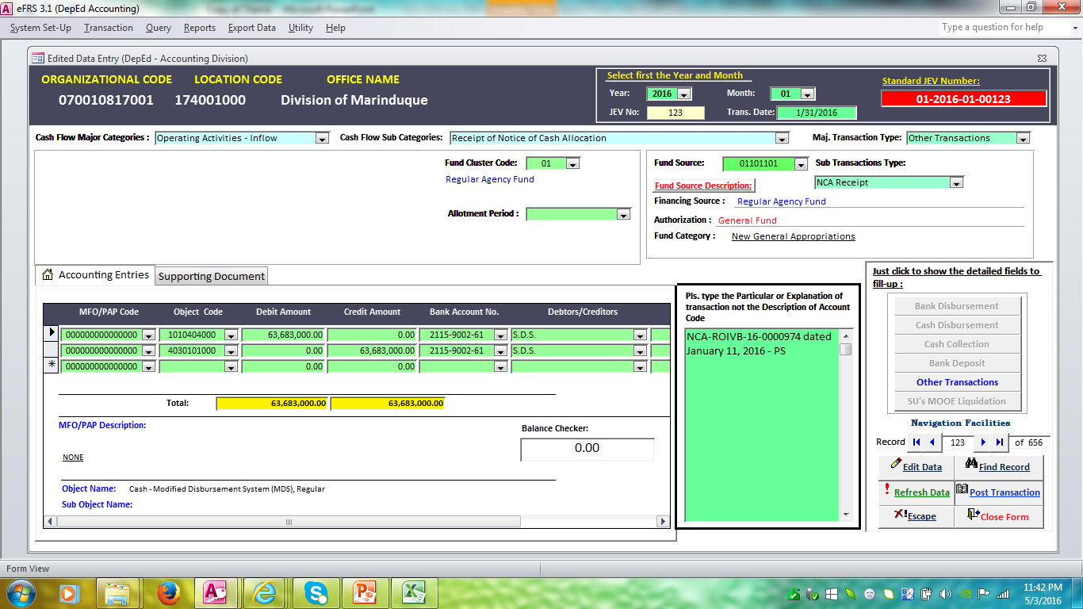
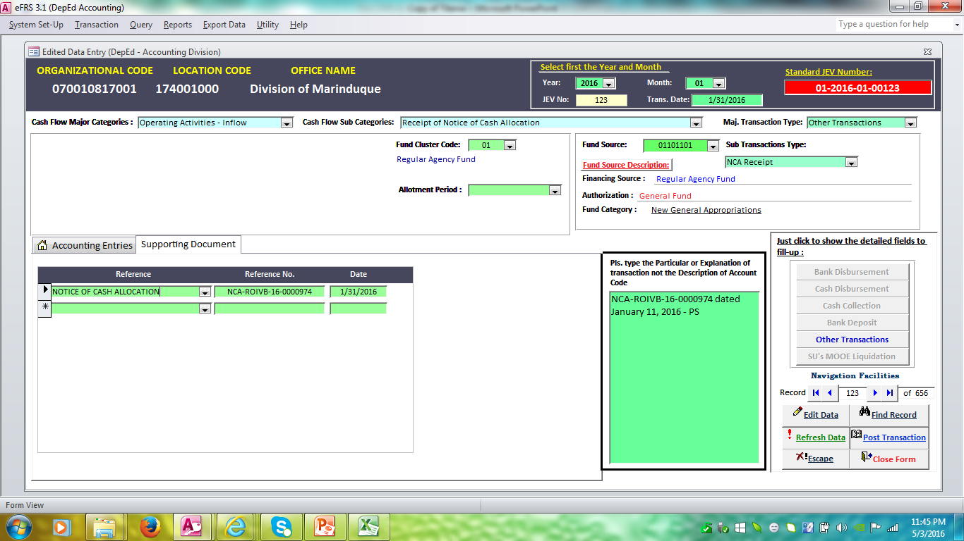
OTHER TRANSACTIONS

Slide 26
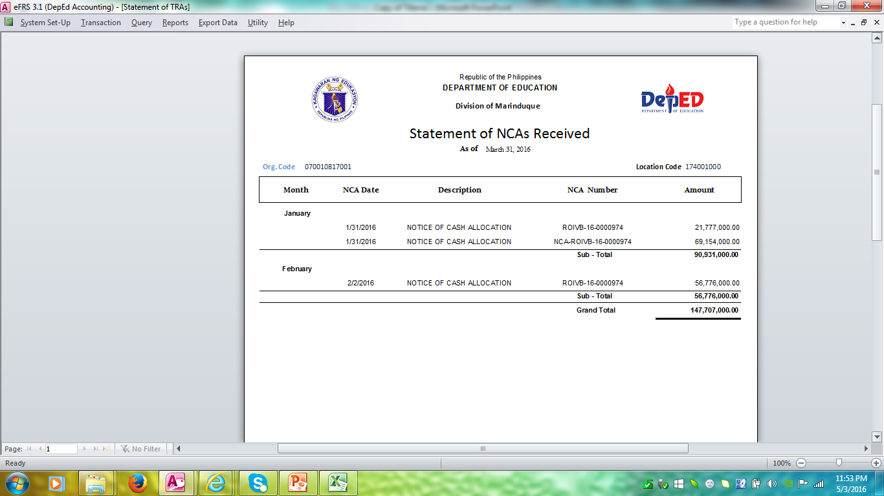
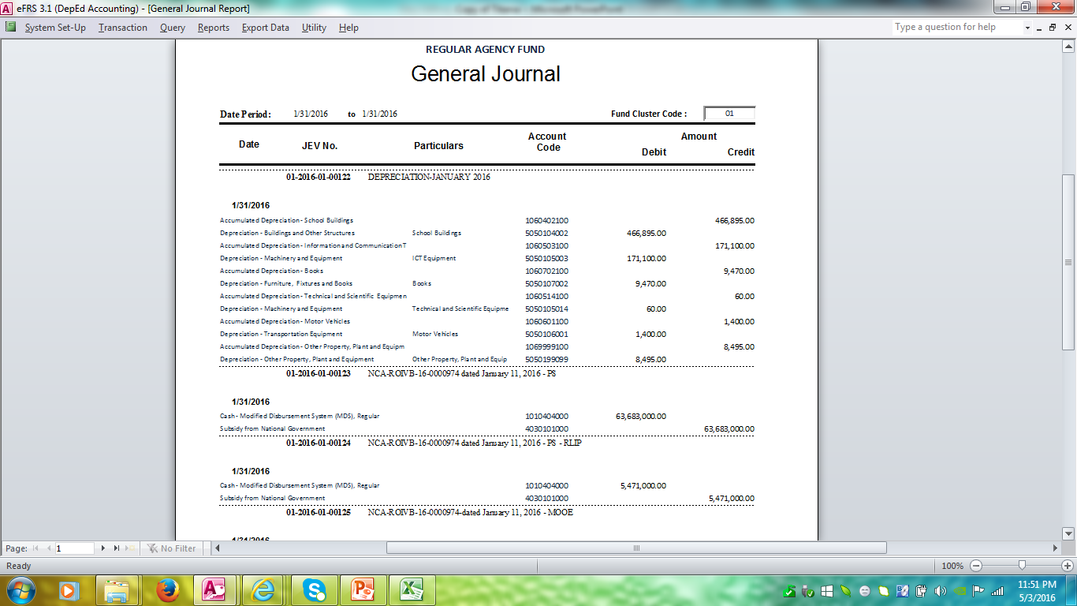
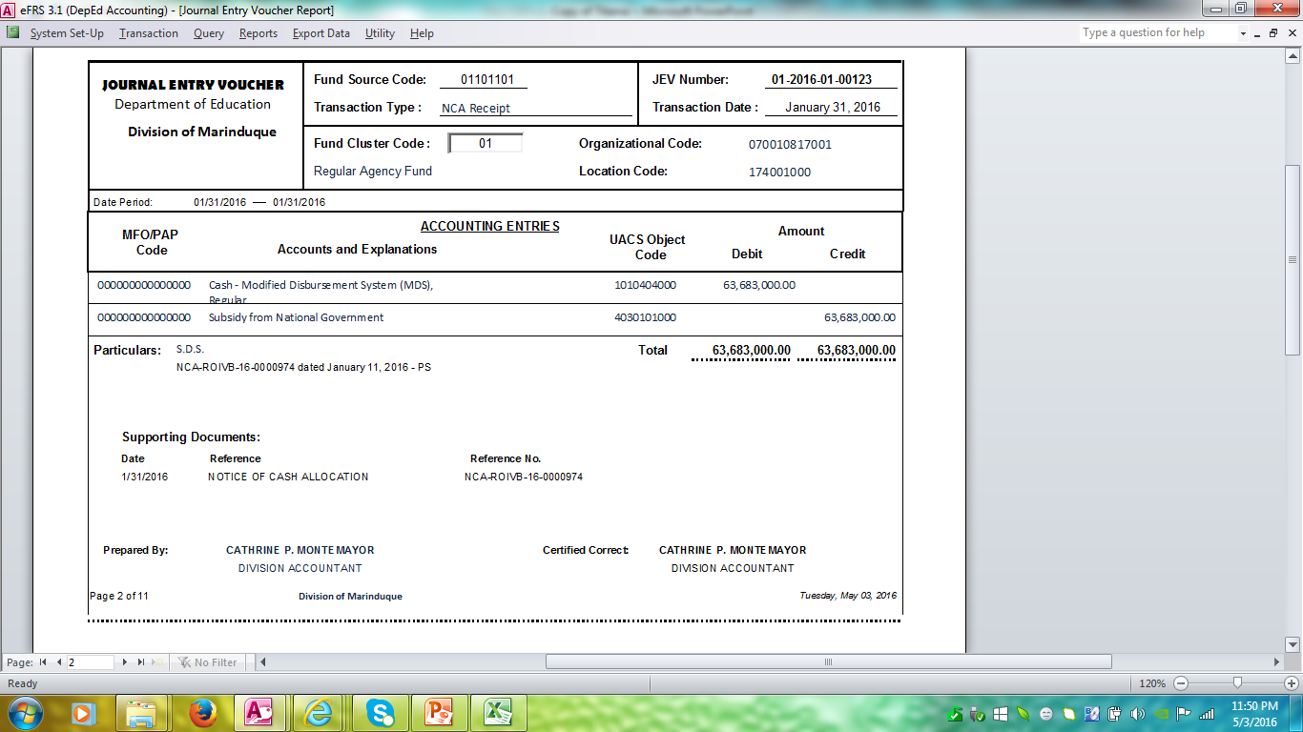
Report Generated

Slide 27
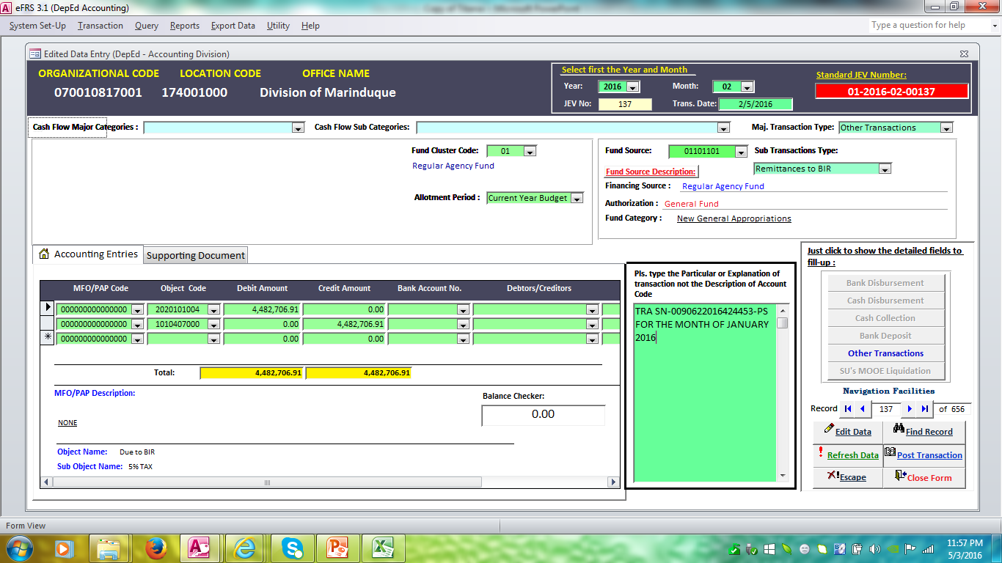
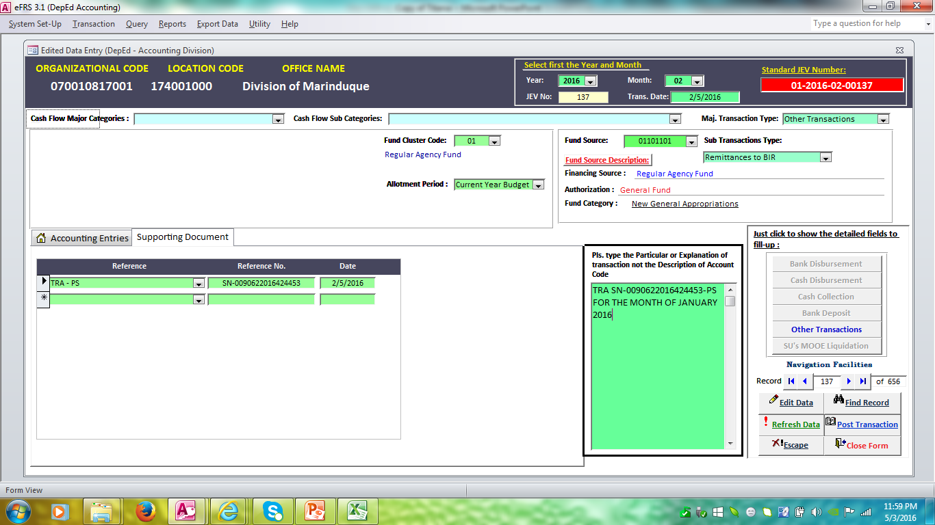
OTHER TRANSACTIONS

Slide 28
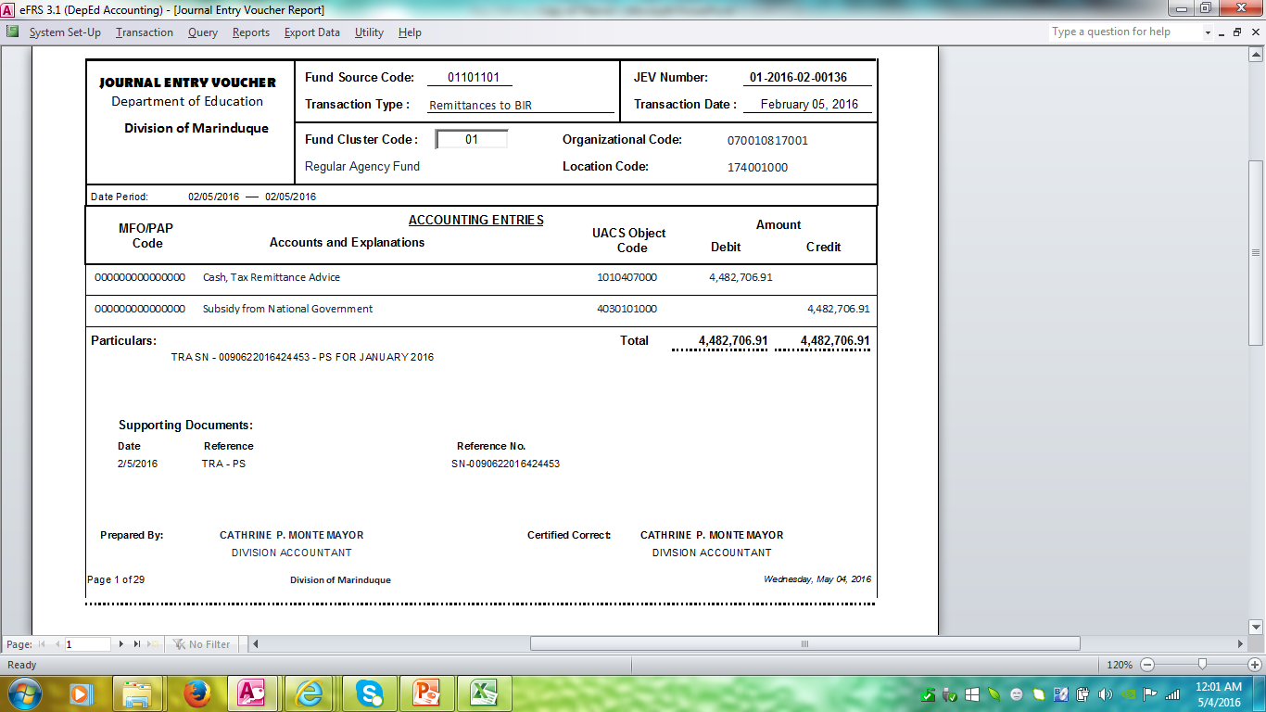
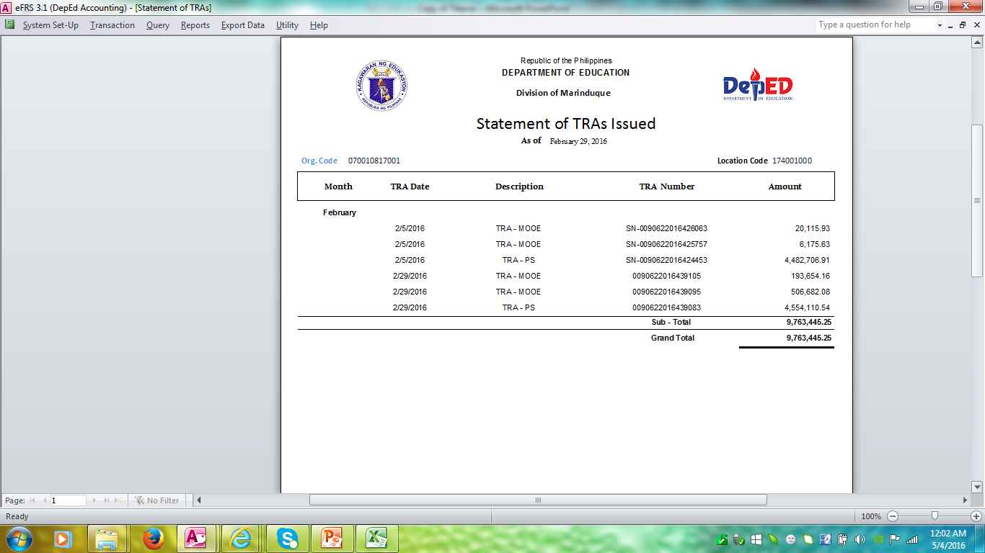
Report Generated

Slide 29
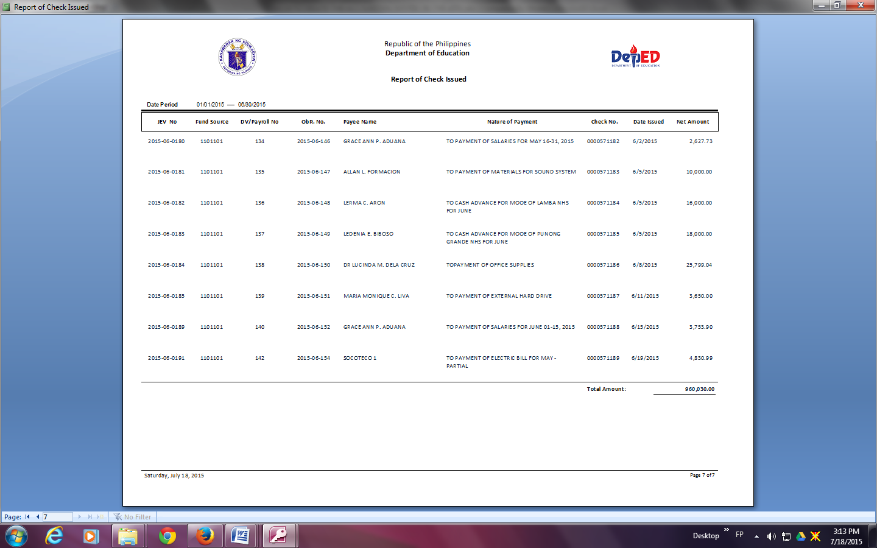
REPORT OF CHECK/ADA ISSUED

Slide 30
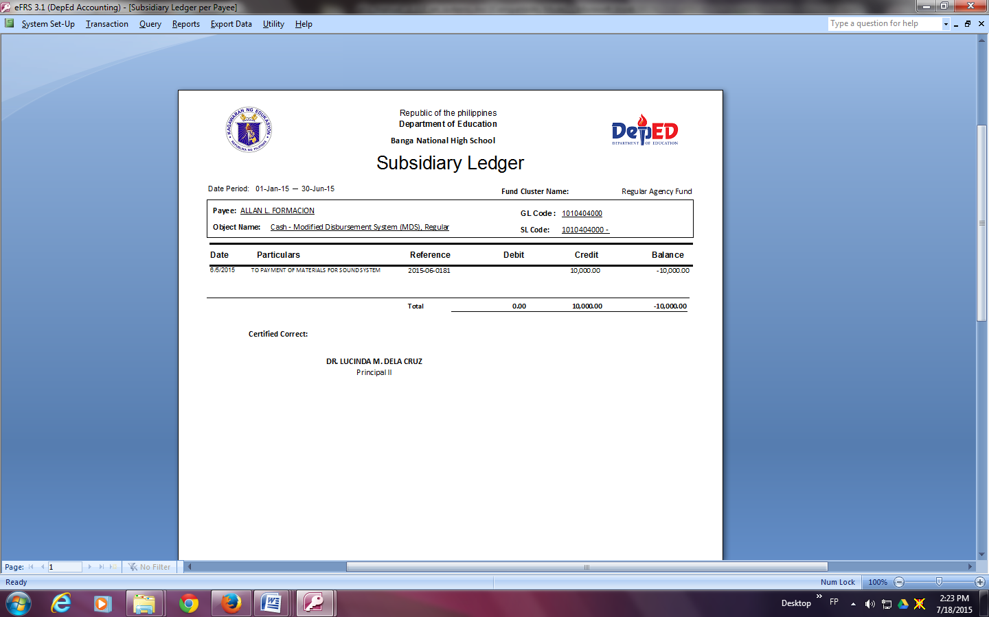
SUBSIDIARY LEDGER

Slide 31
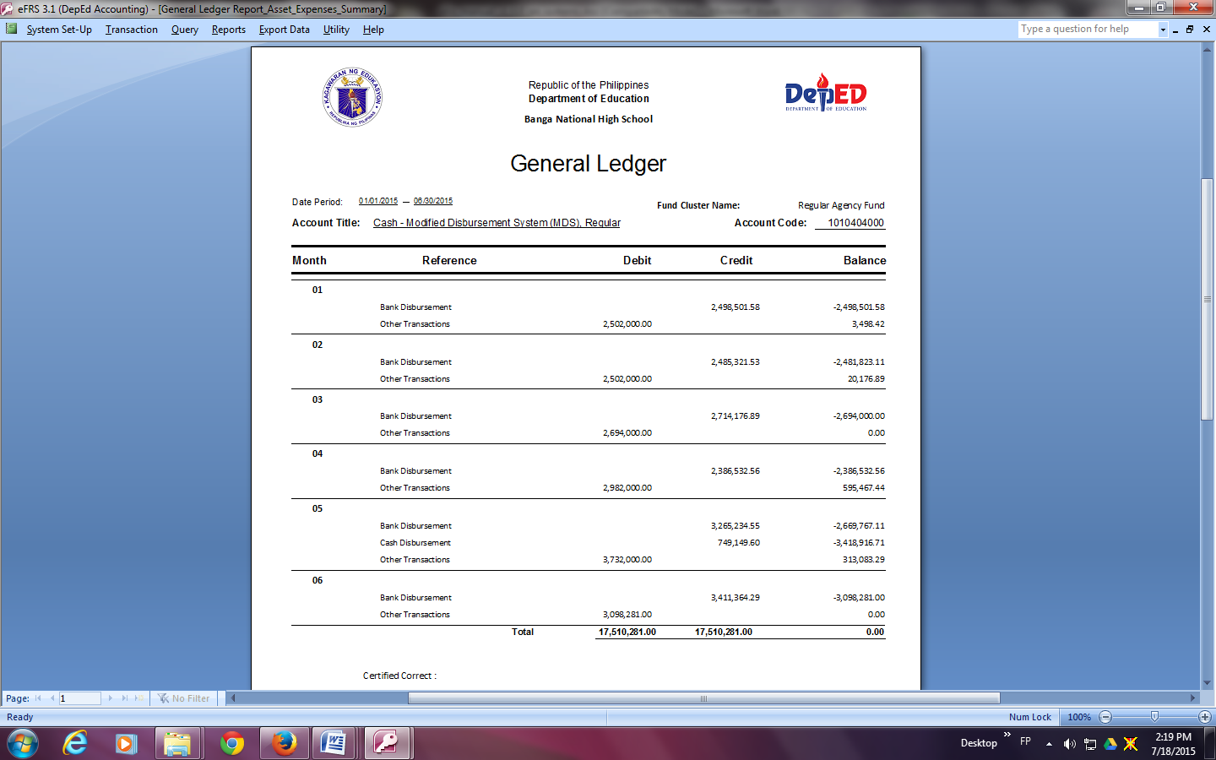
GENERAL LEDGER

Slide 32
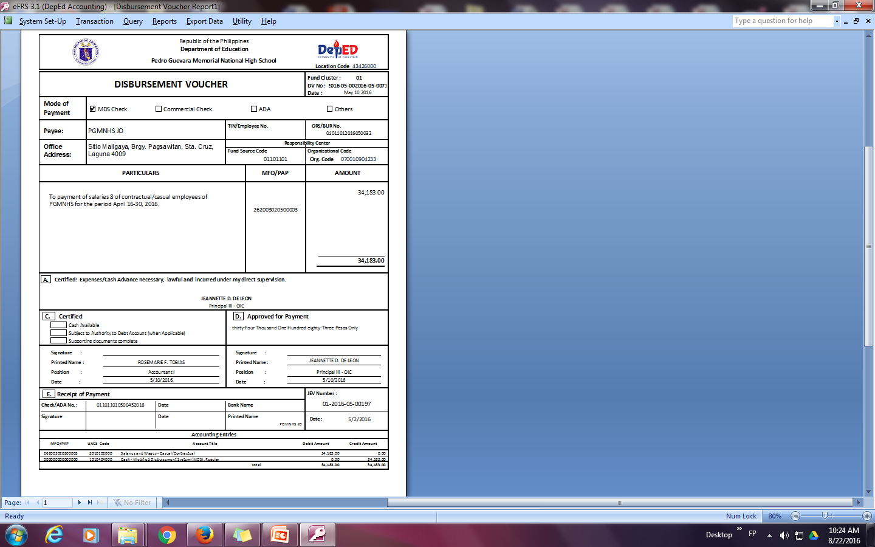
DISBURSEMENT VOUCHER

Slide 33
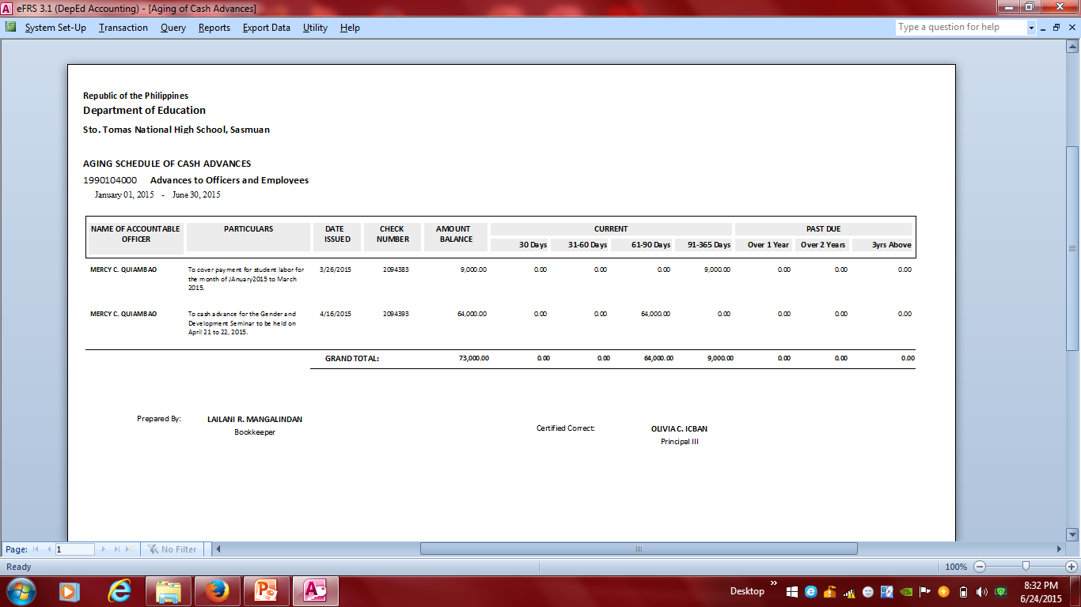
AGEING OF CASH ADVANCES

Slide 34
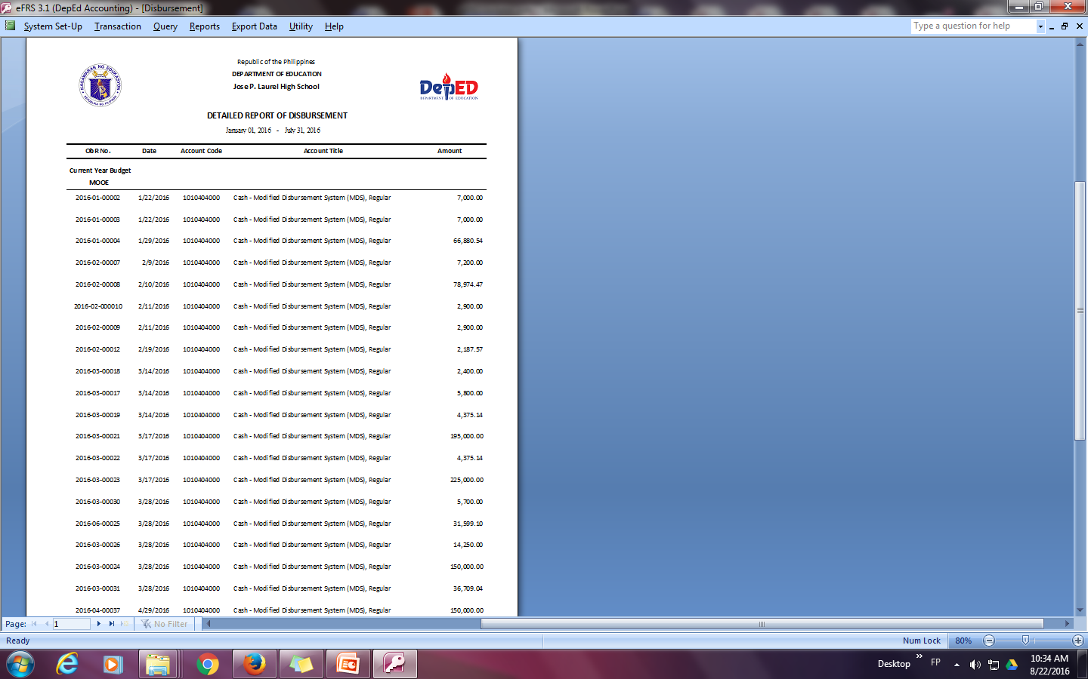

Slide 35
COMPONENT OF THE FINANCIAL STATEMENT (PPSAS)

Slide 36
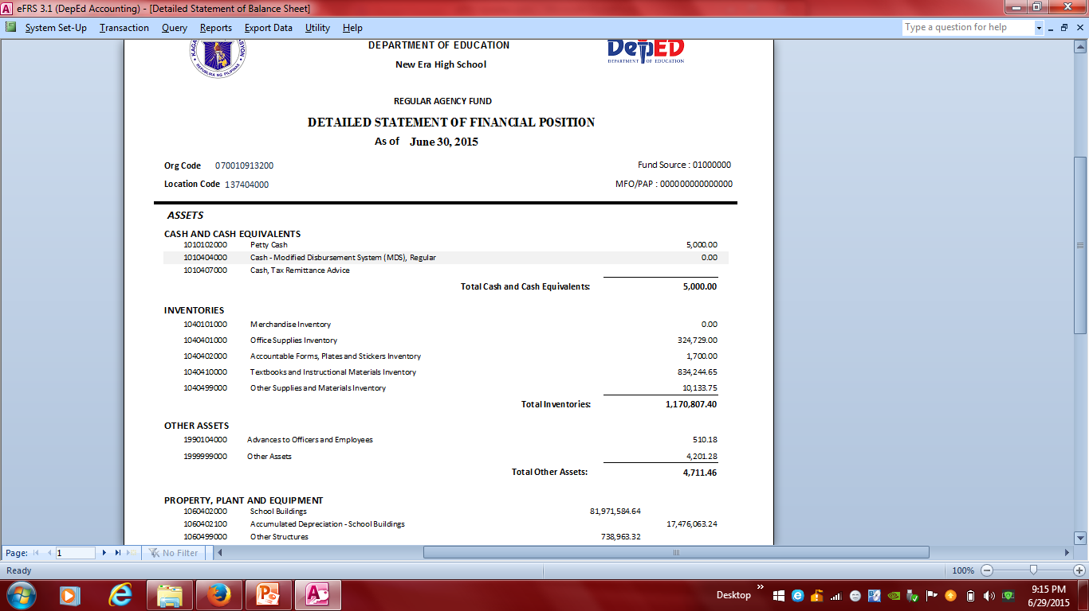
STATEMENT OF FINANCIAL POSITION (ANNEX A)

Slide 37
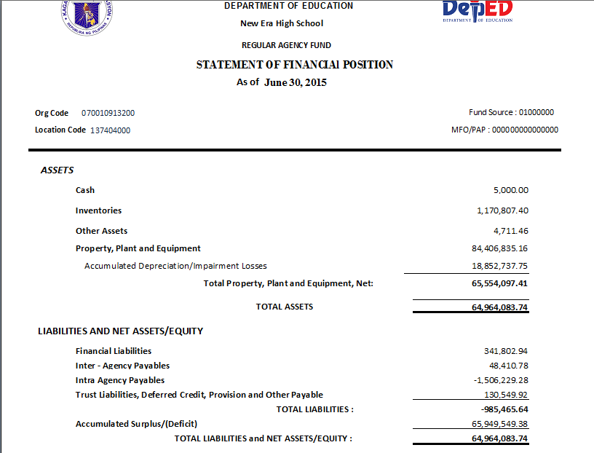
STATEMENT OF FINANCIAL POSITION (ANNEX A1)

Slide 38
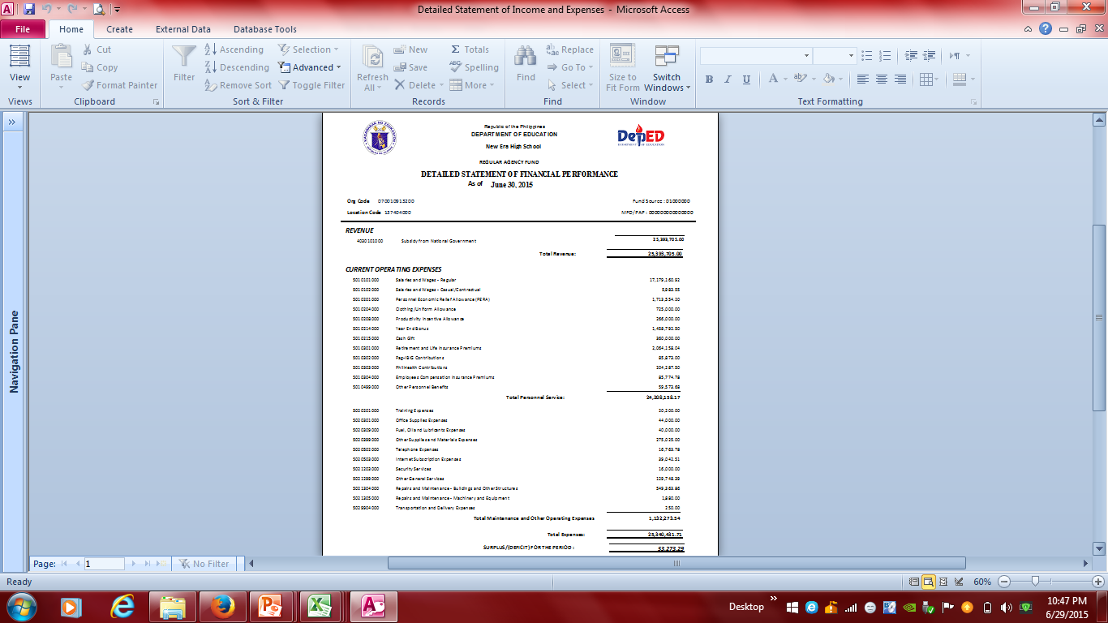
STATEMENT OF FINANCIAL PERFORMAMNCE (ANNEX B)

Slide 39
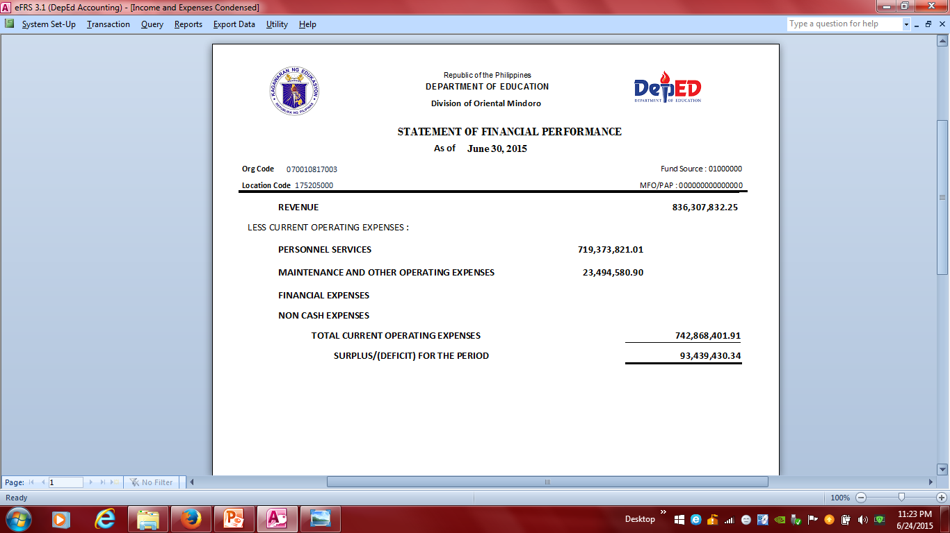
STATEMENT OF FINANCIAL PERFORMAMNCE (ANNEX B1)

Slide 40

STATEMENT OF CHANGES IN NET ASSETS/EQUITY

Slide 41

DETAILED STATEMENT OF CASH FLOW (ANNEX C )

Slide 42

CONDENSED STATEMENT OF CASH FLOW (ANNEX C1)

Slide 43


Slide 44


Slide 45


Slide 46


Slide 47
DOs AND DON’Ts IN THE eFRS
  Don’t leave blank the required fields.
  Do the backing up of files every month.
  Don’t use the “ESC” function in the keyboard if you are in Data Entry.
  Do the proper closing of the eFRS.
  Don’t use the eFRS while in compressed folder.

Slide 48

CONSOLIDATION FLOW CHART
TRIAL BALANCE (ALL IMPLEMENTING UNITS)
CONSOLIDATED TRIAL BALANCE (DIVISION OFFICES)
CONSOLIDATED TRIAL BALANCE (REGIONAL OFFICE)
Take Note:
Review the Trial Balance of IUs and check the balances per account code
Counter check per schedule the balances of important accounts.
Then print the Financial Statement for submission of hard copy.
CENTRAL OFFICE – FS CONSOLIDATOR

Slide 49

Question or
Clarification?

Slide 50

50
Notes:
50
50

